Slide 1
This is a mix of my slides on climate science and renewable energy
It is not meant as a single presentation, but educators are welcome to use slides as appropriate
Notes:
Note that these are slides from various presentations and are not necessarily in a logical order – and some double up. Some may be out of date also.

Slide 2
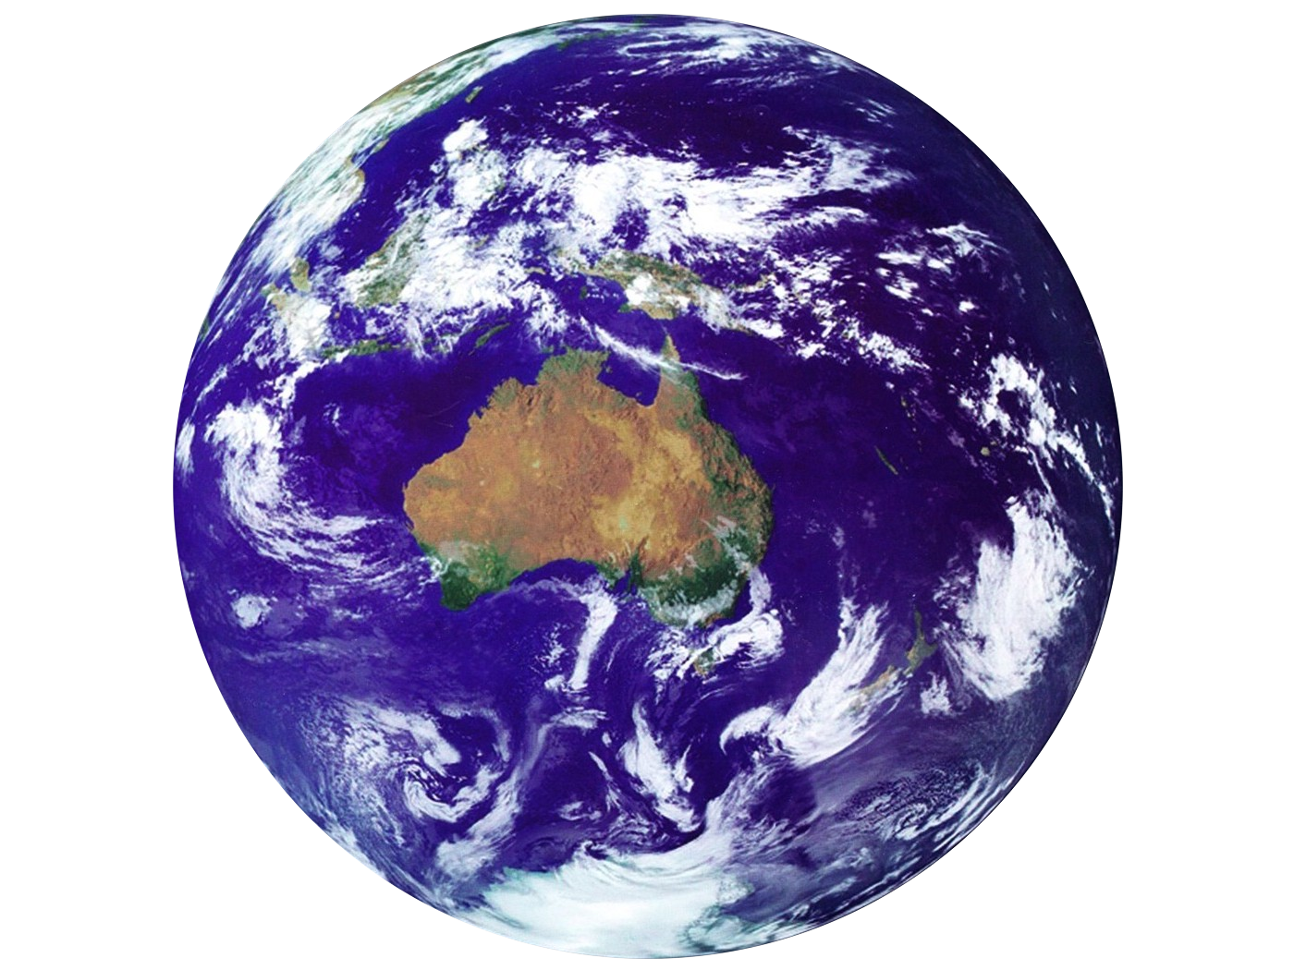
Climate Change
Does it really matter?

Slide 3
Climate Science 4 Sceptics

Slide 5
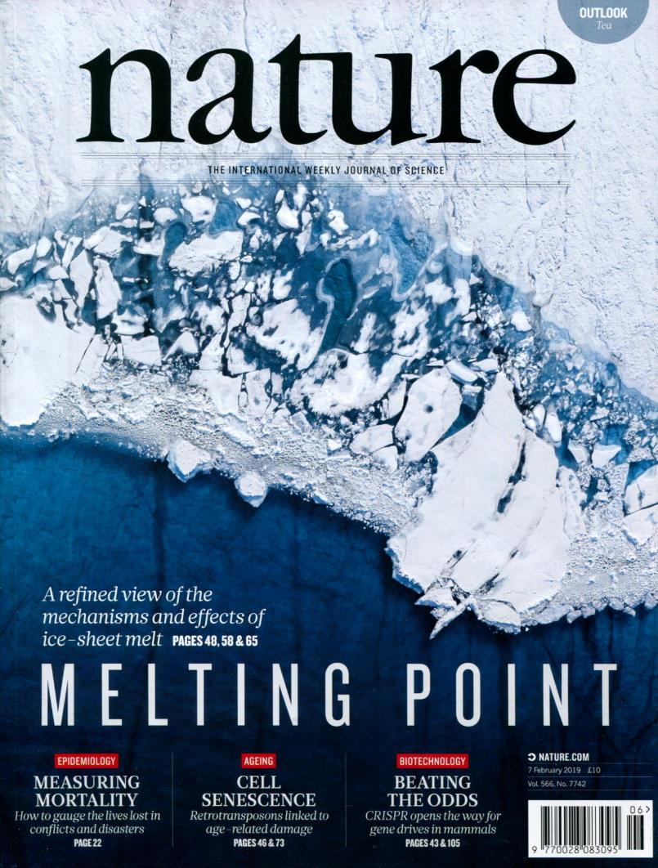
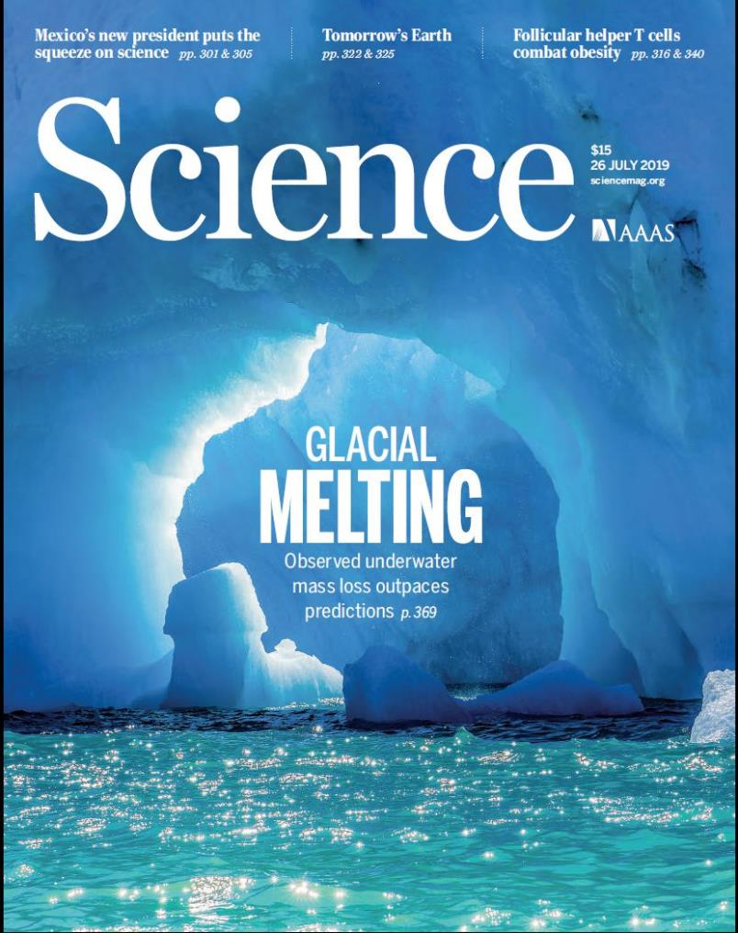
Where is the science?
Notes:
This is not meant to be a science lesson, but I want to explain what the science is telling us and why scientists are so concerned that the public understand the seriousness of the issue.
The science I will show you is based on the thousands of articles about climate change from the key science journals in the world, eg, Science (USA) and Nature (UK) – Not just one or two ‘cherry picked’ articles which are then exaggerated and distorted.
I am concerned that although many of my “activist” friends keep telling me that “the science is out there”, it is not really – if it was everyone would be pushing hard for emission reductions! Clearly the public – and the politicians - do not understand the seriousness of the situation!
[The figure of 97% (+) scientists accept the ‘consensus’ is probably an underestimate! The claim that it is less is based on the fact that a lot of the articles don’t claim AGW is human – that’s just because it is not contested, any more than papers about evolution don’t claim “Darwin was right”.]

Slide 6
Does Earth’s climate change?
If so, how much and why?
Could we be affecting it?
What could happen, does it matter?
What can we do about it?
Questions, comments?
Notes:
Chance for questions after each main section – unless you have some urgent and relevant question

Slide 7
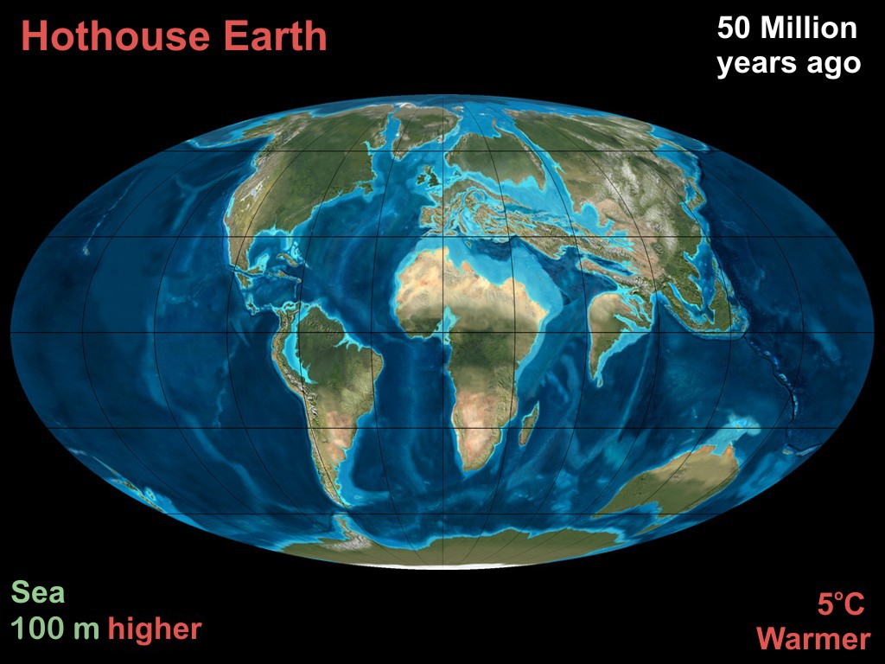
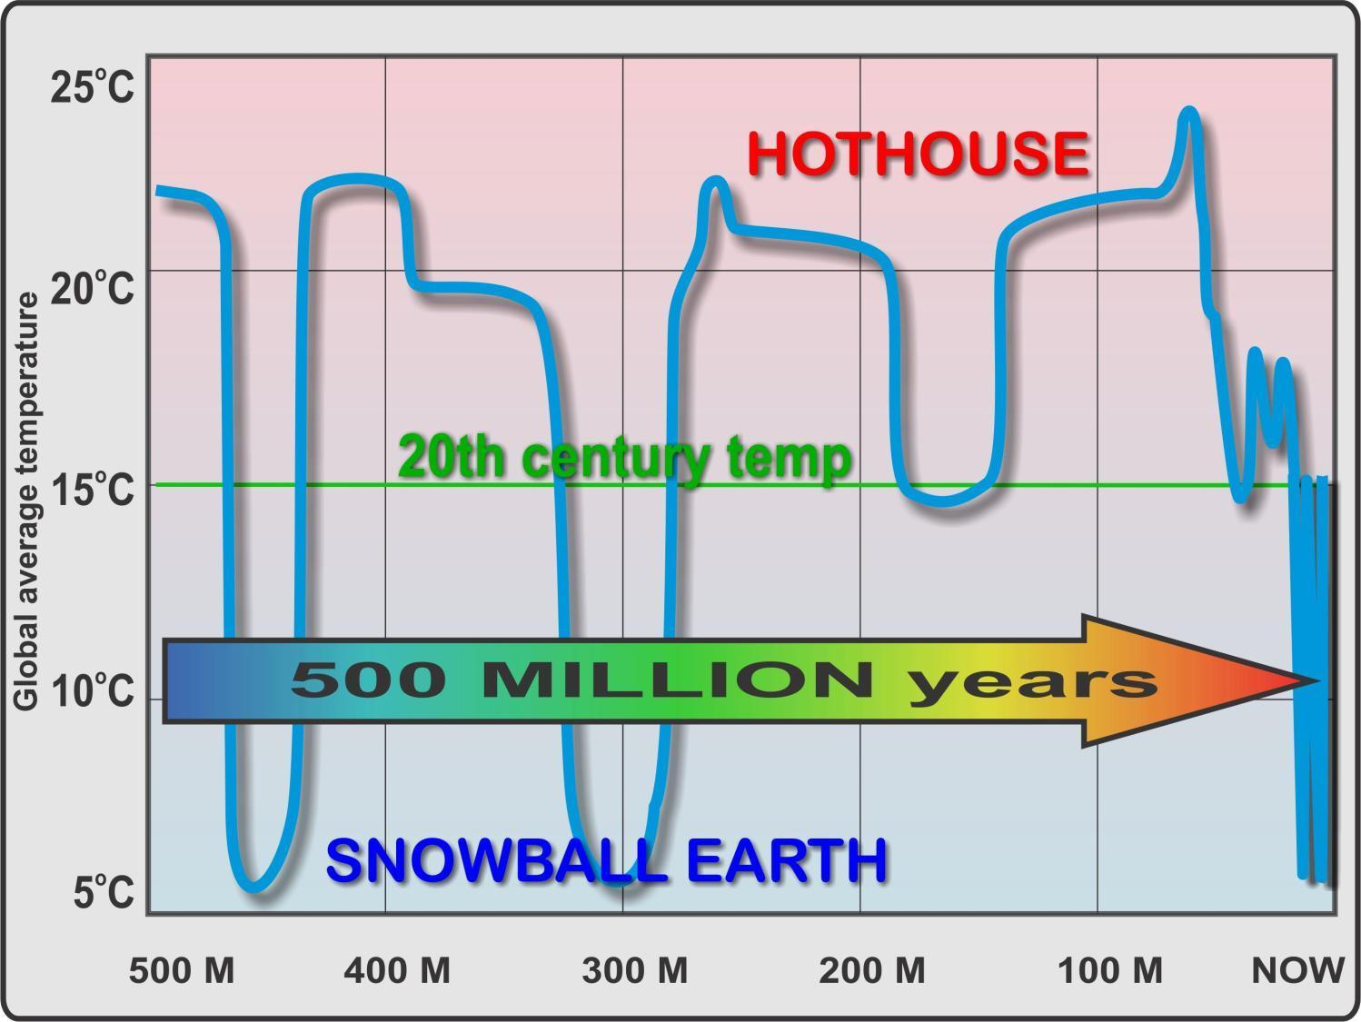
Notes:
It is hard for us to picture just how much Earth’s climate can change. We think in terms of winter v’s summer, polar regions v’s tropics or simply, yesterday was cool today is warm: and think “what could a few degrees difference make?” What is hard for us to conceptualise is how much difference that CAN make! Actually, it wipes out ecosystems. It melts or freezes vast ice plains and glaciers. It greatly increases the number of ‘unliveable days’ in hot parts of the world. It upturns weather patterns.
The big picture – It changes a LOT over long time periods. Hothouse and Snowball were VERY different to now! Last full hothouse was 50 million years ago, “minor hothouse” 3 million years ago, but last full ice age only 20,000 years ago. See next two slides

Slide 8
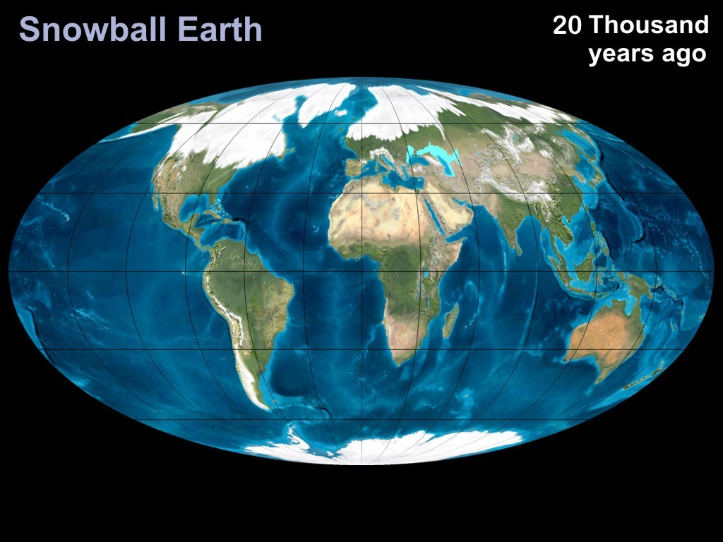
Last Ice Age
About 5ºC cooler Sea levels 100M LOWER
Notes:
JUST 20,000 years ago. Most of northern hemisphere countries under ice. You could walk to Tasmania or PNG - people did.

Slide 9
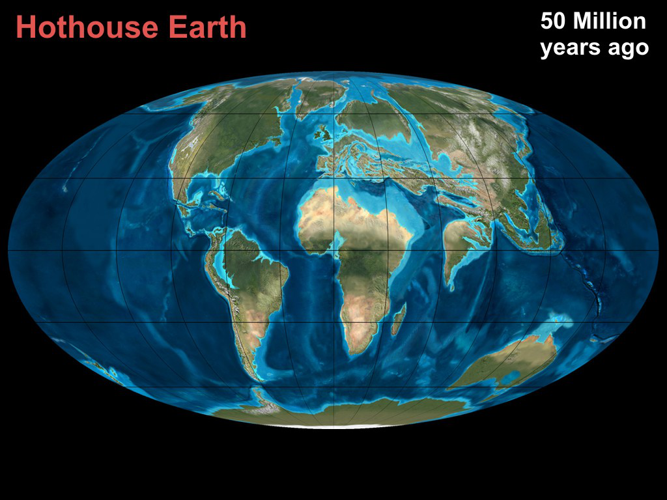
Eocene
About 5ºC warmer Sea levels 100M HIGHER
Notes:
For most of its life Earth has been hotter than now. Eocene was a full hothouse, but it has been warmer than now quite a lot. Most of Melbourne would be well under water. Shoreline around the foothills of the Dandenongs. Large inland Australian sea. Large areas of Europe, Middle east, Asia underwater.
Would take centuries or millennia to reach that stage, but do we want to condemn future generations to ever changing sea levels and climate? And we would have BIG problems with SLR of one metre – much less 100 metres.

Slide 10
Why does it change so much
Notes:
Well we have a pretty good understanding of why it changes so much – it’s all to do with some pretty basic physics.

Slide 11
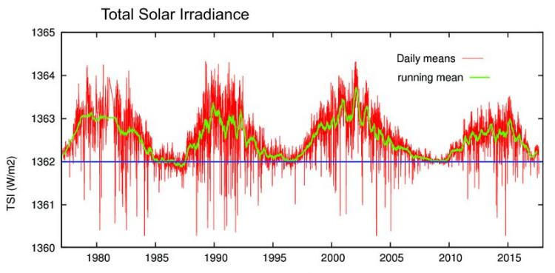
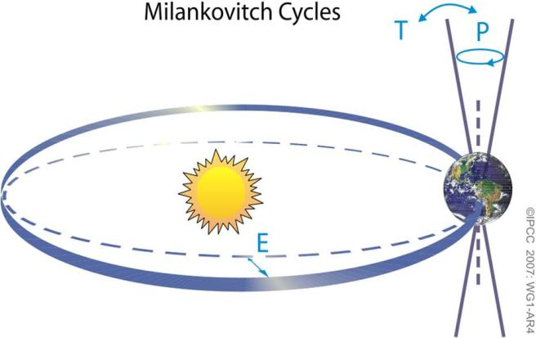
So the big question is ... WHY the changes?
The Sun:
Solar Irradiance
(Decreasing now!)
Wobbles in Earth’s orbit
(Also decreasing now!)
Notes:
But both of these are quite small – and would be cooling Earth!
Two main reasons: 1 Heat received depends on Sun and Earth’s position and angle
Greenhouse effect is not the only factor that influences the Earth’s temperature. Why does the heat balance change? The energy received from the Sun varies slightly over time, Note that it was low ~ 1700 which caused the Little Ice Age (LIA)
Also, since late 20th cent it has been dropping – but temperatures are going up!

Slide 12
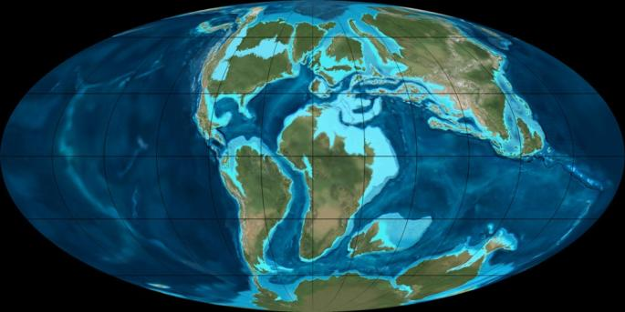
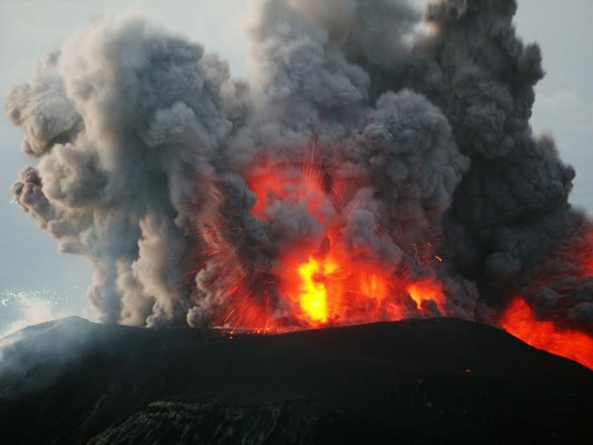
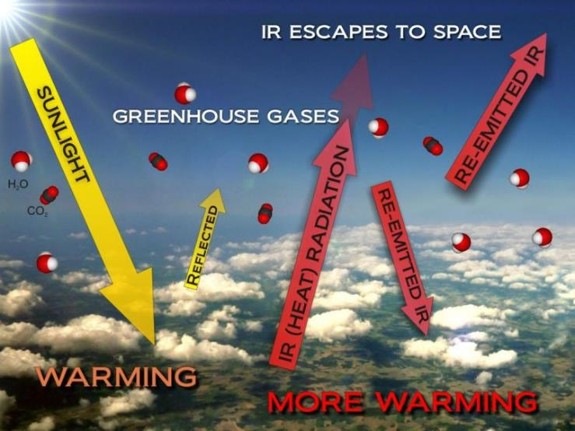
So the big question is ... WHY the changes?
The Earth:
Continental drift
Different life forms changed the atmosphere
Massive volcanoes
Changes to the (+33ºC) greenhouse gases (CO₂ H₂O CH₄)
Notes:
Two main reasons: 2 Heat absorbed depends on the atmosphere and surface
We know very well that CO2 and H2O molecules absorb IR light and send (some of) it back to warm the Earth. Greenhouse effect is not the only factor that influences the Earth’s temperature. Why does the heat balance change? The energy received from the Sun varies slightly over time, Note that it was low ~ 1700 which partly caused the Little Ice Age (LIA)
Also, since late 20th cent it has been dropping – but temperatures are going up!

Slide 13
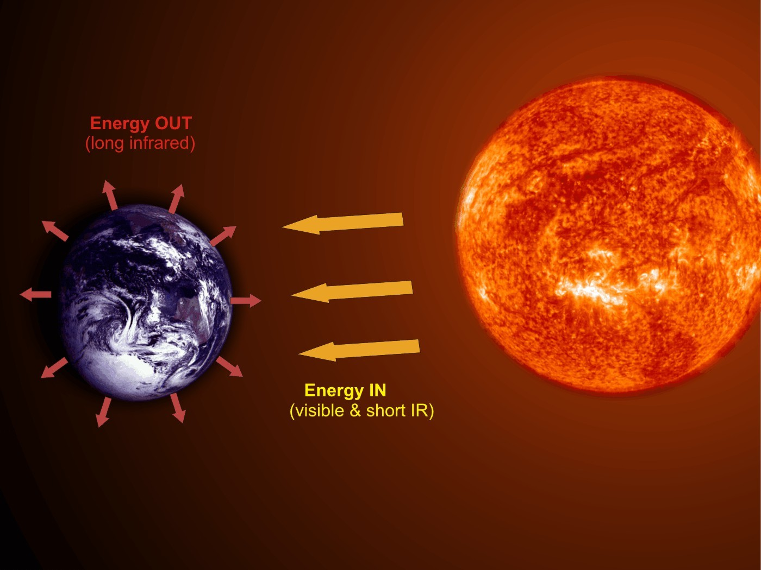
Climate Science 101
When Energy IN equals Energy OUT the temperature is stable
If less energy escapes than comes in we get warmer
Notes:
Earth’s temperature is controlled by the amount of energy we receive from the Sun and that absorbed and re-emitted by the Earth, but that changes for various reasons.
Its pretty simple really – if more heat is coming in than going out the Earth’s temperature must increase. As it gets hotter, the amount of IR radiation radiated will increase. Once the incoming and outgoing are equal the temperature will remain relatively stable.

Slide 14
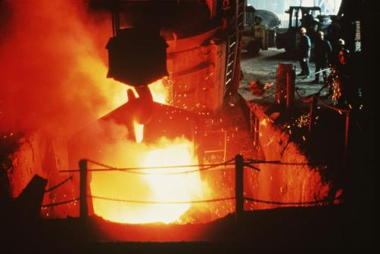
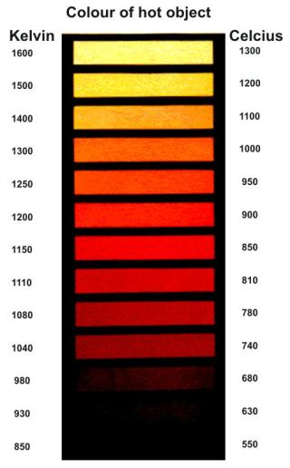
A little ^{(19th century)} physics
Don’t panic!
Earth’s energy balance
Two simple laws of physics enable us to figure out the energy balance:
The Stefan-Boltzmann law...
I = εσT⁴
Wien’s law... λ_{max} = 0.0029/T
S-B just tells us how much heat a hot object radiates.
Wien tells us what sort of radiation it will be.
(fortunately others have done the hard work for us!)
Notes:
NOTE: It is NOT intended that these laws should be understood – just that they exist and that scientists can use them to figure out how the climate works. Could just mention the points below the formulae to show that it is not that complicated. For your info: S-B: I is the power (watts) radiated from a 1 m² area of surface at a temperature of T (K). The σ is the Stefan-Boltzmann constant which has a value of 5.67 x 10⁻⁸ W/m².K. So σ is partly just a conversion of units, but it tells us how much energy is radiated away from a hot “ideal blackbody”. ε is the emissivity of the radiating body and is 1 for an ideal black body.
Wien: λ in m and T in K This tells us that as something gets hotter it gets ... not redder ... but bluer! Well initially it gets red (from invisible, or rather IR) but then gets ‘white hot’ and then blue hot. (Demo car headlight with increasing volts).

Slide 15
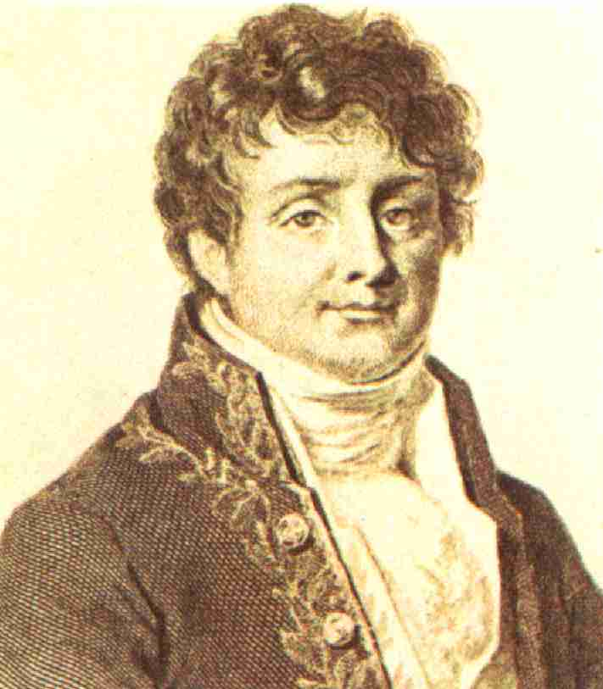
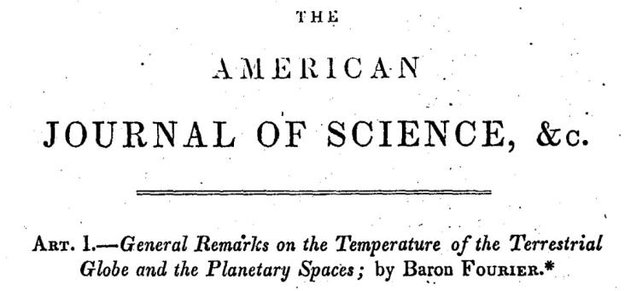
Climate Science 101
“The Earth should be a lot colder than it is”
Joseph Fourier ~1820
Notes:
Could use the term “Earth’s energy balance” here if appropriate to explain that energy in from the Sun can be calculated and energy out must balance this – but energy out is dependent on the average temperature. From AIP: Beginning with work by Joseph Fourier in the 1820s, scientists had understood that gases in the atmosphere might trap the heat received from the Sun. As Fourier put it, energy in the form of visible light from the Sun easily penetrates the atmosphere to reach the surface and heat it up, but heat cannot so easily escape back into space. For the air absorbs invisible heat rays (“infrared radiation”) rising from the surface. The warmed air radiates some of the energy back down to the surface, helping it stay warm. This was the effect that would later be called, by an inaccurate analogy, the "greenhouse effect." [The Discovery of Global Warming - Spencer Weart, AIP]

Slide 16
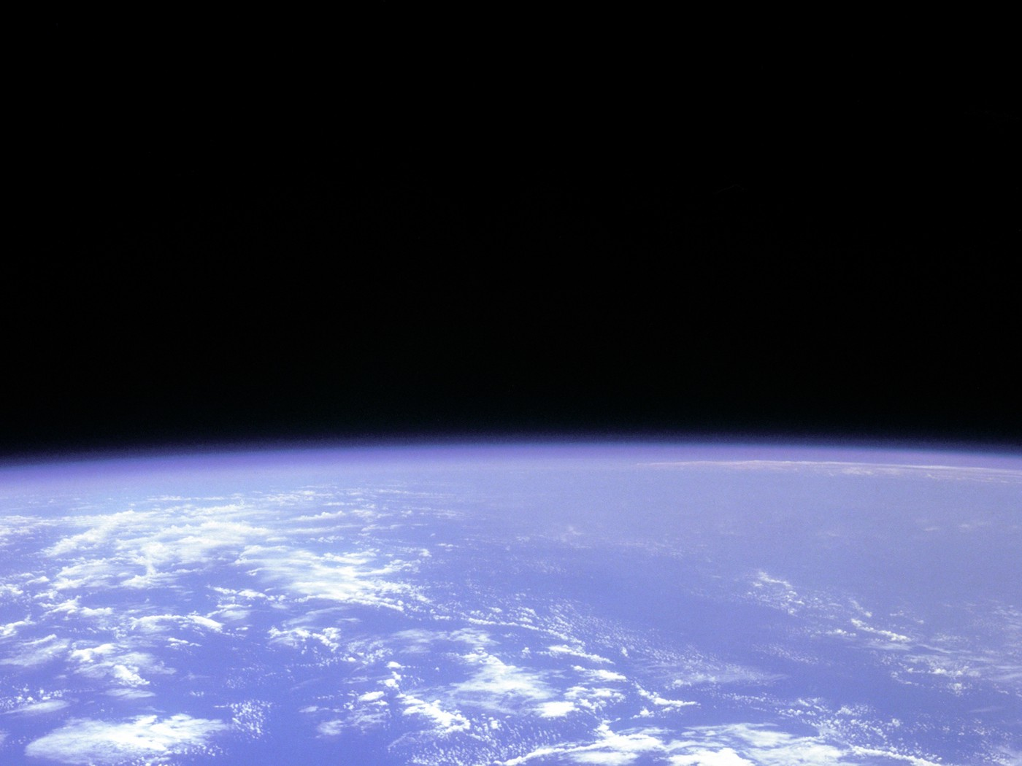
Climate Science 101
Fourier realised that (despite its apparent transparency) the atmosphere must be trapping heat
Notes:
This was a little surprising because air appears to be totally transparent to the light from the Sun – which is why we see it so clearly. It is also a very thin layer and doesn’t LOOK as though it would insulate the Earth. Explained later: However, the outgoing ‘heat radiation’ is not visible light like that from the Sun but infrared radiation. (The light from the Sun includes short wavelength IR, but the outgoing IR is longer wavelength radiation which turns out to be absorbed by H2O and CO2)

Slide 17
Climate Science 101
Eunice Newton Foote:
First person to discover that water vapor and CO₂ absorb heat from sunlight (1856)
Notes:
It is thought that Eunice was the first person to discover this, but it was Tyndall (next slide) who got most of the credit.

Slide 18
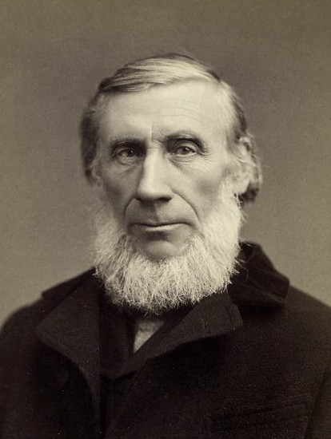
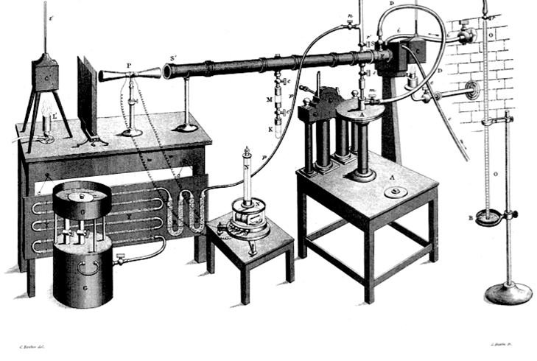
Climate Science 101
Tyndall’s experiment in which he found it was the water vapour and carbon dioxide gases in the air that were trapping heat
John Tyndall ~ 1860
H₂O and CO₂ are not transparent to IR light
Notes:
Even though they compose only less than 1% (H2O) and 0.04% (CO2).
Tyndall set out to find whether there was in fact any gas in the atmosphere that could trap heat rays. In 1859, his careful laboratory work identified water vapor (H2O) and carbon dioxide (CO2), despite their tiny amounts. But just as a tiny amount of ink will block more light than an entire glass of clear water, or a small amount of smoke will block the Sun, so the trace of CO2 altered the balance of heat radiation through the entire atmosphere. [The Discovery of Global Warming - Spencer Weart, AIP]

Slide 19
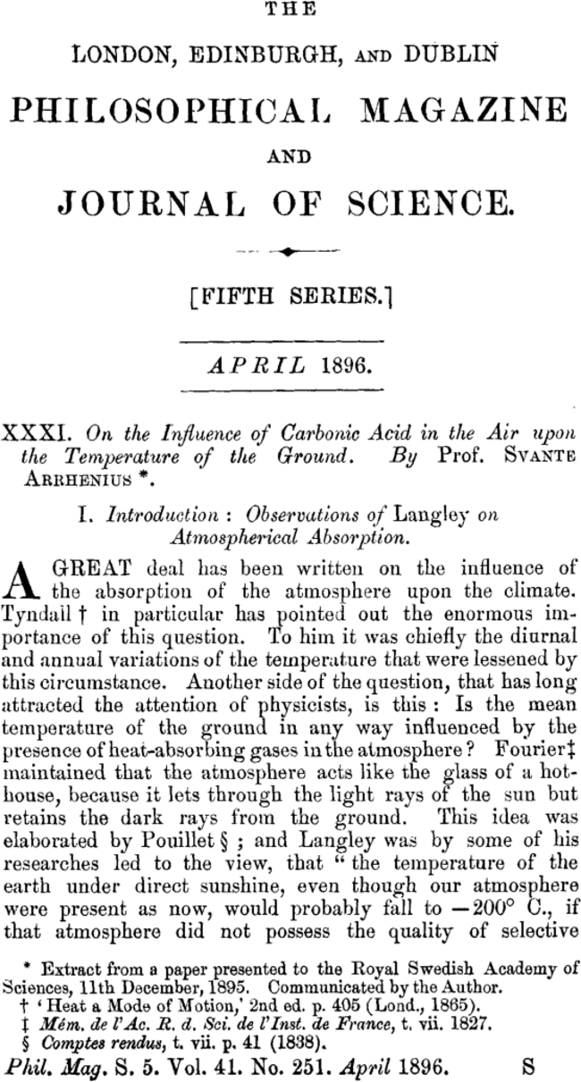
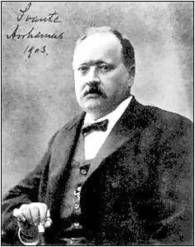
Climate Science 101
Svante Arrhenius worked it out in 1896 It’s a matter of the Earth’s energy balance
Notes:
Refer to ‘Earth’s energy balance’ again. And his analysis was pretty much correct.

Slide 20
Climate Science 101
Svante Arrhenius worked it out in 1896
“CO₂ and H₂O absorb heat and send enough back to Earth to raise the temperature by
+33 degrees!”
Notes:
We now call this the greenhouse effect, it has made the Earth a comfortable +15ºC instead of a frozen -18ºC

Slide 21
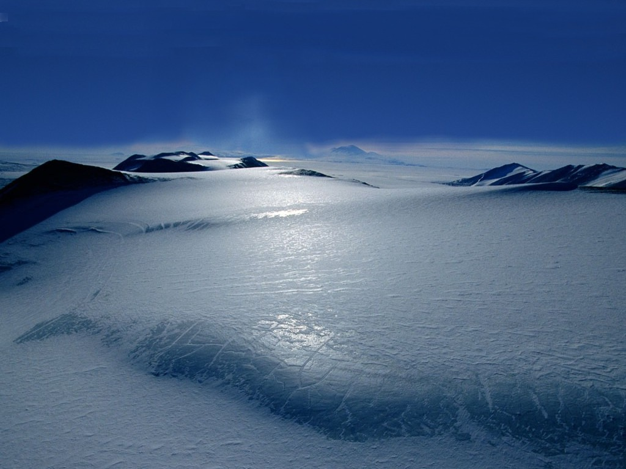
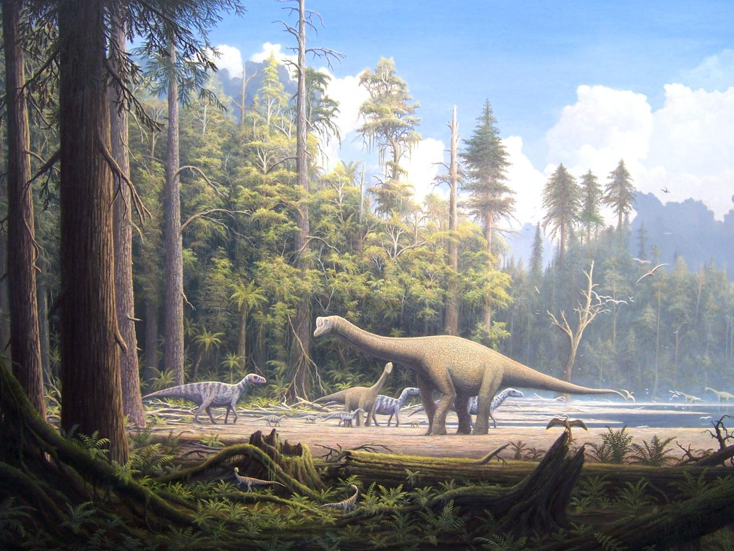
If there was no greenhouse effect Earth would be a frozen snowball at about – 18ºC
So Greenhouse effect
= +33ºC warmer
Crucial for life on Earth
Notes:
Average temp of Moon is about -18ºC. The present greenhouse effect is responsible for a +33ºC temperature increase. That’s way more than the hothouse/icehouse changes we were talking about. If we increase the CO2 this MUST increase this 33ºC – the big question is by how much?

Slide 22
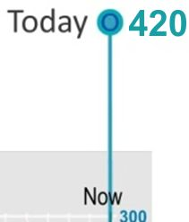
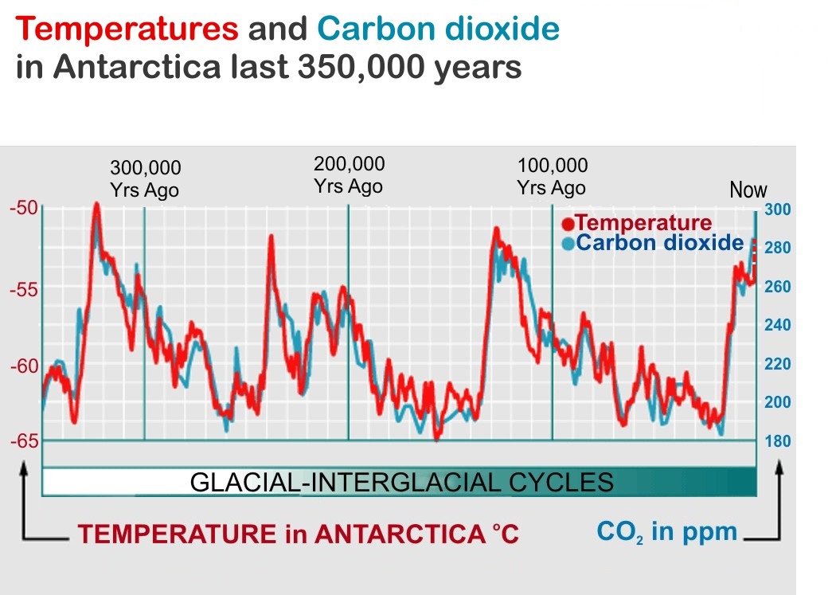
?
Notes:
There’s a strong relationship between temperature and CO2 over the last million years or so.
The reason for these changes is well known, the Milankovitch (Milanković) cycles. But the CO2 actually follows the temperature as it is one of those positive feedback effects – warmer water releases CO2 which traps heat and warms the water further releasing more CO2 – giving more warming etc. But it reaches a limit because more moisture means more clouds and therefore more reflected sunlight. (That didn’t happen on Venus – which has a runaway greenhouse effect and temperature of about 450 degrees.
CO2 has gone up from less than 300 ppm to over 400 ppm in the last century - almost entirely as the result of our burning of coal oil and gas. We can not expect the temperature to stay still!

Slide 23
Does Earth’s climate change?
If so, how much and why? …Yes, a LOT!
Could we be affecting it? … How?
What could happen, does it matter?
What can we do about it?
Questions?
Notes:
We have seen that Earth’s climate DOES change – a lot – for various reasons to do with the Sun and the Earth, and the atmosphere. So are we affecting the atmosphere? [If anything, natural factors would be cooling the Earth now. It is only our changes to the atmosphere that are warming it.]

Slide 24
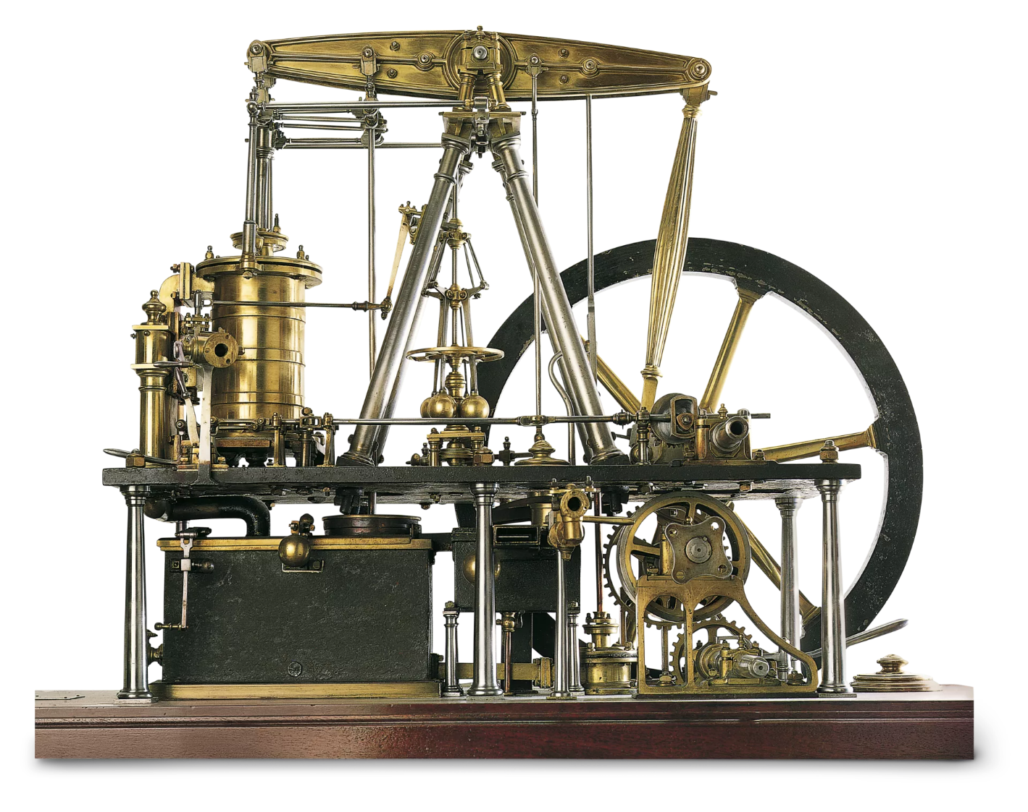
James Watt’s steam engine 1769
Notes:
It all started with the industrial revolution in the 17th and 18th centuries. Watt’s engines were the first to be used for mass transit and larger scale power.

Slide 25
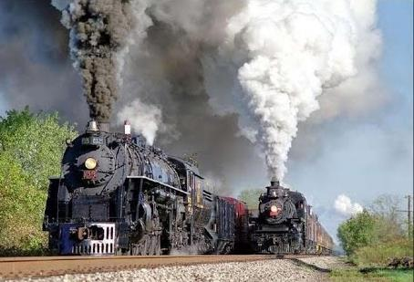
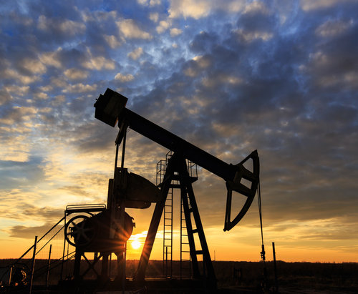
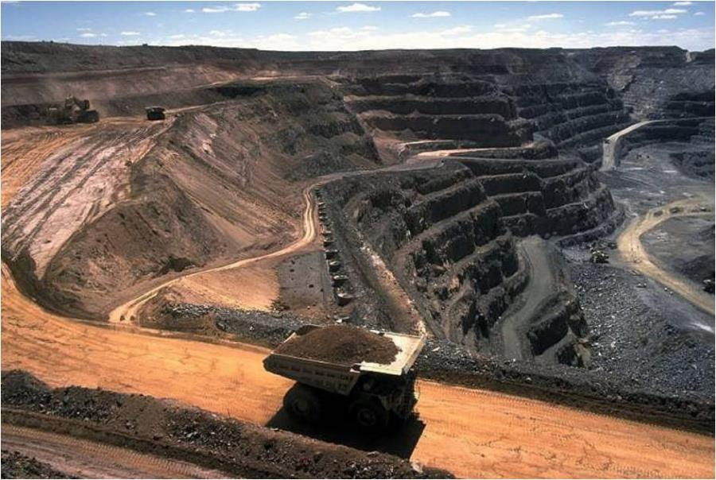
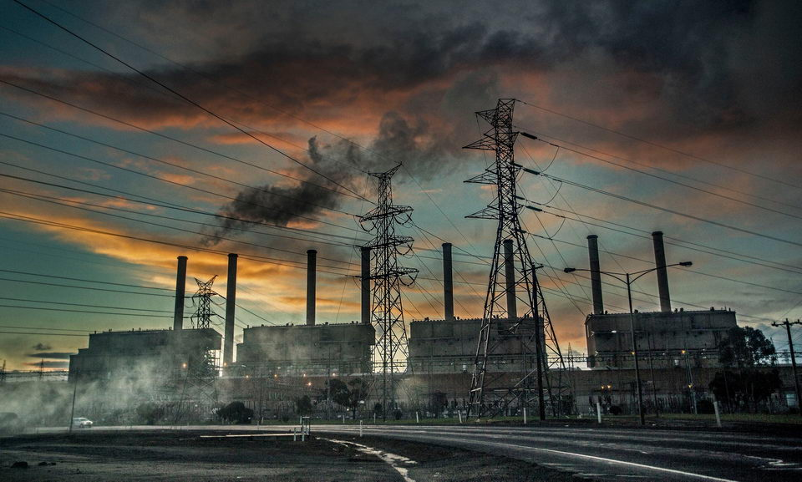
Notes:
Then steam power became much more serious, followed by the discovery of oil. But then we got serious about digging up coal and using it to produce electricity – which is responsible for the biggest share of emissions around 30 – 40%

Slide 26
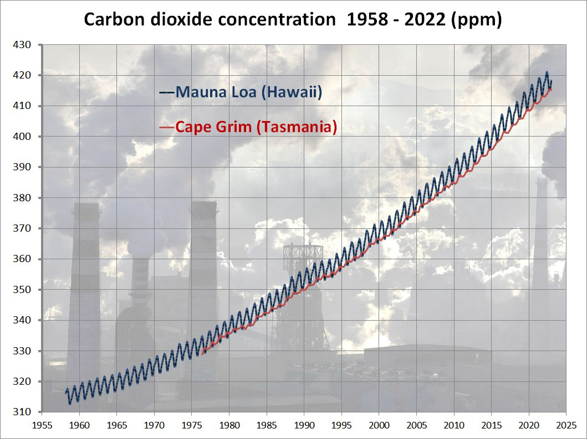
421 ppm
May 2022
400 ppm = 0.04%
Rate of increase is STILL increasing!
Notes:
Pre-industrial CO2 was about 280 ppm. There is no reasonable doubt that the reason for this rise is emissions from burning fossil fuels. Problem is that even if we can keep our emissions from rising there is a large part of the world which is trying to catch up to us and their emissions are rising using the curve to bend upwards. Furthermore, even if we stopped adding CO2 now it would stay high at this level for quite a few decades.

Slide 27
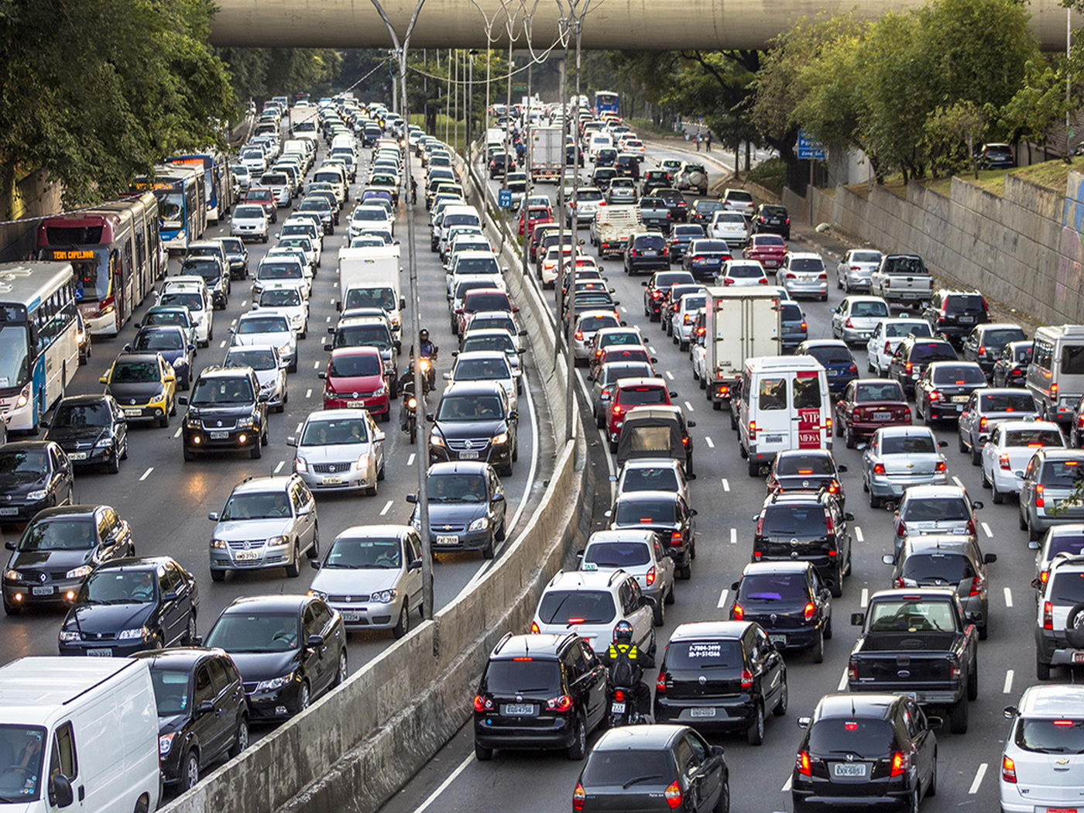
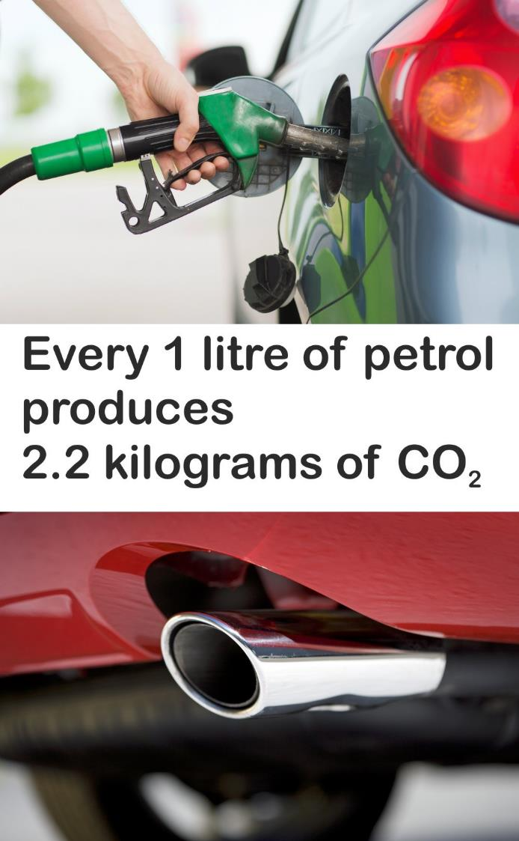
Notes:
Transport emissions are about 18% of our emissions

Slide 28
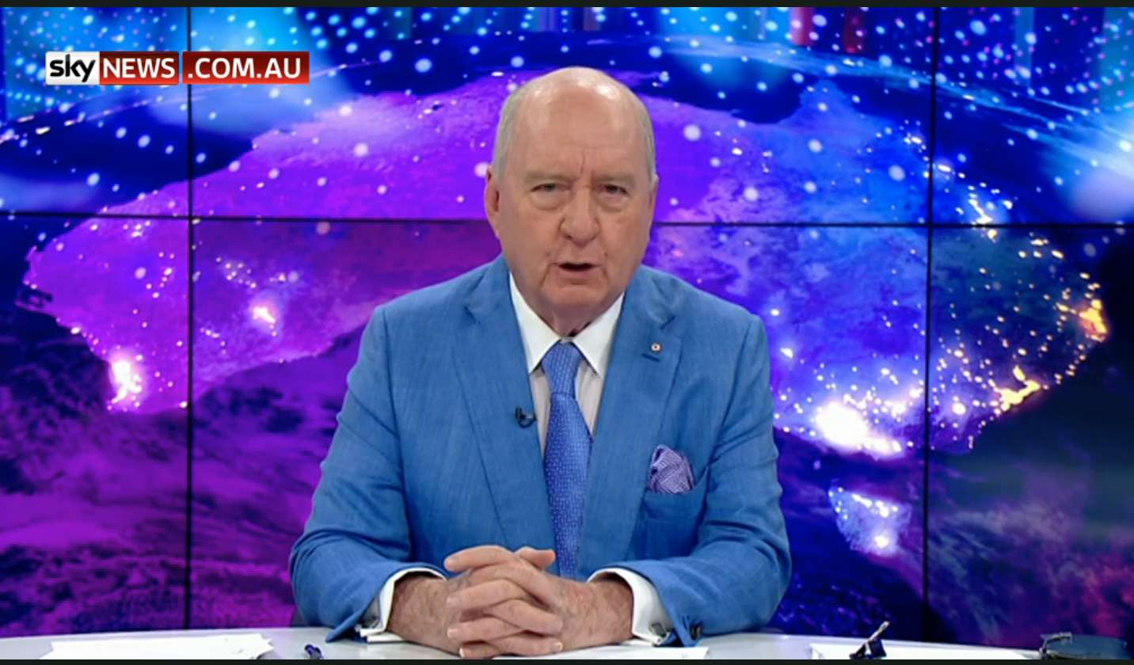
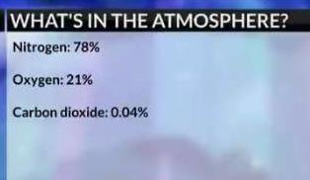
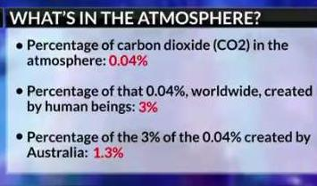
Nonsense from Murdoch media
Alan Jones, Andrew Bolt etc think climate change is a hoax
1.3% from Australia with 0.3%
of the population is FOUR TIMES our fair share!
Notes:
Recent change of approach was nothing but greenwash!
But that 1.3% is from 0.3% of the world’s population – we are emitting FOUR TIMES our fair share!
Sky News 7 May 2019 AND SKY NEWS is very prominent on social media
The 0.04% might sound small, but there is a VERY SIMPLE explanation….

Slide 29
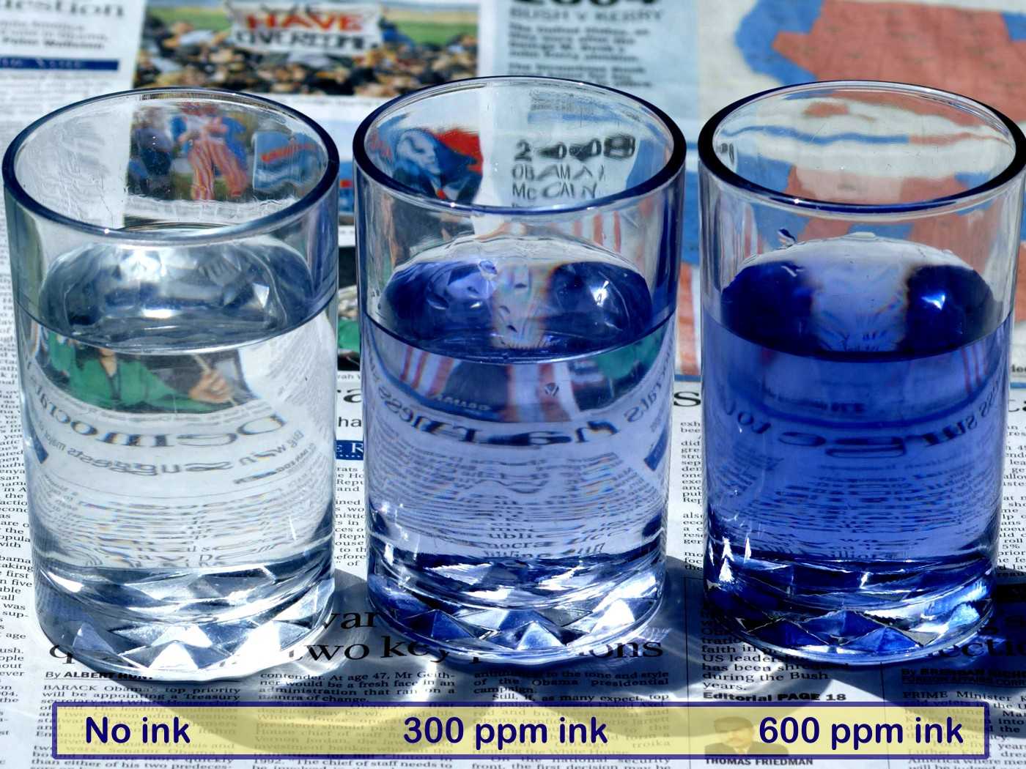
Climate science
300 ppm (or 0.03%) might not sound like much, but here is the effect of adding 300 ppm of ink to a glass of water:
“But there is only 0.04% (that’s 400 ppm) of CO₂ in the air!”
Notes:
400 ppm might seem a very small amount of CO2 to have such an effect. Only 0.04%. But consider this analogy. Think of the water as like the atmosphere – most light goes straight through it.
Think of ink rather like the CO2 in the atmosphere – it absorbs light, just as CO2 absorbs invisible infrared light (warmth)
The air, or water simply have little or no effect on the light/IR, but the CO2 does.
400 ppm might sound like a very small amount of CO2 in the atmosphere, but the problem is that over 99% of the atmosphere has NO EFFECT on the greenhouse effect. In this experiment, the water is like the nitrogen and oxygen – simply irrelevant as far as the absorption of light (or IR) is concerned. TRY THIS AT HOME! (Could use food colour etc.)

Slide 30
Notes:
Pre-industrial there was a bit over 2 TRILLION tonnes of CO2 in the atmosphere
Note that every year around 770 gtn CO2 go in and out of the biosphere, our 20 gtn is “only” about 3% of that – BUT…
CO2 from land is increasing because we are clearing land and planting less
CO2 going into the ocean from the atmosphere is decreasing because more is going in from our emissions (decreasing the pH) and the ocean is warming.
(Ocean is warming but concentration of CO2 in the atmosphere is increasing at a faster rate.)

Slide 31
Now 50%
Notes:
But now there is over 3 TRILLION tonnes. We have added a TRILLION tonnes of CO2 to the atmosphere! Half as much again. [420 ppm = 3300 gtn]
Note that every year around 770 gtn CO2 go in and out of the biosphere, our 20 gtn is “only” about 3% of that – BUT…
CO2 from land is increasing because we are clearing land and planting less
CO2 going into the ocean from the atmosphere is decreasing because more is going in from our emissions (decreasing the pH) and the ocean is warming. CO2 level now almost 420ppm
(Ocean is warming but concentration of CO2 in the atmosphere is increasing at a faster rate.)

Slide 32
Where are the emissions coming from?
Very little different in 2022
Down 20% since 2005
LULUCF
–8%
Notes:
Greenhouse gas emissions by Australia 2020 (above 2013 but very similar now – only drop is LULUCF (Land Use Land Use Change & Forestry) Figures (then) now:
Electricity (32.2%) 32.4
Stationary energy (excl. electricity) (19.3%) 21.1
Transport (17.0%) 18.6
Waste + Fugitive emissions (9.7%) 2.7 + 10.3
Industrial processes (5.7%) 6.6
Agriculture (13.6%) 16.4
Waste (2.5%) 2.7
Forestry 2006 15%, 2013 3%, negative now – 8.2%

Slide 33
Where are world emissions coming from?
Australia
China - and much of that is to make the stuff we buy!
Notes:
So our 1.3% of emissions is from only 0.3% of the population – ie we emit FOUR TIMES our fair share!
Of course the largest emitters are the largest countries, but more important is the amount per person!
Only places like Qatar and UAE are higher than us! Even Saudi Arabia is less!
If exported fossil fuels were included the figure would be about three times that!
[Different calculations seem to give figures about 22 tonnes]

Slide 34
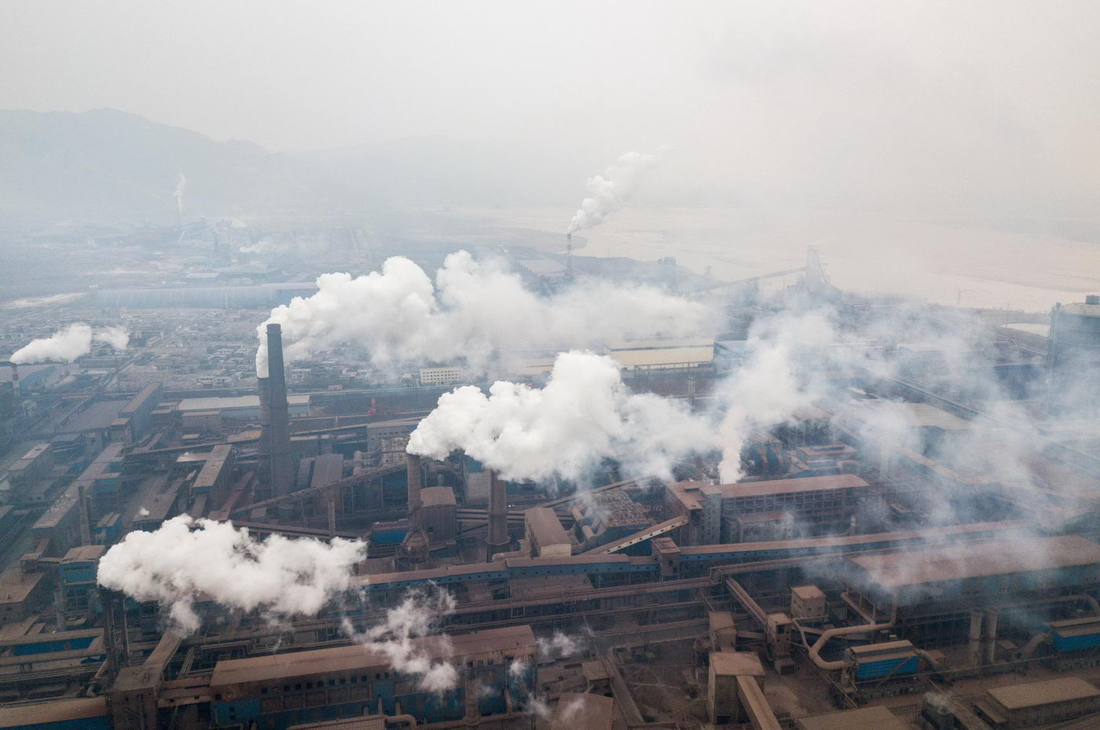
Chinese steel plant
Notes:
We are not counting emissions used on our behalf in China and other countries.
Using our coal and our iron ore! We will come back to this issue (Green steel)

Slide 35
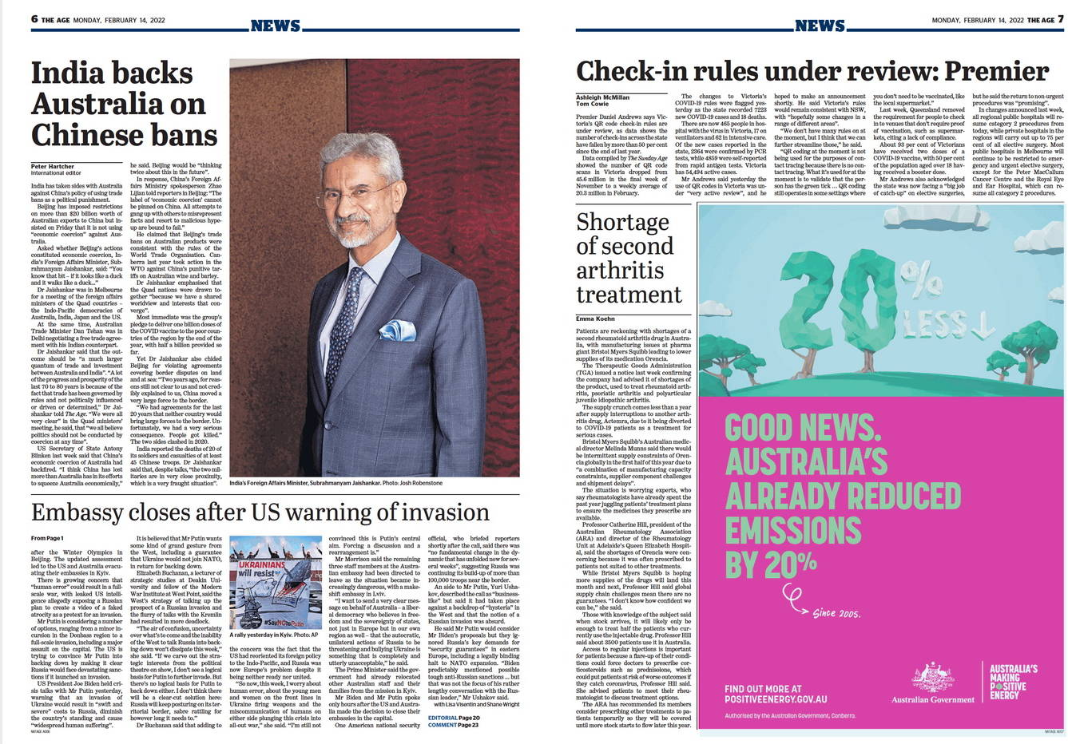
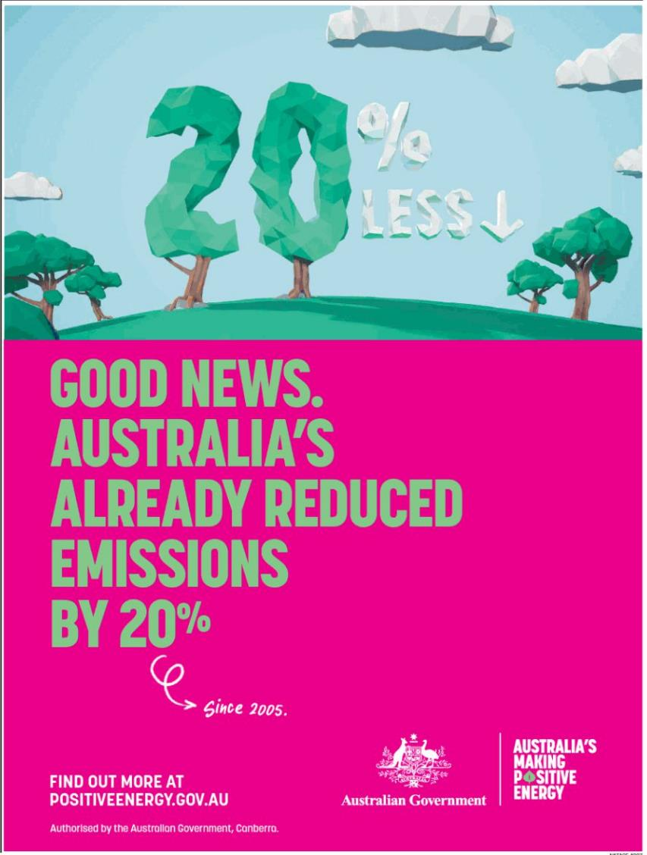
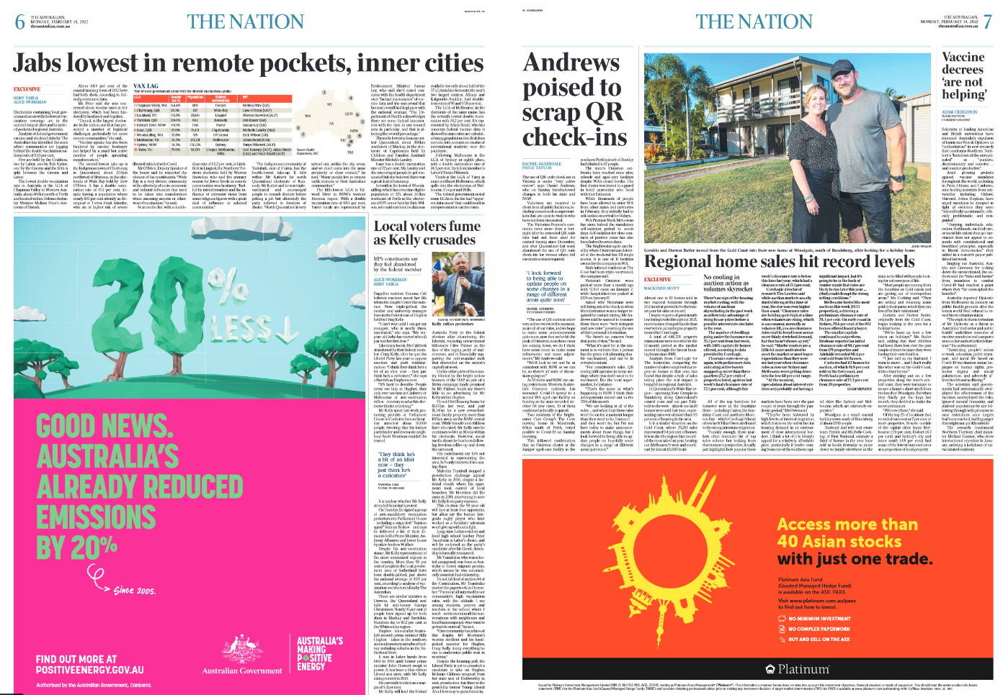
Notes:
Good they put the 20% in the trees! Because this was due to almost nothing the Fed have done! It is mainly land use changes, HH solar panels and covid!

Slide 36
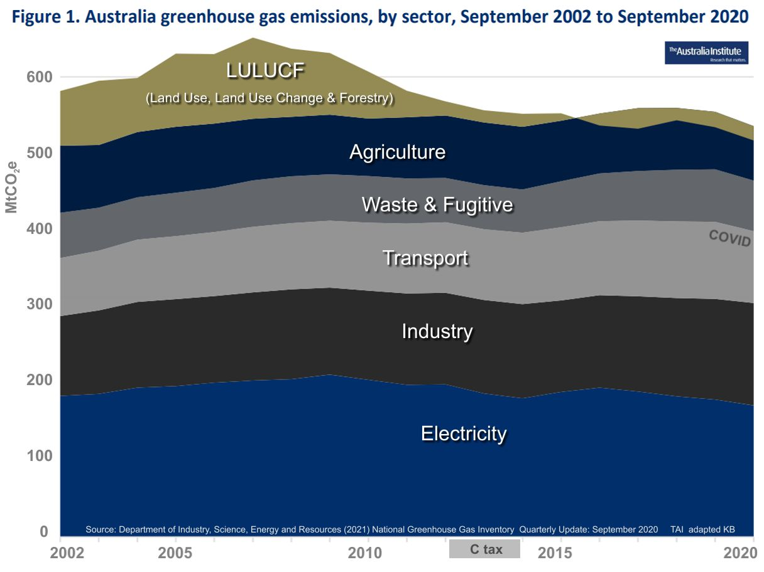
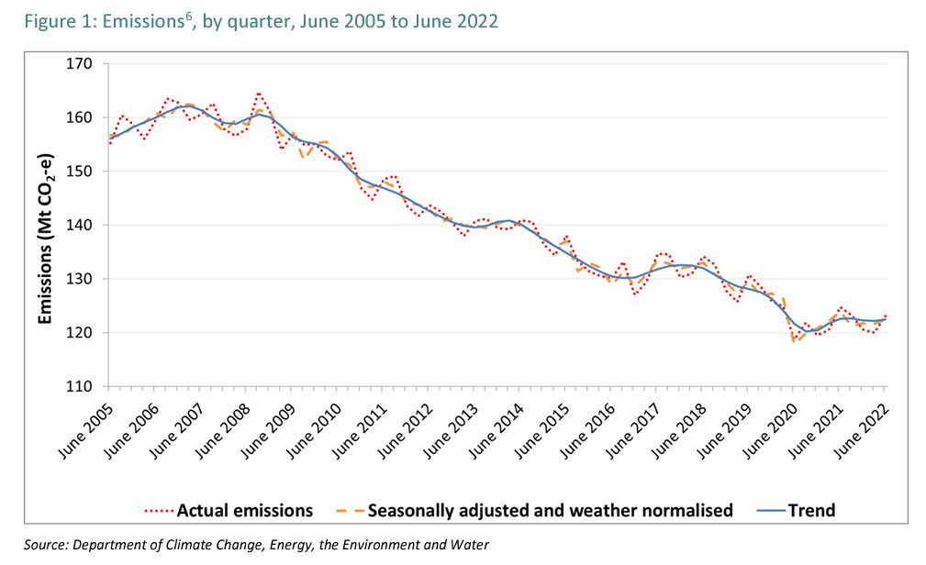
-20%
Notes:
The 20% has almost nothing to do with anything the Feds have done. It was mostly due to ending land clearing in Queensland, installation of HH solar and drop in transport due to covid.
Also note the drop during the time of the carbon tax! And the rise after it.
And while there was a drop during covid, unfortunately emissions have gone up again in 2021-22!

Slide 37
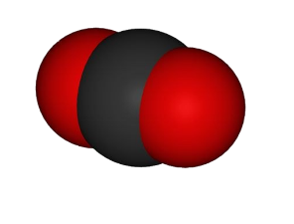
But it’s not just carbon dioxide (CO₂)
It’s methane (CH₄) and other gases
CO₂ is around 65%
CH₄ is around 20%
Notes:
Natural gas, methane – a more potent greenhouse gas. Direct leaks as well as leaks from wells. Also from coal mines.
Methane is responsible for around 20% of global warming.
[H2O is also, but it is a “feedback” ghg, CO2 and CH4 are “forcing” ghg’s If it weren’t for CO2 the atmosphere would freeze out all H2O and earth would freeze up.]

Slide 38
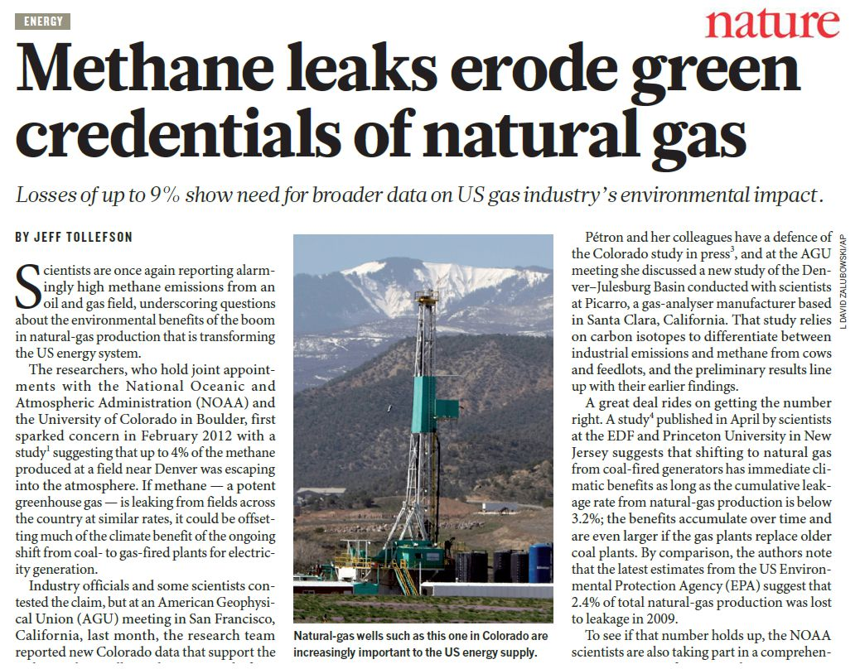
Notes:
Natural gas, methane – a more potent greenhouse gas. Direct leaks as well as leaks from wells. Also from coal mines.
Methane is responsible for around 20% of global warming.
[H2O is also, but it is a “feedback” ghg, CO2 and CH4 are “forcing” ghg’s If it weren’t for CO2 the atmosphere would freeze out all H2O and earth would freeze up.]

Slide 39
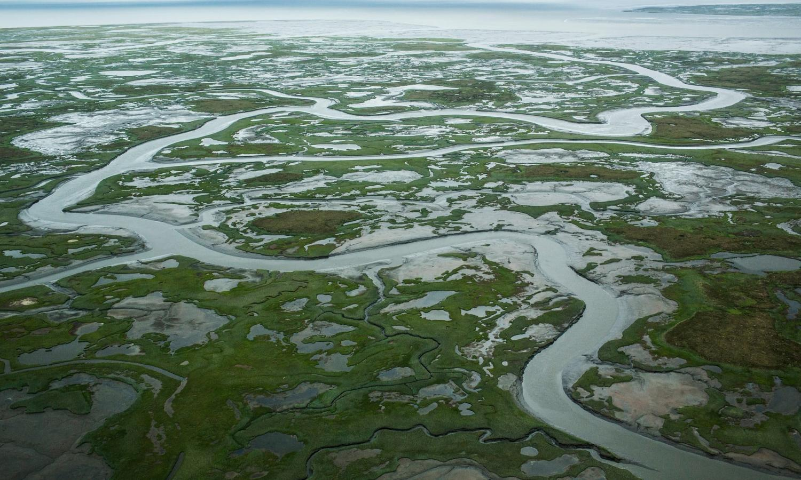
Arctic and Alaskan tundra (permafrost) is melting
This is increasing CO₂ & CH₄ emissions…which…
Notes:
Which of course drives global warming
which melts the permafrost which…
Slow-freezing Alaska soil driving surge in carbon dioxide emissions It is estimated that Arctic permafrost contains roughly twice as much carbon as the Earth’s entire atmosphere! And CH4 is about 80 times stronger than CO2 as a greenhouse gas.
Northern tundra’s autumn carbon dioxide emissions increased 70% between 1975 and 2015, researchers find, blaming warming temperatures
Guardian, Tue 9 May 2017
The soils of Alaska’s tundra are taking longer to freeze over than in past decades. Photograph: Andrew Burton/Getty Images
Alaska’s soils are taking far longer to freeze over as winter approaches than in previous decades, resulting in a surge in carbon dioxide emissions that could portend a much faster rate of global warming than scientists had previously estimated, according to new research.
In the Arctic summer, the upper level of soil, which sits above a vast sheet of permafrost that covers much of Alaska, thaws out and decomposing organic matter starts to produce CO2. From October, colder temperatures help freeze the soil again, locking up the CO2.
It is estimated that Arctic permafrost contains roughly twice as much carbon as the Earth’s entire atmosphere. This means its disappearance would probably contribute to a severe change in the climate that would be dangerous to many species, including humans.

Slide 40
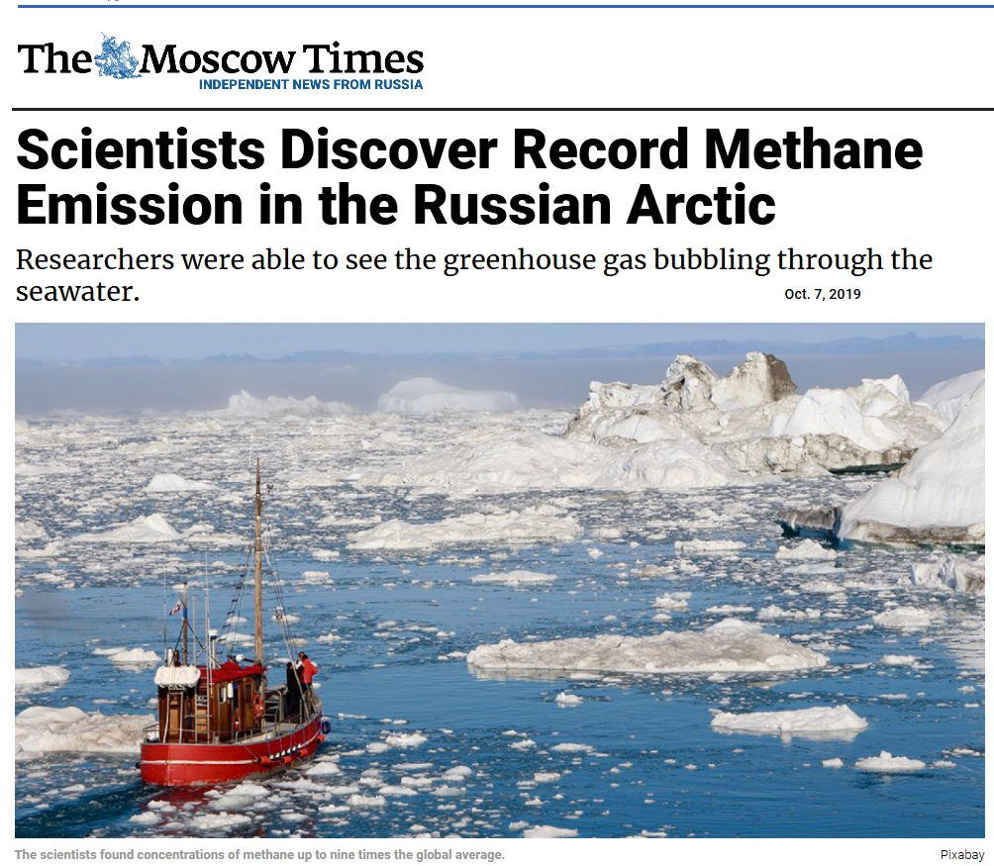

Slide 41
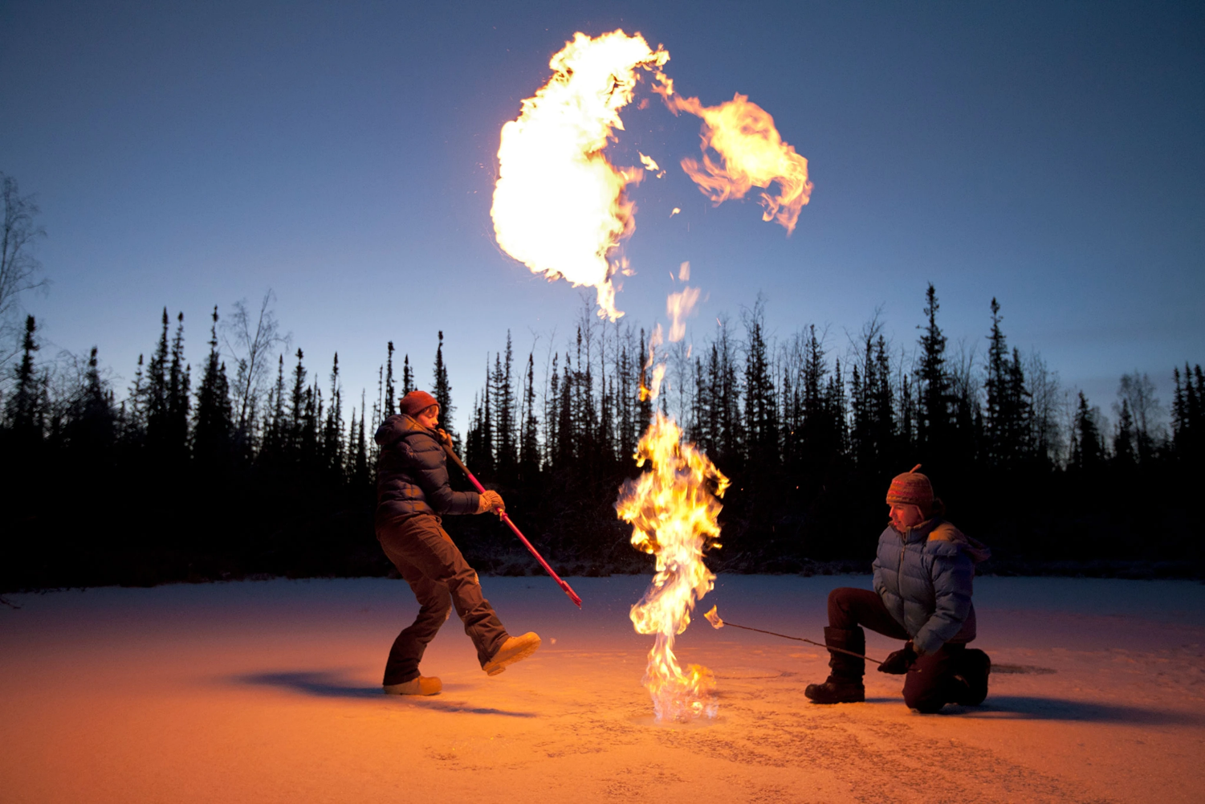
Methane just leaks from the ground in warming tundra

Slide 42
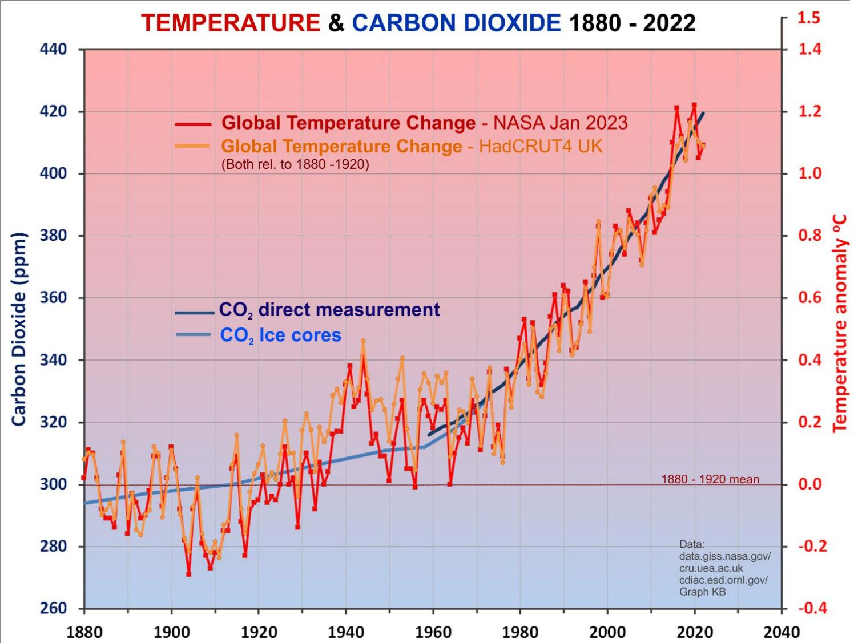
El Niños
La Niñas
Notes:
So what is actually happening now? Clearly there IS a connection between CO2 and temperature… as we expect. 2021 was the hottest ever La Niña year. Temperatures (red, orange) have gone up pretty much in line with the CO2 (blue – from ice cores and more recently direct measurement) as expected.
It’s not nice to consider what the next El Niño might be like!

Slide 43
Does Earth’s climate change?
If so, how much and why? … YES a lot!
Could we be affecting it? … YES, CO₂,CH₄!
What could happen, does it matter?
What can we do about it?
Questions?
Notes:
There is no real doubt that the extra CO2 we are putting in the atmosphere is causing the warming we are seeing. We are also adding CH4 and more – but it is the CO2 that is the prime cause of warming. To suggest otherwise goes against all the science we know about the greenhouse effect. The rapid increase in temperatures does not correlate with any other known natural phenomena.
But what will happen and does it matter?

Slide 44
So what will this extra CO₂ do to the +33ºC Greenhouse effect? And how will it affect us?
Two ways to answer:
Use our understanding of the physics of the climate (ie. ‘computer modelling’)
Look at what has happened in the past – and compare it to what we see happening now.
Notes:
Remember that the greenhouse effect is +33ºC, but we have increased CO2 by 50% - how much will the temperature increase?

Slide 45
Doing the Physics
Notes:
Not going to explain all this, but briefly it is a matter of applying well known physics to the way the atmosphere behaves. It is similar to the way meteorologists predict the weather – but on a longer time scale.
Divide atmosphere up into cells. If one cell is warmer than the one next door heat will flow to the cooler one. Likewise with pressure. This is basically how weather forecasters do their work.
BoM diags
See also https://www.carbonbrief.org/qa-how-do-climate-models-work

Slide 46
Doing the Physics …
IPCC
Notes:
Takes into account huge amount of data from all sorts of factors that affect the climate.
From IPCC FAQ Based on excellent article about climate modelling in Physics World Feb 07 www.physicsweb.org

Slide 47
IPCC
Notes:
We have huge amounts of data about the energy flows into and out of the Earth – and in fact we know that there is more heat in than out at present!
NB 1 less out than in!

Slide 48
Doing the Physics
Scientists put all the laws of physics and chemistry into computer models which can do the vast numbers of calculations needed.
Some of the
basic equations:
Good description of climate models at
www.carbonbrief.org/
qa-how-do-climate-models-work
Notes:
It’s complicated stuff, but it’s basic physics and it works!

Slide 49
So what do they predict?
Actual
Predictions
with no CO₂ increase
2015
Notes:
Without the extra CO2 we would be cooling slowly.
Note – hindcast from 1860 - 2010

Slide 50
So what do they predict?
Predictions
WITH CO₂ increase
(to 2015)
Notes:
But with it we get pretty good agreement with what’s actually happening. The models are pretty good!
Note – hindcast from 1860 – 2010 Years 2010 – 2015 got deniers excited, but see next slide!

Slide 51
Notes:
From 1980. GISTEMP extended to 2020 Hiatus there but clearly we have caught up! And it was never below the range of variation in models.

Slide 52
So what will this extra CO₂ do to the +33ºC Greenhouse effect? And how will it affect us?
Two ways to answer:
Use our understanding of the physics of the climate (ie. ‘computer modelling’)
Look at what has happened in the past – and compare it to what we see happening now.
Notes:
Remember that the greenhouse effect is +33ºC, but we have increased CO2 by 50% - how much will the temperature increase?

Slide 53
Looking at the past – the big picture
Pliocene
CO₂ ~400ppm
Sea levels
~30 m higher
LIG CO₂~280ppm 125,000 yr ago About +1ºC
Sea ~8m higher
Holocene
10,000 yrs of stable climate
+3°C
+2°C
+1ºC
LIA & MWP
Human civilisation
Notes:
Human civilization has developed in the last 10,000 years because the climate was stable! Two periods of interest…
LIG Last InterGlacial 150,000 – 100,000 yr ago. CO2 similar to pre-industrial (280 ppm) temperatures only about 1 deg higher (ie about same as now!) but sea levels around 6 – 9 m higher than now.
Pliocene, 2-3 million yr ago – similar to now CO2, only a couple of degrees warmer, but sea level about 25 – 40 m higher, little polar ice, …. Etc!! ??

Slide 54
?
Milanković cycles
Notes:
Now just let’s look back at the more “recent” past – last few hundred thousand years! We see a strong relationship between CO2 and temperature. Why such a big change? (As solar irradiation doesn’t change very much) And is the red line going to follow the blue line up?!
The reason for these changes is well known, the Milankovitch (Milanković) cycles – changes in Earth’s orbit. But initially the CO2 actually follows the temperature – we explain why in the next slide.

Slide 55
Earth’s Greenhouse climate
Solar warming
Still higher temperatures
Higher temperatures
More greenhouse warming
More H₂O
& CO₂ into atmosphere
Positive feedback!
Notes:
A “SELF REINFORCING CYCLE” The solar warming because of changes in the orbit starts the process, but this means more CO2 goes into the air – which means more warming …. it is one of those positive feedback effects – warmer water releases CO2 which traps heat and warms the water further releasing more CO2 – giving more warming etc. But it reaches a limit because more moisture means more clouds and therefore more reflected sunlight. (That didn’t happen on Venus – which has a runaway greenhouse effect and temperature of about 450 degrees.)
CO2 has gone up from less than 300 ppm to over 400 ppm in the last century - almost entirely as the result of our burning of coal oil and gas.
Note that while H2O goes in and out of the atmosphere every day, once CO2 goes into the atmosphere it stays there for around a century. So while H2O is called a “feedback GHG”, CO2 is a “forcing GHG”

Slide 56
Earth’s climate – looking at the past
The last ‘interglacial’ – similar to current climate.
Maybe ~2°C warmer than pre-industrial average...
Notes:
The last interglacial is very interesting because it was the last time Earth was very similar to now. Temperature only a little warmer – in fact pretty similar to what we are now approaching. But the CO2 was much less! And yet…

Slide 57
July
2009
“A team at the National University of Mexico has been studying 121,000 year old coral reefs in the Yucatan Peninsula, formed during the
last interglacial period when sea level peaked at around 10 metres higher than today. Findings show that at one point the sea rose
3 metres within 50 to 100 years.”
And temperatures then were only a couple of degrees warmer than the 20th C.
But CO₂ levels were only 280 ppm
Notes:
Abrupt climate changes have occurred in the past. We should not think that it can’t happen again. 3 m this century would be absolutely catastrophic. And that’s just the sea rise – add to that the changes in land fertility and ecosystem collapse. SEE New Scientist: Sea level rise: It's worse than we thought * 01 July 2009 by Anil Ananthaswamy New Scientist issue 2715.

Slide 58
So what would a 10 m sea level rise look like?
(Balsillie and Donoghue, 2004)
10 metre sea level rise for Melbourne
Notes:
This is what it was like in the LIG

Slide 59
Looking at the past – the big picture
Pliocene
CO₂ ~400ppm
Sea levels 20 -
40 m higher
LIG CO₂~280ppm 125,000 yr ago About +1ºC
Sea 8 – 10 m higher
Holocene
10,000 yrs of stable climate
+3°C
Human civilisation
Notes:
Just let’s go back to the Pliocene again – 3 million yr ago, similar CO2 level (not all that long ago) and only about 3 deg warmer – but VERY different – next slide!

Slide 60
CO₂ about 400 ppm
LARGE areas of EU, ME & Asia underwater,
and ALL coastal cities
About 2ºC warmer Sea levels 20 - 40M HIGHER
Notes:
Going further back to the Pliocene, when CO2 levels were similar to now, note much less snow, Florida and much of Europe flooded, much of coastal Australia wiped out.
This isn’t going to happen in our lifetime, but it could within a few generations.
With 40m of sea rise we would be on the shoreline if not under water here!

Slide 61
Notes:
This represents a 30 cm rise in 90 years, or 33 cm per century, which doesn’t sound huge, but it is rising at an increasing rate. In the last decade it rose over 5 cm (half a metre in a century). BUT this is mostly thermal expansion and does not represent the increasing contribution of ice melt (next slide)

Slide 62
But sea level rise has two components
As temperature rises water expands
As ice melts sea level rises slowly at first but then accelerates rapidly
Sea level →
Time →
Notes:
The red rate is increasing and is mainly only due to thermal expansion.
The IPCC reports underestimated the effect of melting ice because it was poorly understood. But as we have come to understand it better the consequences look more and more worrying.
It accelerates because the more ice that melts the more easily it will slide into the sea. Also, the melt rate depends on temperature differences between ice and water, not just actual temperature. Initially that might be only a degree, eg 0 and 1 degrees, but as water warms to 2 degrees the temperature difference has DOUBLED.

Slide 63
0ºC Ice stays frozen +1ºC Ice melts
But at +2ºC
ice melts at MORE than twice the rate
Notes:
While ice is surrounded by water at close to 0ºC it doesn’t melt, but a small temperature increase of 1ºC makes a big difference to rate of melting! And +2ºC more than doubles melt rate!

Slide 64
BUT …
Computer models have had trouble understanding how fast polar ice will melt …
It’s not just a matter of melting as such – it’s complicated!
And ice seems to be melting FASTER than we thought!
Notes:
It’s not just the melting, it’s the behaviour of the ice sheets as water flows through them and lubricates the base. It’s the angle of the rock the ice is sitting on. It’s how fast warmer currents are reaching the poles… and more.
The trouble is that most of the new work coming out is finding that things are WORSE than we thought, not better!

Slide 65
Notes:
So what is happening now? Our trip to Greenland Sep 2018

Slide 66
Greenland ice sheets are melting
Notes:
Greenland Ice Loss Billion Tonnes per Year
1992 – 2001 34 BTY
2012 – 2016 247 BTY (over seven times as much – per year!)

Slide 67
The Eqi Glacier
Ilulissat
Jakobshavn glacier
Notes:
Trip about 60 km each way.

Slide 68
Greenland’s glaciers are calving at an increasing rate
From Ilullssat to the Eqi glacier
Notes:
Beautiful ‘unreal’ scenery on the 60 km trip to see the glacier front.

Slide 69
The Eqi Glacier
4 Km wide 200 m high
Notes:
Face of this glacier is 200 m high and over 1 km wide. Slabs constantly fall off. (KB photos)

Slide 70
Greenland’s glaciers are carving at an increasing rate
Eqi Glacier near Ilullssat, Greenland
Notes:
Face of this glacier is 200 m high and over 1 km wide. Slabs constantly fall off. (KB photos)

Slide 72
Jakobshavn, the largest, fastest glacier in Greenland
100 Million Tonnes
of ice every day
Notes:
(KB photos) Jakobshavn Glacier Fjord drains 6.5% of the Greenland ice sheet^{[1]} and produces around 10% of all Greenland icebergs. Some 35 billion tonnes of icebergs calve off and pass out of the fjord every year. [100 million tonnes every day] Icebergs breaking from the glacier are often so large (up to 1 km in height) that they are too tall to float down the fjord and lie stuck on the bottom of its shallower areas, sometimes for years, until they are broken up by the force of the glacier and icebergs further up the fjord. Studied for over 250 years, the Jakobshavn Glacier has helped develop modern understanding of climate change and icecap glaciology [Wikipedia]

Slide 73
Jakobshavn, the largest, fastest glacier in Greenland
Calving face recession 1902 - 2010
20 km
Notes:
It took all last century to recede 20 km. It receded more than that in the first ten years of this century. In the last decade it has receded out of this picture.

Slide 74
Jakobshavn, the largest, fastest glacier in Greenland
Calving face 2018
Notes:
Google Earth It releases 100 million tonnes of ice every day. And the speed at which it is flowing has gone from about 20 metres/day 2000 to 50 metres/day now.

Slide 75
Ice sheets are melting at much faster rates
Greenland Ice Loss
1992 – 2001: 34 Billion Tonnes per Year
2012 – 2016: 247 Billion Tonnes per Year
(If Greenland melts it adds 7 metres to sea level!)
NASA/Goddard Space Flight Center Conceptual Image Lab
Notes:
7 times as much in less than 20 years! During the summer melt season, melt water accumulates in undulations on the surface of the Greenland ice sheet. Eventually, these melt lakes drain through crevasses or moulins (tunnels under the ice sheet surface), delivering water to the bottom of the ice sheet. This melt water lubricates the interface between the ice and the bedrock, causing the ice to flow faster toward the sea during summer. As summer melt increases and more melt water is available, the greater its effect on summer ice sheet flow rates.
Accelerating Ice Sheet Animations by Susan Twardy Released on August 29, 2007 NASA_a10153_H264_30fps.mp4

Slide 76
Ice sheets are melting at much faster rates
Greenland Ice Loss
1992 – 2001: 34 Billion Tonnes per Year
2012 – 2016: 247 Billion Tonnes per Year
(If Greenland melts it adds 7 metres to sea level!)
NASA/Goddard Space Flight Center Conceptual Image Lab
Notes:
7 times as much in less than 20 years! During the summer melt season, melt water accumulates in undulations on the surface of the Greenland ice sheet. Eventually, these melt lakes drain through crevasses or moulins (tunnels under the ice sheet surface), delivering water to the bottom of the ice sheet. This melt water lubricates the interface between the ice and the bedrock, causing the ice to flow faster toward the sea during summer. As summer melt increases and more melt water is available, the greater its effect on summer ice sheet flow rates.
Clips from: Accelerating Ice Sheet Animations by Susan Twardy Released on August 29, 2007 NASA_a10153_H264_30fps.mp4

Slide 77
What’s happening at the calving face:
Time lapse clips from movie doco “Chasing Ice” (2012)
Notes:
25 sec of clips including showing NYC for scale – with time lapse movie. Chasing Ice available on Beamafilm.

Slide 78
Notes:
But it’s not just anecdotal, scientists are studying it: Greenland lost a record amount of ice during an extra warm 2019, with the melt massive enough to cover California in more than four feet (1.25 meters) of water, a new study said. [Ca 423,970 km² Vic is 227,444 km² so Vic to 2.33 m]
After two years when summer ice melt had been minimal, last summer shattered all records with 586 billion tons (532 billion metric tons) of ice melting, according to satellite measurements reported in a study Thursday. That's more than 140 trillion gallons (532 trillion liters) of water.
That's far more than the yearly average loss of 259 billion tons (235 billion metric tons) since 2003 and easily surpasses the old record of 511 billion tons (464 billion metric tons) in 2012, said a study in Communications Earth & Environment. The study showed that in the 20th century, there were many years when Greenland gained ice.
"Not only is the Greenland ice sheet melting, but it's melting at a faster and faster pace," said study lead author Ingo Sasgen, a geoscientist at the Alfred Wegener Institute in Germany.
Last year's Greenland melt added 0.06 inches (1.5 millimeters) to global sea level rise. That sounds like a tiny amount but "in our world it's huge, that's astounding," said study co-author Alex Gardner, a NASA ice scientist. Add in more water from melting in other ice sheets and glaciers, along with an ocean that expands as it warms—and that translates into slowly rising sea levels, coastal flooding and other problems, he said.

Slide 79
Notes:
Published: 20 August 2020
Return to rapid ice loss in Greenland and record loss in 2019 detected by the GRACE-FO satellites
Ingo Sasgen, et.al Communications Earth & Environment volume 1, Article number: 8 (2020)

Slide 80
“Observed underwater mass loss outpaces predictions”
..melt rates up to a hundred times larger than predicted
Notes:
“Observed underwater mass loss outpaces predictions” Science July 2019

Slide 81
Arctic summer sea ice
1984 - 2016
Less and Younger (thinner)
Notes:
Melting arctic sea ice won’t increase sea levels, BUT it warms the Arctic and helps melt the Greenland ice! This is an example of one of the “tipping points”. The more ice that is lost the faster it disappears! Particularly note that now most ice is less than 4 years old – ie. It is very vulnerable to short term changes.

Slide 82
More dark water
Less ice
Warmer water
Another “positive feedback loop”
Notes:
This is a feedback loop! More ice melts – more dark water absorbs more heat – more ice melts ….
A tipping point – once it starts it may not stop!

Slide 83
And at the other end of the Earth...
East
Larsen
West
Thwaites
Totten
Ross
Notes:
As if the Greenland story is not bad enough, in the Antarctic the story is similar, but BIGGER - massive ice sheets are collapsing – faster than we thought.

Slide 84
Grounding line moving backwards
Notes:
Antarctica’s ice is melting at an unexpectedly rapid rate – underwater mass loss is outpacing predictions.
Unlike Greenland, which is mostly above sea level, warmer water is getting in underneath the ice and the “grounding point” is moving backwards – which makes the tongue, the ice shelf, much more vulnerable. When a section breaks off, more ice slides forwards.

Slide 85
Huge rifts on the Amery ice shelf in Eastern Antarctica
Source: climate.nasa.gov 2018/2021
Notes:
Big problem is we don’t know how quickly warmer water is getting underneath the land ice (some of which is below sea level) and speeding up the glaciers. Note, some ‘sceptics’ have pointed out that sea ice has increased – but that’s because the ice is falling off the land!!

Slide 86
But some say we can’t rule out rises
of
2 to 5 metres
Notes:
The point of all this is that virtually every new study of ice sheets is coming out with the same conclusion – they are melting far more rapidly than was first thought! And the last one reminds us that the melting won’t stop in 2100! It will go on for centuries, even millenia.

Slide 87
Nature, 24 September 2020
Notes:
You don’t get ice back by going back to the same temperature as you lost it!
In particular, the Filchner–Ronne Ice Shelf (FRIS) and the Ross Ice Shelf are sliding into the sea more and more rapidly.
ABSTRACT: Here we show that the Antarctic Ice Sheet exhibits a multitude of temperature thresholds beyond which ice loss is irreversible. …. at global warming levels around 2 degrees Celsius above pre-industrial levels, West Antarctica is committed to long-term partial collapse owing to the marine ice-sheet instability. Between 6 and 9 degrees of warming above pre-industrial levels, the loss of more than 70 per cent of the present-day ice volume is triggered, mainly caused by the surface elevation feedback. At more than 10 degrees of warming above pre-industrial levels, Antarctica is committed to become virtually ice-free. The ice sheet’s temperature sensitivity is 1.3 metres of sea-level equivalent per degree of warming up to 2 degrees above pre-industrial levels, almost doubling to 2.4 metres per degree of warming between 2 and 6 degrees and increasing to about 10 metres per degree of warming between 6 and 9 degrees. Each of these thresholds gives rise to hysteresis behaviour: that is, the currently observed ice-sheet configuration is not regained even if temperatures are reversed to present-day levels. In particular, the West Antarctic Ice Sheet does not regrow to its modern extent until temperatures are at least one degree Celsius lower than pre-industrial levels. Our results show that if the Paris Agreement is not met, Antarctica’s long-term sea-level contribution will dramatically increase and exceed that of all other sources.

Slide 88
Problem is, every new discovery INCREASES the expected sea level rise!
Notes:
Some scientists are saying it could be 2 or even 5 metres by end of century!

Slide 89
Bangladesh - Ganges delta
Croplands only 1 or 2 metres above SL
1 Billion people live below 10 m above sea level
250 Million people live only 1 or 2 metres above the sea!
Notes:
Huge low lying croplands of Asia would be inundated leading to mass starvation – and thus huge unrest and terrorism!

Slide 90
But it’s not just melting ice that’s the problem!
GREATER SPREAD
MORE HOT DAYS
HIGHER AVERAGE
HOTTER EXTREME DAYS
+1ºC
Notes:
Note that the curve flattens out – a greater spread of temperatures, still with cold days, but the hot extremes are more than just 1 degree hotter.
This means that already hot part of the Earth become almost impossible to work in.

Slide 91
CO₂ is warming the world!
Amazon forest die-back
“dry-season length over southern Amazonia has increased significantly since 1979”
Increased dry-season length over southern Amazonia in recent decades and its implication for future climate projection
Rong Fu et.al. PNAS 5 Nov 2013
Notes:
PNAS | November 5, 2013 | vol. 110 | no. 45 www.pnas.org/cgi/doi/10.1073/pnas.1302584110
Whether the dry-season length will increase is a central question in determining the fate of the rainforests over Amazonia and the future global atmospheric CO2 concentration. We show observationally that the dry-season length over southern Amazonia has increased significantly since 1979. We do not know what has caused this change, although it resembles the effects
of anthropogenic climate change. The global climate models that were presented in the Intergovernmental Panel on Climate Change’s fifth assessment report seem to substantially underestimate the variability of the dry-season length. Such a bias implies that the future change of the dry-season length, and hence the risk of rainforest die-back, may be underestimated
by the projections of these models.

Slide 92
+2.0ºC
12 hottest years all since 2005 except 1998
2020
Notes:
Note that the “global” increase in temperatures includes oceans. Land temperature increases are typically higher than the global average. And last year (2021) was the hottest ever La Nina year.
From BoM Annual climate statement 2019 - 9 January 2020: Australia’s climate in 2019
Australia's warmest year on record, with the annual national mean temperature 1.52 °C above average
Both mean annual maximum and minimum temperatures above average for all States and the Northern Territory
Annual national mean maximum temperature warmest on record (2.09 °C above average)
Widespread warmth throughout the year; January, February, March, April, July, October, and December all amongst the ten warmest on record for Australian mean temperature for their respective months
Significant heatwaves in January and in December
Australia's driest year on record
Nationally-averaged rainfall 40% below average for the year at 277.6 mm
Rainfall below average for most of Australia
Rainfall above average for parts of Queensland's northwest and northern tropics
Much of Australia affected by drought, which was especially severe in New South Wales and southern Queensland
Widespread severe fire weather throughout the year; national annual accumulated Forest Fire Danger Index highest since 1950, when national records began
One of the strongest positive Indian Ocean Dipole events on record; El Niño–Southern Oscillation neutral throughout the year

Slide 94
Notes:
NSW fires and Victorian bushfires: massive smoke rises from wildfires burning in East Gippsland. Tens of thousands of people were scrambling to escape the south-east coast of Australia before worse fire conditions returned on Friday and Saturday. Photograph: Dale Appleton/DELWP Guardian 3 Jan 2020

Slide 95
Of the response from the government, he said "in a nutshell it has been difficult and the Prime Minister has seen fit not to meet with us"
Notes:
In the past I have heard some federal politicians dodge the question of the influence of climate change on extreme weather and fires by saying, "It's terrible that this matter is being raised while the fires are still burning." But if not now, then when?
"Unprecedented" is a word that we are hearing a lot: from fire chiefs, politicians, and the weather bureau. I have just returned from California where I spoke to fire chiefs still battling unseasonal fires. The same word, "unprecedented", came up.
NSW residents told to brace for 'unprecedented' conditions as fatal bushfires persist
Unprecedented dryness; reductions in long-term rainfall; low humidity; high temperatures; wind velocities; fire danger indices; fire spread and ferocity; instances of pyro-convective fires (fire storms – making their own weather); early starts and late finishes to bushfire seasons. An established long-term trend driven by a warming, drying climate. The numbers don’t lie, and the science is clear.
If anyone tells you, "This is part of a normal cycle" or "We’ve had fires like this before", smile politely and walk away, because they don’t know what they’re talking about.
Warmer, drier conditions with higher fire danger are preventing agencies from conducting as much hazard reduction burning – it is often either too wet, or too dry and windy to burn safely. Blaming "greenies" for stopping these important measures is a familiar, populist, but basically untrue claim.

Slide 97
Unprecedented fires in Greenland and Sweden!
Notes:
A series of blazes is burning roughly in the vicinity of Kangerlussuaq, Greenland, a small town that serves as a basecamp for researchers in the summer to access Greenland’s ice sheet and western glaciers. The largest fire has burned roughly 3,000 acres and sent smoke spiraling a mile into the sky, prompting hunting and hiking closures in the area, according to local news reports. Aug 2017

Slide 98
Unprecedented drought in northern Australia

Slide 99
Unprecedented drought in northern Australia
& unprecedented floods (Feb 2019)
Notes:
Climate models predict that extremes will get stronger – longer droughts but also stronger rains when they do come.

Slide 100
Whole system spins as a result of Earth’s rotation
More heat drives more moist air upwards
Moist air condenses releasing heat
Warm water evaporates
Notes:
It is not surprising that storms will get stronger, it is heat from the ocean that drives most of the weather.
More heat = more moist air rising faster and further. This is what drives hurricanes and cyclones harder.

Slide 101
Hurricane Harvey in infrared
Hurricanes are powered by heat from the ocean
Warmer centre drives stronger winds and rain
Notes:
Giving us stronger storms and hurricanes. We know that they get their energy from warmer water, and we know that the oceans are warmer than they have ever been (in human times). Models suggest stronger storms, but not necessarily more frequent.

Slide 102
Cyclone Haiyan Nov 2013 Philippines
Notes:
Although not more frequent, hurricanes, cyclones and storms are getting stronger and causing more damage. The poorer countries suffer most from the effects of stronger storms – despite not contributing to climate change.

Slide 103
More solar heat absorbed by dark water
STRONGER WINDS
WARMER
Normal jet stream
COLDER
Stronger jet stream
Notes:
The freezing weather in the US is the result of the warming of the Arctic!

Slide 104
Notes:
Nature COMMENT 27 November 2019 Climate tipping points — too risky to bet against
We will look at a couple of these in the next slides.

Slide 105
Notes:
The growing threat of abrupt and irreversible climate changes must compel political and economic action on emissions.
Timothy M. Lenton, Johan Rockström, Owen Gaffney, Stefan Rahmstorf, Katherine Richardson, Will Steffen & Hans Joachim Schellnhuber
An aeroplane flies over a glacier in the Wrangell St Elias National Park in Alaska. Credit: Frans Lanting/Nat Geo Image Collection

Slide 106
Stability landscape showing the pathway of the Earth System out of the Holocene and thus, out of the glacial–interglacial limit cycle to its present position in the hotter Anthropocene.
Will Steffen et al. PNAS 2018;115:33:8252-8259
©2018 by National Academy of Sciences
Notes:
Pre-industrial we were at far end – gradually sliding back to the cold times. But now we have moved toward the hot side and if we keep going we will fall right down into the “hothouse”. But we still have a chance to move to a more ‘stabilized earth’, although with a continual risk of falling into the hothouse.
Caption: Stability landscape showing the pathway of the Earth System out of the Holocene and thus, out of the glacial–interglacial limit cycle to its present position in the hotter Anthropocene. The fork in the road in Fig. 1 is shown here as the two divergent pathways of the Earth System in the future (broken arrows). Currently, the Earth System is on a Hothouse Earth pathway driven by human emissions of greenhouse gases and biosphere degradation toward a planetary threshold at ∼2 °C (horizontal broken line at 2 °C in Fig. 1), beyond which the system follows an essentially irreversible pathway driven by intrinsic biogeophysical feedbacks. The other pathway leads to Stabilized Earth, a pathway of Earth System stewardship guided by human-created feedbacks to a quasistable, human-maintained basin of attraction. “Stability” (vertical axis) is defined here as the inverse of the potential energy of the system. Systems in a highly stable state (deep valley) have low potential energy, and considerable energy is required to move them out of this stable state. Systems in an unstable state (top of a hill) have high potential energy, and they require only a little additional energy to push them off the hill and down toward a valley of lower potential energy.

Slide 107
20,000 years ago
10,000 years ago
Yr 2100+
NOW
Will Steffen et al. PNAS 2018;115:33:8252-8259 KB animation
©2018 by National Academy of Sciences
Notes:
Pre-industrial we were at far end – gradually sliding back to the cold times. But now we have moved toward the hot side and if we keep going we will fall right down into the “hothouse”. But we still have a chance to move to a more ‘stabilized earth’, although with a continual risk of falling into the hothouse.
Caption: Stability landscape showing the pathway of the Earth System out of the Holocene and thus, out of the glacial–interglacial limit cycle to its present position in the hotter Anthropocene. The fork in the road in Fig. 1 is shown here as the two divergent pathways of the Earth System in the future (broken arrows). Currently, the Earth System is on a Hothouse Earth pathway driven by human emissions of greenhouse gases and biosphere degradation toward a planetary threshold at ∼2 °C (horizontal broken line at 2 °C in Fig. 1), beyond which the system follows an essentially irreversible pathway driven by intrinsic biogeophysical feedbacks. The other pathway leads to Stabilized Earth, a pathway of Earth System stewardship guided by human-created feedbacks to a quasistable, human-maintained basin of attraction. “Stability” (vertical axis) is defined here as the inverse of the potential energy of the system. Systems in a highly stable state (deep valley) have low potential energy, and considerable energy is required to move them out of this stable state. Systems in an unstable state (top of a hill) have high potential energy, and they require only a little additional energy to push them off the hill and down toward a valley of lower potential energy.

Slide 108
The Carbon Budget
Annual global emissions ≈ 50 Gt
This was Jan 2018 so – so subtract abt 200 Gt from each of these!
Notes:
So the big question is, how much more CO2 can we put in the atmosphere without exceeding 1.5 or 2 degrees? The answer is that we don’t really know, but we can have a pretty good guess based on what our models tell us and on what has happened in the past. These figures are already 3 years old so subtract 150 Gt from all. And the answer is somewhere between zero and about 800 billion tonnes max. But we are emitting about 50 billion tonnes every year at present. So if we say 400 Gtn, we would have used it all up by 2030. And that’s only a 66% chance.

Slide 109
2016
SOURCES: STEFAN RAHMSTORF/GLOBAL CARBON PROJECT; HTTP://GO.NATURE.COM/2RCPCRU
Notes:
This was 2016 and so about 5 x 50 Gt has already gone – leaving around only 350 Gt. But that is all for the world. We have already used up more than our fair share AND we have the technology and the wealth to cut emissions drastically over the next decade. To think we can do it over the next 30 years is just criminal.

Slide 110
BUT!
We have been emitting CO₂ at a rate FOUR times our fair share!
We have the wealth and technology to do VERY much better.
We have the best solar and wind resources in the world.
We should be leading the way, not being dragged along kicking and screaming.

Slide 111
Notes:
“This is not about saving out planet, it’s about saving ourselves”
https://www.afr.com/life-and-luxury/arts-and-culture/david-attenborough-doco-is-about-saving-ourselves-not-just-the-planet-20200922-p55y1x

Slide 112
Does Earth’s climate change?
If so, how much and why? … YES!
Could we be affecting it? … YES!
Does it matter? … YES!
What can we do about it?
Questions?

Slide 113
What can we do about it?
Become aware!
Talk with others
Vote for the right politicians!
Notes:
Have a look at my website at cs4s.net for more of the science
Talk with family and friends – ask kids about it.
Email politicians.
Scomo from marketing says “Technology not taxes” Well the technology is already there! But it might cost a bit in the short term to get it moving. Solar and wind are already cheaper than fossil fuels!
Does Morrison believe that only God can change the climate like a lot of his fellow Pentecostals do? Or that God gave us fossil fuels to use?

Slide 114
Notes:
The world has a viable pathway to building a global energy sector with net-zero emissions in 2050, but it is narrow and requires an unprecedented transformation of how energy is produced, transported and used globally, the International Energy Agency said in a landmark special report released today.
Climate pledges by governments to date – even if fully achieved – would fall well short of what is required to bring global energy-related carbon dioxide (CO2) emissions to net zero by 2050 and give the world an even chance of limiting the global temperature rise to 1.5 °C, according to the new report, Net Zero by 2050: a Roadmap for the Global Energy Sector.

Slide 115
“…from today, no investment in new fossil fuel supply projects, and no further … unabated coal plants.
“By 2035, there are no sales of new internal combustion engine passenger cars, and by 2040, the global electricity sector has already reached net-zero emissions”.
Notes:
Building on the IEA’s unrivalled energy modelling tools and expertise, the Roadmap sets out more than 400 milestones to guide the global journey to net zero by 2050. These include, from today, no investment in new fossil fuel supply projects, and no further final investment decisions for new unabated coal plants. By 2035, there are no sales of new internal combustion engine passenger cars, and by 2040, the global electricity sector has already reached net-zero emissions.
In the near term, the report describes a net zero pathway that requires the immediate and massive deployment of all available clean and efficient energy technologies, combined with a major global push to accelerate innovation. The pathway calls for annual additions of solar PV to reach 630 gigawatts by 2030, and those of wind power to reach 390 gigawatts. Together, this is four times the record level set in 2020. For solar PV, it is equivalent to installing the world’s current largest solar park roughly every day. A major worldwide push to increase energy efficiency is also an essential part of these efforts, resulting in the global rate of energy efficiency improvements averaging 4% a year through 2030 – about three times the average over the last two decades.

Slide 116
2019
Notes:
See my presentation SuperpowerAus-STAVCON2022-web.pptx for more on Superpower. Also see Garnaut’s later book Superpower Transformation (2022) for an updated version with chapters by experts in their various fields.

Slide 117
Climate Targets Panel 2021
John Hewson
Will Steffen
Lesley Hughes
Malte Meinshausen
To be consistent with Paris goal of global warming 1.5°C, Australia’s 2030 emissions reduction target must be 74% below 2005 levels, with net-zero emissions reached by 2035.
A simple ‘net-zero emissions by 2050’ target for Australia is not sufficient for the Paris goal of warming to well below 2°C.

Slide 118
AEMO NEM plan:
Renewables generate 83% of electricity by 2030.
Coal cut by 60% by 2030.
Electric power generation doubled by 2050.
10,000 km of new transmission lines to connect solar and wind.
Rapid development of hydrogen production
Australia exports energy and ‘green’ products to become energy superpower.

Slide 120
NEM

Slide 121
Net zero is both an immense challenge and a once in a generation, globally significant and nation-building opportunity

Slide 123
Notes:
Solar array about 11 km square

Slide 124
WE NEED TO:
Build MUCH more solar and wind

Slide 125
WE NEED TO:
Strengthen the grid

Slide 126
WE NEED TO:
Backup with storage
Batteries – hours Pumped hydro – days

Slide 127
Notes:
GenCost 2020-21 Final report Paul Graham, Jenny Hayward, James Foster and Lisa Havas June 2021
Levelised cost of electricity
There have been concerns for many years that it is difficult to quantify the additional costs associated with variable renewable electricity generation. Traditional approaches to calculating the levelised cost of electricity fail to include these additional costs, underestimating the full costs to the electricity system. The GenCost team has been seeking to address this issue since the first report in 2018 where we outlined this problem and reviewed a number of alternative solutions.
To calculate the additional costs CSIRO constructed an electricity system model that can calculate the required additional investment considering any existing resources in the system. The key additional investments required are in:
• New transmission to access Renewable Energy Zones
• Additional transmission to strengthen the grid so that dispersed renewable generation can reach key demand centres and expanded state interconnection so that connecting regions can provide more support for one another when renewable generation is low in one or more regions
• Synchronous condensers to support system security
• Battery and pumped hydro storage to meet demand during low renewable generation periods.
ES Figure 0-1 Calculated LCOE by technology and category for 2030
The required amount of additional investment depends on the amount or share of variable renewable energy (VRE) generated. We calculated the additional costs of variable renewable generation for VRE shares from 50% to 90% for the National Electricity Market (NEM). [90% is about as high as variable renewable deployment is likely to need to go as increasing it further would result in the undesirable outcome of shutting down existing non-variable renewable generation from biomass and hydroelectric sources.]
We found that the additional costs to support a combination of solar PV and wind generation in 2030 is estimated at between $6 to $19/MWh depending on the VRE share and region of the NEM. These represent a maximum of costs across nine weather years over which the costs were estimated. When added to variable renewable generation costs and compared to other technology options, these new estimates indicate that wind and solar PV remain the lowest cost new-build technology up to a 60% VRE share.
The closest technology is the low range cost of a gas combined cycle generator which can match the costs of variable renewables with integration costs at a 70% or greater share. However, the low range 2030 gas combined cycle cost assumptions will be challenging to achieve. It requires no climate policy risk at the financing stage (despite the 25 year design life extending beyond the net zero emission targets of most states), a gas price just below $6/GJ throughout that period and a capacity factor of 80% in a system with 70% or greater share of energy from near-zero marginal cost renewables.

Slide 128
Notes:
Graph by KB based on various different estimates including the Worley-Parsons report. There are wide differences in these sorts of estimates depending on the source of gas. Some suggest that gas could be as bad or even worse than coal – depending on the fugitive emissions.

Slide 129
We HAVE the technology!
Solar and Wind
supplemented by
Hydro (& PHES)
Batteries
Upgraded electricity grid
Biofuels
Carbon sinks
And Green manufacture
Renewable hydrogen for green steel and aluminium
Notes:
There is little doubt that solar and wind are our two biggest potential renewable sources. Australia is again the LUCKY COUNTRY as far as solar and wind are concerned! Gas, Nuc & CCS are mentioned more because they are advocated by certain lobby groups than because they are needed. Gas is a better short term ‘fill in’ than coal and coal with CCS is unlikely to ever be economic and is a long way off. Nuclear is feasible but not in the short term and is politically unlikely – and unnecessary in Australia. There is not much chance of phasing nuclear out of the rest of the world for quite a while however. Australia has to look carefully at its role in supplying and possibly reprocessing uranium fuel. There is a strong argument that it would be better for us to reprocess (and bury waste) here than in less politically stable parts of the world. This is a difficult problem for many in the ‘environment’ movement!

Slide 130
Notes:
United Nations chief António Guterres has told leaders of the world’s largest economies, including Australia, that they must present plans for the phase-out of thermal coal use by 2030, saying it is essential to meet the Paris Agreement goals and protect future generations.
In a video message to the Powering Past Coal Alliance Summit held on Tuesday, Guterres called on members of the G7 and the OECD, which includes Australia, to commit to ending the use of coal, adding that countries are not doing enough to reduce emissions and support a transition to a sustainable global economy.
Guterres said that countries should put forward their plans for phasing out the use of coal before key international meetings scheduled for 2021, including the next round of international climate talks to be held in Glasgow before the end of the year.
“Today, I am calling on all governments, private companies and local authorities to take three steps. First, cancel all global coal projects in the pipeline and end the deadly addiction to coal,” Guterres told the summit.
“I urge all OECD countries to commit to phasing out coal by 2030 and for non-OECD countries to do so by 2040. Science tells us this is essential to meet the Paris Agreement goals and protect future generations.”
“Main emitters and coal users should announce their phase-out plans well before the Glasgow Conference. G7 members should take the lead and commit to this phase-out at the G7 June Summit at the latest.”
In a message with particular relevance to Australia, Guterres said that governments and private investors must stop the financing of new coal projects. Guterres argued that the use of coal is not just inconsistent with meeting agreed targets under the Paris Agreement, but that coal was also rapidly becoming economically unviable.
“Once upon a time, coal brought cheap electricity to entire regions and vital jobs to communities,” Guterres said. “Those days are gone.”
“More than half of the renewable capacity added in 2019 achieved lower power costs than the cheapest new coal plants. And coal’s economic viability is declining. This has been accelerated by the pandemic.”
“In virtually all markets, it is now cheaper to build new renewable energy capacity than new coal plants,” Guterres added.
Most members of the G7 have joined the Powering Past Coal Alliance, a group of countries and sub-national governments, which have set deadlines to phase out the use of coal. Canada and the United Kingdom launched the alliance in 2017 and were subsequently joined by Germany, France and Italy.
The United States and Japan remain the only G7 countries not to join the alliance, and Australia has yet to sign on.
Guterres pointed to a recent review of emissions reduction targets set by governments under the Paris Agreement, which found that the world was “nowhere near” being on track to keep global warming within agreed levels and that global emissions were expected to fall by just 0.5 per cent by 2030.
“Last Friday, the UN climate convention secretariat published the initial version of its Nationally Determined Contributions report — the collective scorecard on our path to 2030. The news wasn’t good. We have a long way to go,” Guterres said.
“But major emitters have a chance to present or re-submit more ambitious national climate plans in the next few months with credible emissions cuts aligned with the 1.5 degree objective. And if we take immediate action to end the dirtiest, most polluting and, yes, more and more costly fossil fuel from our power sectors, then we have a fighting chance to succeed.”
“This means that global coal use in electricity generation must fall by 80% below 2010 levels by 2030,” Guterres added.
The focus on leading global economies, through the reference to the G7 and the OCED, places additional international pressure on countries like Australia, where the Nationals, the junior partner in the Coalition government, is pushing for more coal generation facilities to be built.
In Australia, some existing coal generators are expected to close by 2030, both because they are old, such as the Liddell power station in New South Wales, or forced out early because of growing competition from renewables, as Origin Energy recently hinted could occur at the Eraring power station.
Adding to the pressures on the Morrison government is the potential election of a former federal cabinet minister as the new head of the OECD forum.
The OECD is expected to elect a new secretary general before the end of March, with former federal finance minister Mathias Cormann, a leading candidate.
Cormann has sought to address criticism that he is an unsuitable candidate for the role, given his previous support for cancelling Australia’s carbon price mechanism and lacklustre climate policies under successive coalition governments in Australia.
In a recent statement posted to LinkedIn, Cormann made clear that he accepted the global need to act on climate change, including commitments to a zero emissions target by 2050 – which is now considered the bare minimum for any OECD nation.
“Climate change is impacting everyone. Accelerating wildfires, more frequent dangerous weather events and rising sea levels,” Cormann’s LinkedIn post says. “On the critical issue of taking ambitious and effective action on climate change, it is essential that the OECD provide global leadership. Achieving global net-zero emissions by 2050 requires an urgent and major international effort.”
It is unclear whether Cormann would use the potential appointment to the OECD secretary general role to push the Morrison government to strengthen its emissions reduction targets.
Australian Greens leader Adam Bandt told RenewEconomy that Cormann would not be able to take a credible stance on climate policy as OECD secretary general, given his history in Australian politics.
“I am worried that Cormann will slow down global climate action, just as he did in Australia,” Bandt said. “We are talking about someone who recently just co-wrote a federal budget that included subsidies for gas and coal.”
“It defies credibility that Cormann could now be issuing calls to world leaders to phase out coal use or commit to zero emissions targets.”
Prime minister Scott Morrison has refused to set a deadline for an Australian shift to net zero emissions.

Slide 131
Notes:
United Nations secretary-general António Guterres has called on wealthy countries, including Australia, to commit to larger cuts to greenhouse gas emissions after a new report published by the UNFCCC found targets being set by national governments are nowhere near enough to limit global warming to safe levels.
The interim NDC Synthesis Report published by the UNFCCC on Friday detailed the results of an assessment of the emissions reduction commitments officially announced by national governments, including those of Australia, finding that they “fall far short” of the reductions needed to limit global warming to levels agreed to under the Paris Agreement.

Slide 132
But the Sun doesn’t always shine!
And the wind doesn’t always blow!

Slide 133
So we need storage!

Slide 135
We HAVE the technology!
Solar and Wind
supplemented by
Hydro (& PHES)
Batteries
Upgraded electricity grid
Biofuels
Carbon sinks
And Green manufacture
Renewable hydrogen for green steel and aluminium
Notes:
There is little doubt that solar and wind are our two biggest potential renewable sources. Australia is again the LUCKY COUNTRY as far as solar and wind are concerned! Gas, Nuc & CCS are mentioned more because they are advocated by certain lobby groups than because they are needed. Gas is a better short term ‘fill in’ than coal and coal with CCS is unlikely to ever be economic and is a long way off. Nuclear is feasible but not in the short term and is politically unlikely – and unnecessary in Australia. There is not much chance of phasing nuclear out of the rest of the world for quite a while however. Australia has to look carefully at its role in supplying and possibly reprocessing uranium fuel. There is a strong argument that it would be better for us to reprocess (and bury waste) here than in less politically stable parts of the world. This is a difficult problem for many in the ‘environment’ movement!

Slide 136
Australian Solutions - solar!
Notes:
Australia has one of the best solar resources in the world. Note that our average irradiance is over 200 W/m². Germany, the world’s leader in solar PV, only has about half our solar radiation! We have lost the lead that we once had and it will be difficult to regain, but we could become one of the biggest producers of solar energy. If some sort of fuel can be produced from solar energy (hydrogen or ....) we could become a huge exporter of energy.

Slide 137
Australian Solutions - solar!
The yellow square is about 125 km per side
Receives ~200 PJ (av) of solar energy per day
Ample for ALL of Australia’s energy (at only 5% collection efficiency).
[A large city uses around 1 PJ of electricity
per day]
TOTAL Australian energy use:
~ 11 PJ per day = 120 GW
That is about 80 ‘Hazelwoods’ (1.6 GW)
Notes:
Australia’s total end use energy is of the order of 4000 PJ per year (after conversion losses etc) [1 PJ = 10¹⁵ joules]
This is 11 PJ/day or an average power of 120 GW [1 PJ/day = 1000000 GJ per (24x3600) sec = 11.6 GW]
120 GW is equivalent to about 80 Hazelwood power stations (1.6 GW)
Sunlight falls on Australia at an average rate of 250 W/m² (day/night/year average) which is 250 MW per sq km
And so area of 100 km x 100 km receives around 250 x 10,000 MW = 2500 GW or about 20 times the total needed.
This is over 200 PJ/day
So even at only 5% collection efficiency that area is ample for ALL of Australia’s energy needs.
[It is not suggested that we have one big station where that square is! It would be dispersed around the country nearer to major cities. Remember that a large city needs around 1 PJ per day.]
ABARE says Aus total electricity generation is 260 TWh/yr (2007) = 2.6 PJ/day (presumably after conversions losses) [1 TWh = 3.6 PJ]
Figure of 11 PJ/day is probably after conversion losses.

Slide 138
The federal government has given the environmental green light to a $600m, 660 MW gas-fired power plant at Kurri Kurri in NSW’s Hunter Valley, days after Labor did an about-face on its calls to halt the project…
However, the Opposition Leader stipulated the plant should move entirely to green hydrogen, starting at 30% when it opens, a move in step with a broader policy push towards renewable power
Notes:
The federal government has given the environmental green light to a $600m power plant at Kurri Kurri in NSW’s Hunter Valley, days after Labor did an about-face on its calls to halt the project. The decision means development of the Hunter Power Project – a 660MW capacity
gas-fired power plant – will go ahead after Labor withdrew its opposition to the project on the proviso it runs entirely on green hydrogen by the end of the decade. Environment Minister Sussan Ley will announce on Monday the project has been given approval after a rigorous assessment and on the condition that Snowy Hydro Limited meets the NSW’s government’s conditions set when it approved the project. “This
thorough bilateral assessment with NSW has paved the way for the development and operation of this critical infrastructure in a way that sensitively manages, protects and rehabilitates the environment,” Ms Ley said.
Though federal Labor had previously opposed the project, Anthony Albanese announced during a visit to Kurri Kurri last Tuesday that his party would back the publicly funded gas-fired project if elected. However, the Opposition Leader stipulated the plant should move entirely to green
hydrogen, starting at 30 per cent when it opens, a move in step with a broader policy push towards renewable power.

Slide 139
Notes:
However, the project has been slammed by environmental groups and senior energy market analysts who have labelled the project as “dirty, unnecessary and expensive.” Energy expert and member of the Climate Council, Dr Madeline Taylor, said the emergence of lower-cost clean energy technologies created the genuine prospect the Kurri Kurri gas generator could become a stranded asset, leaving Australian taxpayers exposed to the investment risk. “As renewable energy and storage technologies become cheaper by the day, this short-sighted investment in a new gas-fired power station, built with taxpayer money, makes no sense from an energy or economic perspective, and will likely end up as a stranded asset,” Taylor said. “We need a total transformation of our electricity system based on renewables and storage technologies. Gas for electricity generation is often expensive, inefficient, and not commercially viable. “At a time when the world is turning away from gas-fired electricity and embracing renewables, Australia could rapidly decarbonise and become a renewable energy superpower, but instead, public money is being funnelled into a project potentially representing a liability to our clean energy future,” Taylor added.

Slide 141
Notes:
Graph by KB based on various different estimates including the Worley-Parsons report. There are wide differences in these sorts of estimates depending on the source of gas. Some suggest that gas could be as bad or even worse than coal – depending on the fugitive emissions.

Slide 144
Notes:
United Nations chief António Guterres has told leaders of the world’s largest economies, including Australia, that they must present plans for the phase-out of thermal coal use by 2030, saying it is essential to meet the Paris Agreement goals and protect future generations.
In a video message to the Powering Past Coal Alliance Summit held on Tuesday, Guterres called on members of the G7 and the OECD, which includes Australia, to commit to ending the use of coal, adding that countries are not doing enough to reduce emissions and support a transition to a sustainable global economy.
Guterres said that countries should put forward their plans for phasing out the use of coal before key international meetings scheduled for 2021, including the next round of international climate talks to be held in Glasgow before the end of the year.
“Today, I am calling on all governments, private companies and local authorities to take three steps. First, cancel all global coal projects in the pipeline and end the deadly addiction to coal,” Guterres told the summit.
“I urge all OECD countries to commit to phasing out coal by 2030 and for non-OECD countries to do so by 2040. Science tells us this is essential to meet the Paris Agreement goals and protect future generations.”
“Main emitters and coal users should announce their phase-out plans well before the Glasgow Conference. G7 members should take the lead and commit to this phase-out at the G7 June Summit at the latest.”
In a message with particular relevance to Australia, Guterres said that governments and private investors must stop the financing of new coal projects. Guterres argued that the use of coal is not just inconsistent with meeting agreed targets under the Paris Agreement, but that coal was also rapidly becoming economically unviable.
“Once upon a time, coal brought cheap electricity to entire regions and vital jobs to communities,” Guterres said. “Those days are gone.”
“More than half of the renewable capacity added in 2019 achieved lower power costs than the cheapest new coal plants. And coal’s economic viability is declining. This has been accelerated by the pandemic.”
“In virtually all markets, it is now cheaper to build new renewable energy capacity than new coal plants,” Guterres added.
Most members of the G7 have joined the Powering Past Coal Alliance, a group of countries and sub-national governments, which have set deadlines to phase out the use of coal. Canada and the United Kingdom launched the alliance in 2017 and were subsequently joined by Germany, France and Italy.
The United States and Japan remain the only G7 countries not to join the alliance, and Australia has yet to sign on.
Guterres pointed to a recent review of emissions reduction targets set by governments under the Paris Agreement, which found that the world was “nowhere near” being on track to keep global warming within agreed levels and that global emissions were expected to fall by just 0.5 per cent by 2030.
“Last Friday, the UN climate convention secretariat published the initial version of its Nationally Determined Contributions report — the collective scorecard on our path to 2030. The news wasn’t good. We have a long way to go,” Guterres said.
“But major emitters have a chance to present or re-submit more ambitious national climate plans in the next few months with credible emissions cuts aligned with the 1.5 degree objective. And if we take immediate action to end the dirtiest, most polluting and, yes, more and more costly fossil fuel from our power sectors, then we have a fighting chance to succeed.”
“This means that global coal use in electricity generation must fall by 80% below 2010 levels by 2030,” Guterres added.
The focus on leading global economies, through the reference to the G7 and the OCED, places additional international pressure on countries like Australia, where the Nationals, the junior partner in the Coalition government, is pushing for more coal generation facilities to be built.
In Australia, some existing coal generators are expected to close by 2030, both because they are old, such as the Liddell power station in New South Wales, or forced out early because of growing competition from renewables, as Origin Energy recently hinted could occur at the Eraring power station.
Adding to the pressures on the Morrison government is the potential election of a former federal cabinet minister as the new head of the OECD forum.
The OECD is expected to elect a new secretary general before the end of March, with former federal finance minister Mathias Cormann, a leading candidate.
Cormann has sought to address criticism that he is an unsuitable candidate for the role, given his previous support for cancelling Australia’s carbon price mechanism and lacklustre climate policies under successive coalition governments in Australia.
In a recent statement posted to LinkedIn, Cormann made clear that he accepted the global need to act on climate change, including commitments to a zero emissions target by 2050 – which is now considered the bare minimum for any OECD nation.
“Climate change is impacting everyone. Accelerating wildfires, more frequent dangerous weather events and rising sea levels,” Cormann’s LinkedIn post says. “On the critical issue of taking ambitious and effective action on climate change, it is essential that the OECD provide global leadership. Achieving global net-zero emissions by 2050 requires an urgent and major international effort.”
It is unclear whether Cormann would use the potential appointment to the OECD secretary general role to push the Morrison government to strengthen its emissions reduction targets.
Australian Greens leader Adam Bandt told RenewEconomy that Cormann would not be able to take a credible stance on climate policy as OECD secretary general, given his history in Australian politics.
“I am worried that Cormann will slow down global climate action, just as he did in Australia,” Bandt said. “We are talking about someone who recently just co-wrote a federal budget that included subsidies for gas and coal.”
“It defies credibility that Cormann could now be issuing calls to world leaders to phase out coal use or commit to zero emissions targets.”
Prime minister Scott Morrison has refused to set a deadline for an Australian shift to net zero emissions.

Slide 145
Notes:
United Nations secretary-general António Guterres has called on wealthy countries, including Australia, to commit to larger cuts to greenhouse gas emissions after a new report published by the UNFCCC found targets being set by national governments are nowhere near enough to limit global warming to safe levels.
The interim NDC Synthesis Report published by the UNFCCC on Friday detailed the results of an assessment of the emissions reduction commitments officially announced by national governments, including those of Australia, finding that they “fall far short” of the reductions needed to limit global warming to levels agreed to under the Paris Agreement.

Slide 146
Not including LULUC

Slide 147
But the Sun doesn’t always shine!
And the wind doesn’t always blow!

Slide 148
So we need storage!

Slide 149
So we need storage!

Slide 151
Pumped Hydro storage – Snowy 2.0
This is Tumut PHES in the Snowy Mountains
It stores the equivalent of 300,000 MWh of energy...
which would supply about 15 million houses for a day.
Notes:
And if the energy could be distributed!

Slide 152
Pumped Hydro storage
This is Kidston in Qld
There are many abandoned mines in Australia which could be made into PHES plants
(Including at Yallourn!)
Notes:
If we can stop the coal fired stations!

Slide 153
Oven MountainPHES
600 MW
12 hours
storage
Notes:
The Oven Mountain Pumped Hydro Energy Storage project is a 600MW ‘off river’ development located on private land near the Macleay River between Armidale and Kempsey and is expected to provide up to 12 hours of storage. The project has highly favourable and studied natural terrain, including an excellent head height and only a short distance between the two reservoirs.

Slide 154
Andrew Blakers and team at ANU have identified thousands of possible off-river PHES sites around Australia

Slide 155
And there’s Hydrogen!
Notes:
NEED MORE ON H2 – blue and green H, Sweden and Latrobe valley.

Slide 156
Notes:
Renewable electricity is great for many ff replacements, but for very large users hydrogen may be the better solution.
Certainly for steel making for example.

Slide 160
Notes:
Both published March/April 2021 - - NEED MORE from these!!

Slide 161
2038
2028
Notes:
Mathematical trend line exponential – more consistent with last couple of decades as inferred by AAS & Climate Council

Slide 162
2046
2032
Notes:
Mathematical trend line polynomial – more consistent with longer trend as inferred by Bill Hare (Climate Analytics)

Slide 163
Notes:
From AAS – check source

Slide 165
Notes:
From Guardian

Slide 166
Hazelwood Power Station Morwell 1600 MW
Notes:
Hazelwood PS 1600 MW or about a quarter of Melbourne’s electrical supply.

Slide 167
The solutions !
Notes:
Homes more efficient, Renewable powered transport, Video conferencing instead of travelling, home batteries?

Slide 168
But chances are that’s about 75% coal fired electricity!
Notes:
Particularly if charged at night in Vic or NSW. Even if it’s solar that’s solar that’s NOT going into the grid.

Slide 169
AIR
EV
Notes:
Trams make much more efficient use of electric power than EVs do.
Melbourne to Sydney should be renewable power not air. Quicker also!
Planes and cars are around the same energy/p/km

Slide 174
Some good things!
“CO₂ is a plant food”
Greening of the Earth and its drivers
Zaichun Zhu et.al.
Nature Climate Change 25/4/16
Notes:
Global environmental change is rapidly altering the dynamics of terrestrial vegetation, with consequences for the functioning of the Earth system and provision of ecosystem services.
Yet how global vegetation is responding to the changing environment is not well established. Here we use three long-term satellite leaf area index (LAI) records and ten global ecosystem models to investigate four key drivers of LAI trends during 1982–2009. We show a persistent and widespread increase of growing season integrated LAI (greening) over 25% to 50% of the global vegetated area, whereas less than 4% of the globe shows decreasing LAI (browning).
https://www.nature.com/articles/nclimate3004

Slide 175
Some good things!?
“CO₂ is a plant food”
However:
This ignores all the other negative factors
Effect of heat, droughts, floods, rising sea levels
And
Plants adapt to increased CO₂ (so effect drops)
Nutrition value falls (encourages leaf growth but not proteins etc)
Notes:
FROM https://phys.org/news/2016-04-co2-fertilization-greening-earth.html [CC_SCIENCE/CO2&Plants]
"The fallacy of the contrarian argument is two-fold. First, the many negative aspects of climate change, namely global warming, rising sea levels, melting glaciers and sea ice, more severe tropical storms, etc. are not acknowledged. Second, studies have shown that plants acclimatize, or adjust, to rising CO2 concentration and the fertilization effect diminishes over time," says co-author Dr. Philippe Ciais, Associate Director of the Laboratory of Climate and Environmental Sciences, Gif-suvYvette, France
AND FROM: SA-Ask the Experts Does Rising CO2 Benefit Plants.pdf
...research shows plants “get some benefits early on from higher CO , but that [benefit] starts to saturate” after the gas reaches a certain level, Moore says—adding, “The more CO you have, the less and less benefit you get.” And while rising carbon dioxide might seem like a boon for agriculture, Moore also emphasizes any potential positive effects cannot be considered in isolation, and will likely be outweighed by many drawbacks. “Even with the benefit of CO fertilization, when you start getting up to 1 to 2 degrees of warming, you see negative effects,” she says. “There are a lot of different pathways by which temperature can negatively affect crop yield: soil moisture deficit [or] heat directly damaging the plants and interfering with their reproductive process.” On top of all that, Moore points out increased CO also benefits weeds that compete with farm plants.
Rising CO ’s effect on crops could also harm human health. “We know unequivocally that when you grow food at elevated CO levels in fields, it becomes less nutritious,” notes Samuel Myers, principal research scientist in environmental health at Harvard University. “[Food crops] lose significant amounts of iron and zinc—and grains [also] lose protein.” Myers and other researchers have found atmospheric CO levels predicted for mid-century —around 550 parts per million—could make food crops lose enough of those key nutrients to cause a protein deficiency in an estimated 150 million people and a zinc deficit in an additional 150 million to 200 million. (Both of those figures are in addition to the number of people who already have such a shortfall.) A total of 1.4 billion women of child-bearing age and young children who live in countries with a high prevalence of anemia would lose more than 3.8 percent of their dietary iron at such CO levels, according to Meyers.
Researchers do not yet know why higher atmospheric CO alters crops’ nutritional content. But, Myers says, “the bottom line is, we know that rising CO reduces the concentration of critical nutrients around the world,” adding that these kinds of nutritional deficiencies are already significant public health threats, and will only worsen as CO levels go up. “The problem with [the skeptics’] argument is that it’s as if you can cherry-pick the CO fertilization effect from the overall effect of adding carbon dioxide to the atmosphere,” Myers says. But that is not how the world—or its climate—works.

Slide 177
Still 20%
Notes:
Projections from IEA WEO in 2018 for the Sustainable Development Scenario
(similar to now although new Net Zero scenario is stronger)

Slide 178
Sea level rise could displace many more people than we thought.
340 million by 2050
630 million by 2100 (25 x Oz)
Notes:
Most of the new work coming out is finding that things are WORSE than we thought, not better!
That’s 13 and 25 times our population!
Starving people get angry – and that anger could well be directed at us.

