Slide 1
PHYSCON Feb 2020: What now for Climate Science? Keith Burrows, Beyond Zero Emissions (etc.)
This is a slightly shortened version (without some of my holiday pics) of the presentation at the conference. Please note that there are references and more info on the “Notes” pages of the ppt. But also, that if you only look at the ppt in edit mode (or as the pdf) you will miss quite a bit of animation.
The section on Ross Garnaut’s SuperPower was rather hastily put together and is being revised and updated (watch cs4s) but I have left the slides presented here.
The reference to the earlier Climate Science ppt has been deleted, but that ppt is available on my website http://www.cs4s.net/references.html
I try to update and improve these presentations constantly and make them available on my website for use by teachers. The website of course also has information that hopefully will be of use to teachers (and others!)
I am keen to get feedback and suggestions for improvements – you can email me at keithbphysics@gmail.com
So to download the presentations in powerpoint format go to the “References, Websites, Downloads” page (under MORE/REFERENCES) at “Climate Science for Sceptics” www.cs4s.net or direct: http://www.cs4s.net/references.html

Slide 2
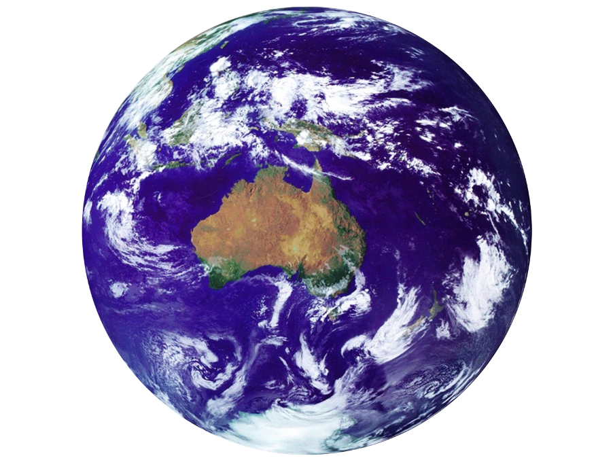
Climate Change
Our kids, their future?
Notes:
For PHYSCON Feb 2020

Slide 3
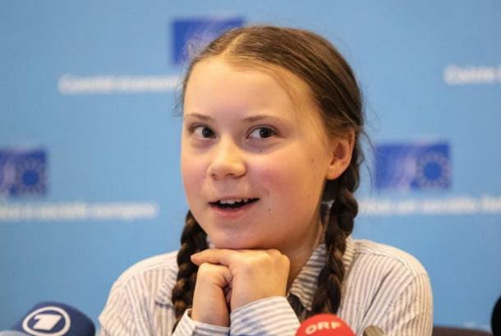
Notes:
Our students hear a lot of conflicting statements about their future under climate change. We need to help them understand the real science – and the real solutions. As Greta says, listen to the scientists!

Slide 4
Debate?
The ‘Echo chamber’

Slide 5
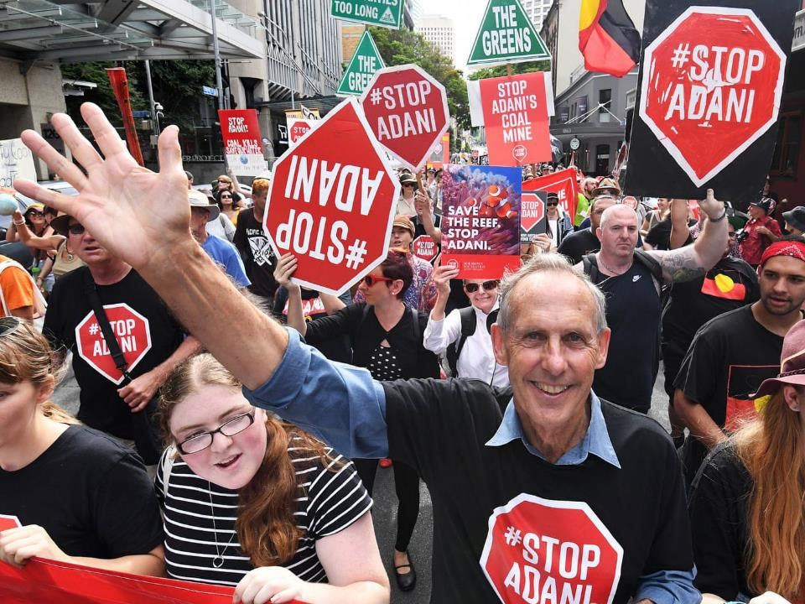
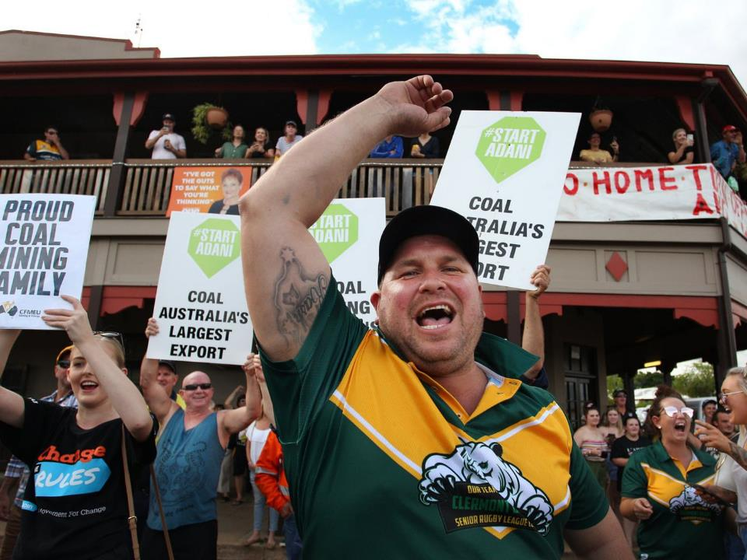
Notes:
One of the more unfortunate examples of an echo chamber. Unfortunately echo chambers simply cement both sides more firmly in their place. We desperately need communication.

Slide 6
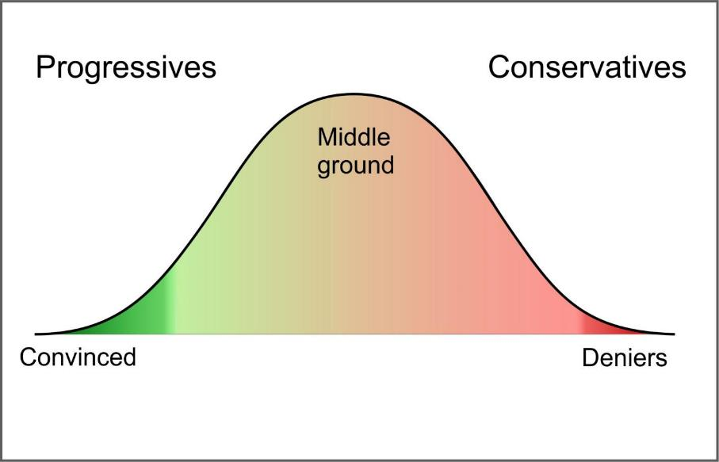
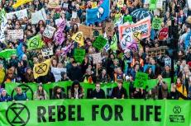
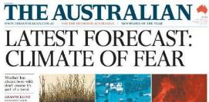
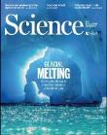
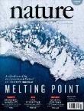
My view of the climate change spectrum
simple
^
“ ” “ ”
Unsure Cynics
Science (the facts)
Notes:
Belief in climate change becomes a function of your politics rather than your trust in scientists
There are lots more examples of echo chambers on both sides

Slide 7
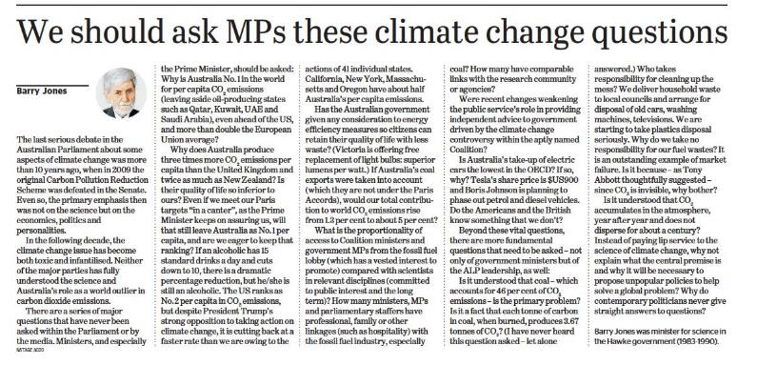
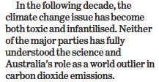
My view of what SHOULD happen!
Text
Unsure Cynics
Science (the facts)
Notes:
Science needs to reclaim the sceptical position – there are doubts!

Slide 8
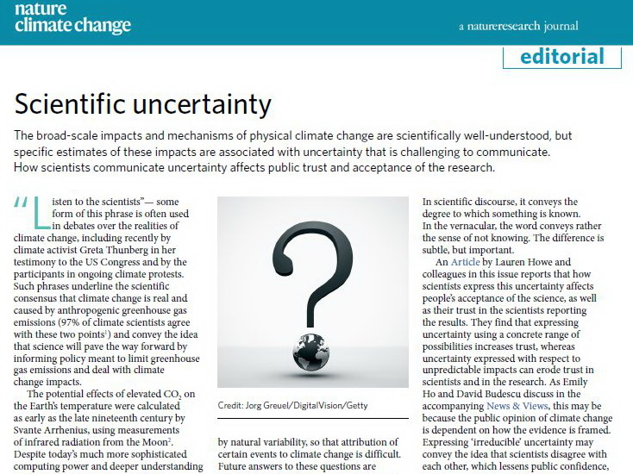
Notes:
The refrain that “the science is settled” has not done a lot of good – it is easy to see that it is NOT settled.
Uncertainty is used by deniers to suggest that we don’t really know whether it is real or not. We need to talk about uncertainty carefully and distinguish between things that are well known and those that are doubtful. A lot of the uncertainty is about just how bad it will be!
This is an area that we, as science teachers, can help clarify.

Slide 9
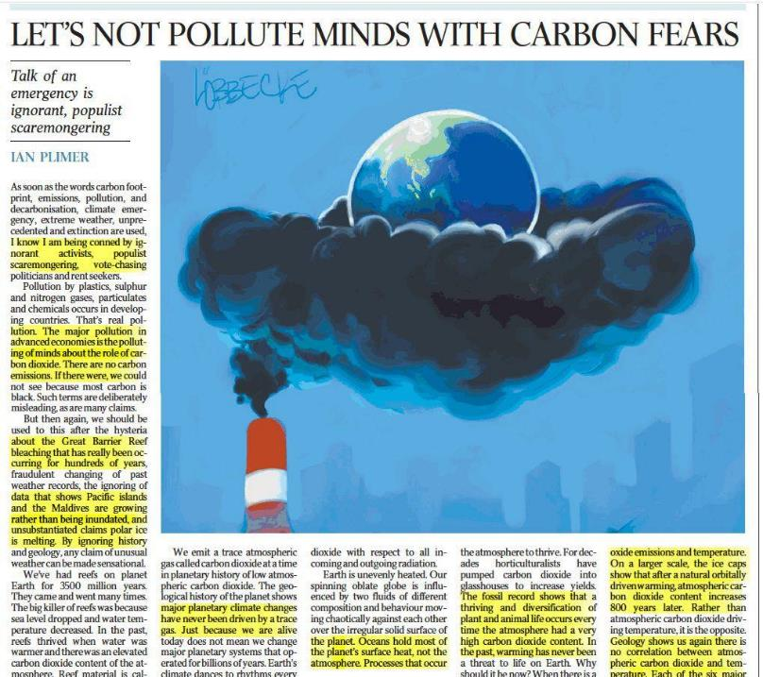
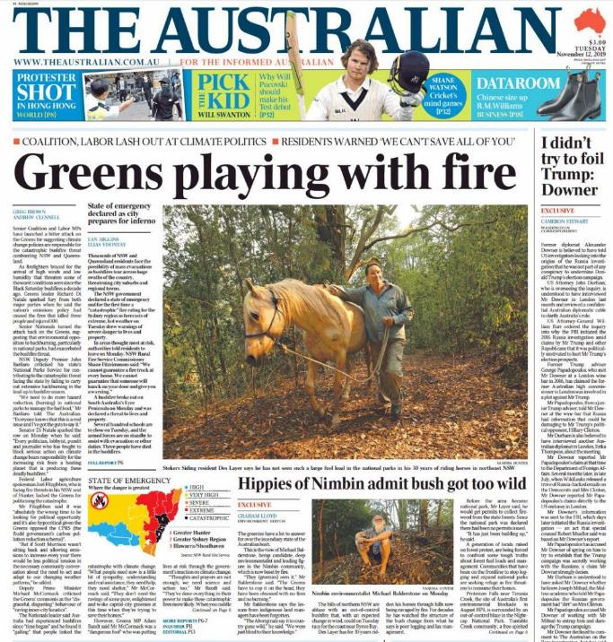
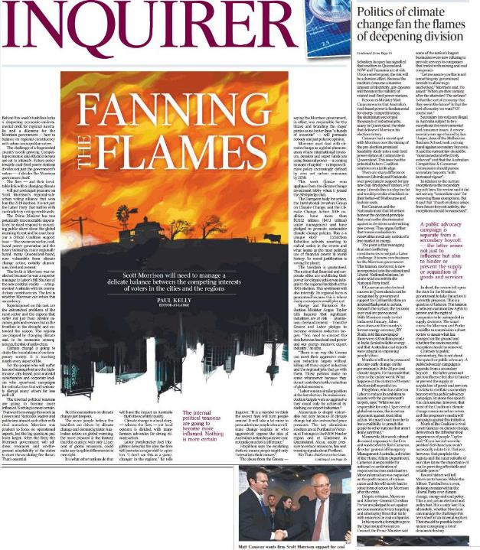
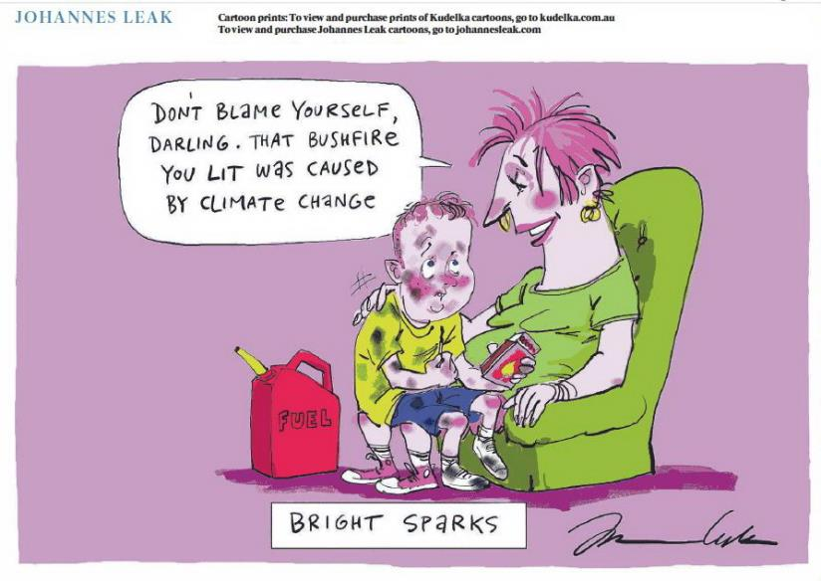
The really dangerous echo chamber

Slide 10
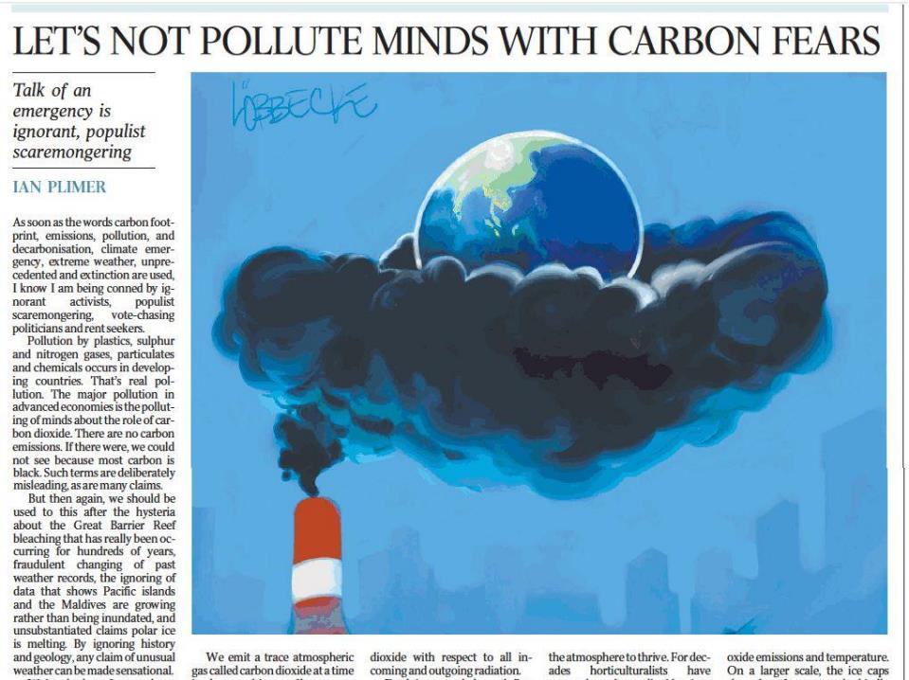
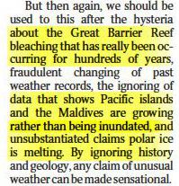
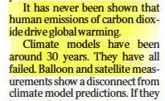
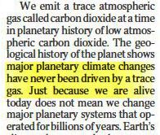
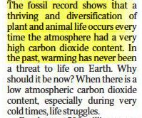
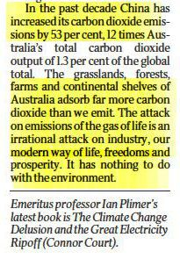
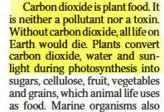
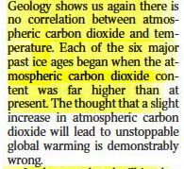
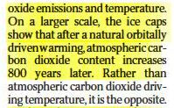
Notes:
Typical Oz articles question whether the GBR is bleaching, say climate models are hopeless, the climate has always changed, CO2 is a trace gas and anyway is good for us (despite being a trace gas!), no correlation between CO2 and temperatures, and we only emit 1.3% global emissions [but never say that’s from 0.3% population and we are highest per person!] This particular article is an APALLING example of the misinformation the Oz peddles. To say there is no correlation between CO2 and temperatures is nothing more than a direct lie!

Slide 11
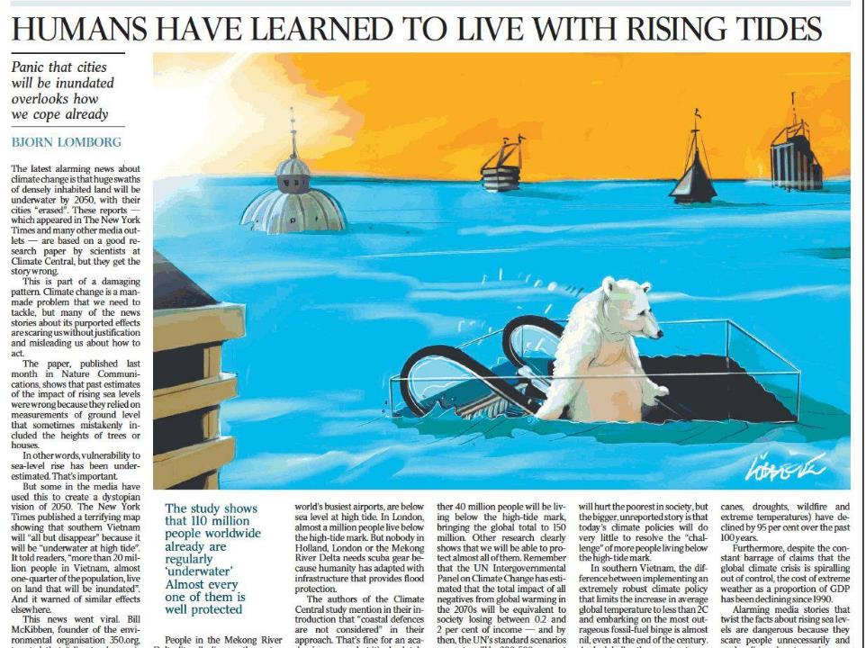
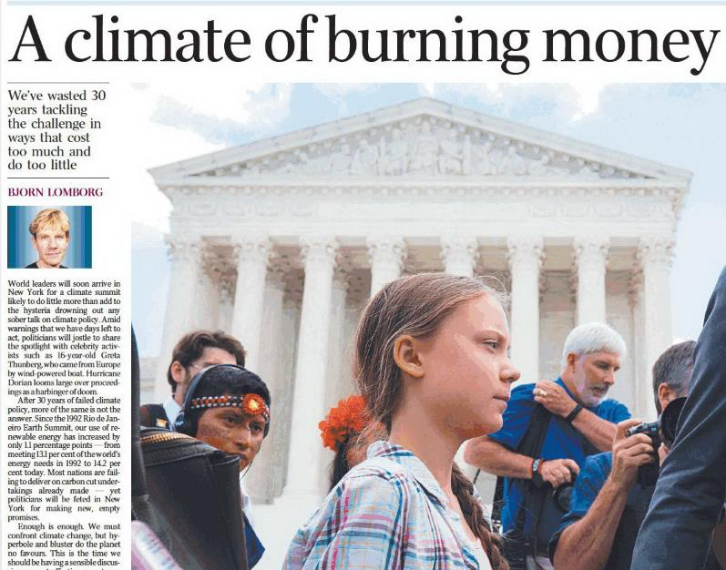
Notes:
Perhaps most dangerous is Lomborg who claims that
1. It won’t be that bad, we can adapt, we can cope already
2. Cost of action is less than possible harm, and anyway we should invest in research and wait until renewable is cheaper than conventional.
** What does he think is happening??!!!

Slide 12
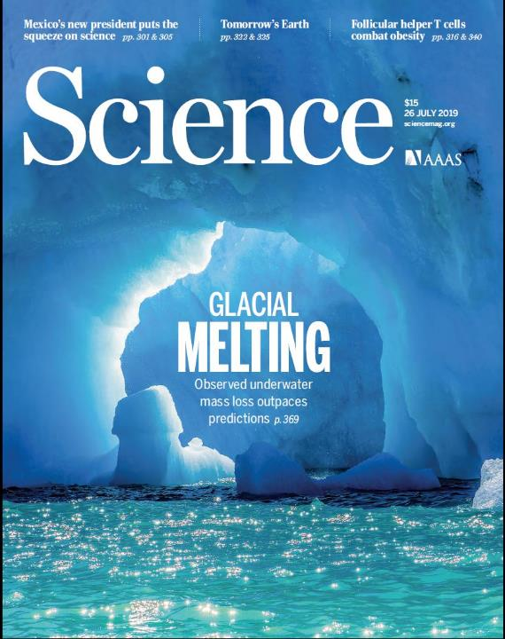
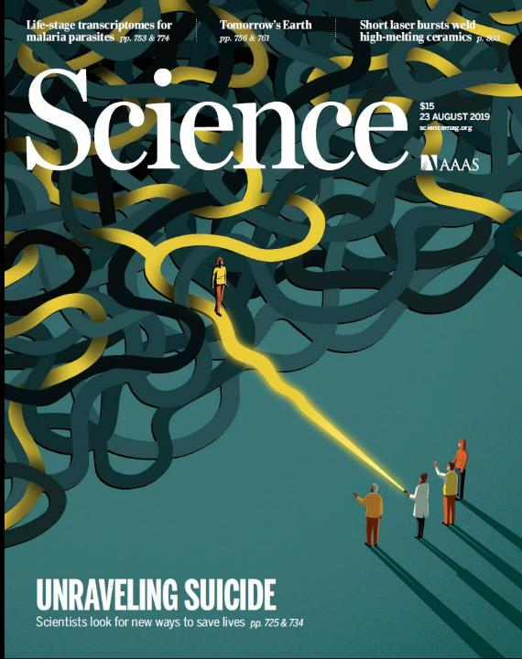
Where is the science?
Notes:
There are thousands of articles about climate change in the key science journals in the world, eg, Science (USA) and Nature (UK) – Not just one or two ‘cherry picked’ articles which are then exaggerated and distorted.
The figure of 97% (+) scientists accept the ‘consensus’ is probably an underestimate! The claim that it is less is based on the fact that a lot of the articles don’t claim AGW is human – that’s just because it is not contested, any more than papers about evolution don’t claim “Darwin was right”.

Slide 13
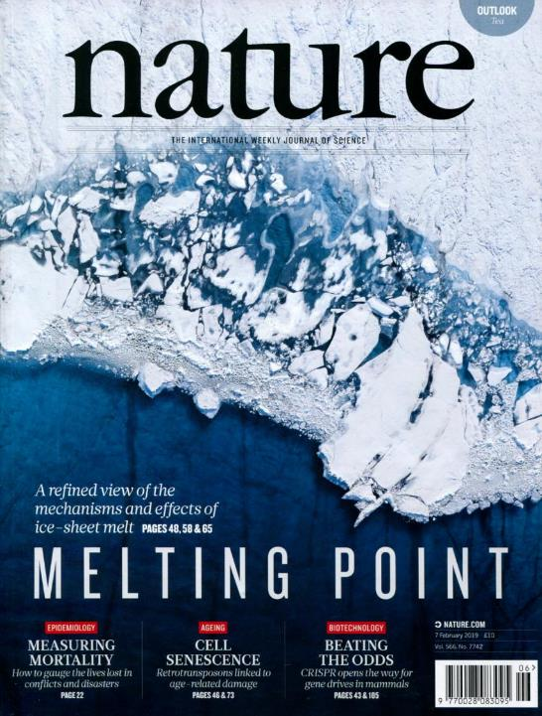
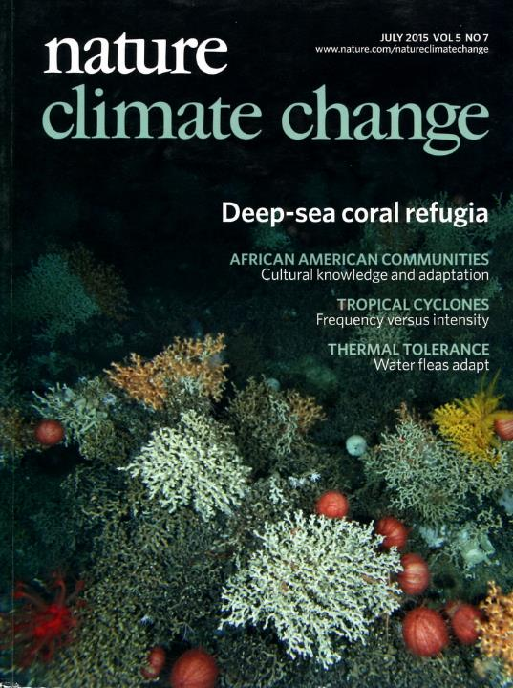
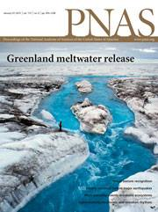
Where is the science?
Notes:
This should be all about science, not politics. Scepticism is fine – but look at ALL the science. That one’s views on a scientific matter should depend on one’s politics is an extremely worrying sign of a world going mad!
Apart from Science and Nature there are a lot of other more specialist journals saying the same thing

Slide 14
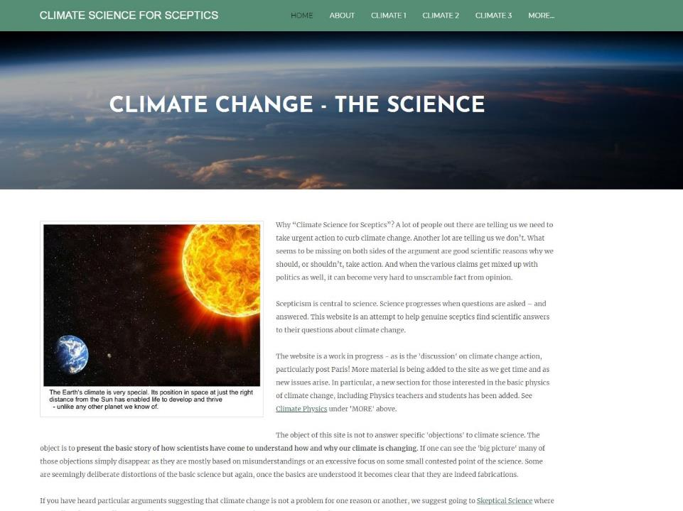
cs4s.net
“Scepticism” should belong to science, not deniers!
Notes:
Plimer and others call themselves sceptics – but they only ever look at the (tiny bit of) science that supports their case and ignore that vast bulk of the science. Scepticism is important in science! It is always good to question generally accepted ideas. BUT – it is important to look at ALL the evidence, not just the bit that suits one’s point of view.

Slide 15
Notes:
This is just an overview of the presentation on climate science referred to at STAVCON Nov 2019. You can download it from cs4s.net on the MORE/REFERENCES page. The following few slides are some of the key slides from this presentation.

Slide 16
Looking at the past – the big picture
Pliocene
CO₂ ~400ppm
Sea levels
~40 m higher
LIG CO₂~280ppm 130,000 yr ago About +1ºC
Sea ~8m higher
Holocene
10,000 yrs of stable climate
+3°C
+2°C
+1ºC
LIA & MWP
Human civilisation
Notes:
This is one of the slides from the ppt referred to on the last slide. The original has more animation. LIG Last InterGlacial 150,000 – 100,000 yr ago. CO2 similar to pre-industrial (280 ppm) temperatures only about 1 deg higher (ie about same as now!) but sea levels around 6 – 9 m higher than now.
Pliocene, 2-3 million yr ago – similar to now CO2, only a couple of degrees warmer, but sea level about 25 – 40 m higher, little polar ice, …. Etc!! ??
NB: In actual presentation there is a fair bit of animation so look at the presentation, not just the slides.

Slide 17
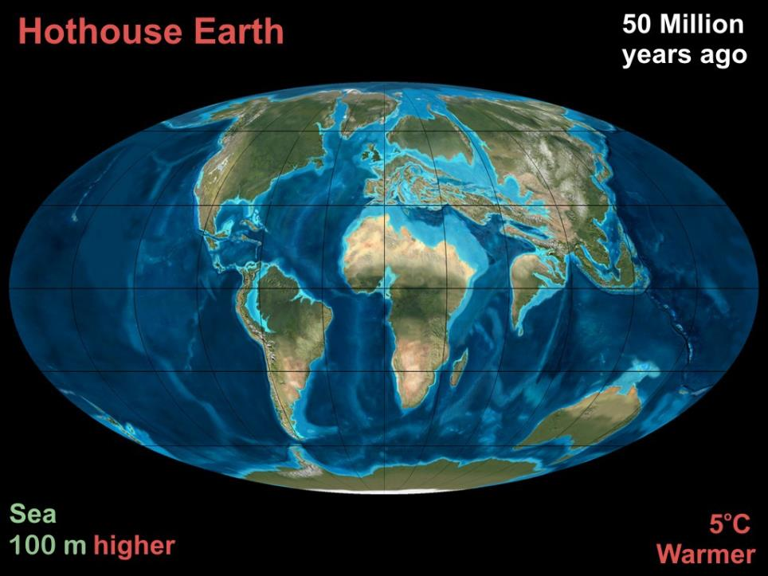
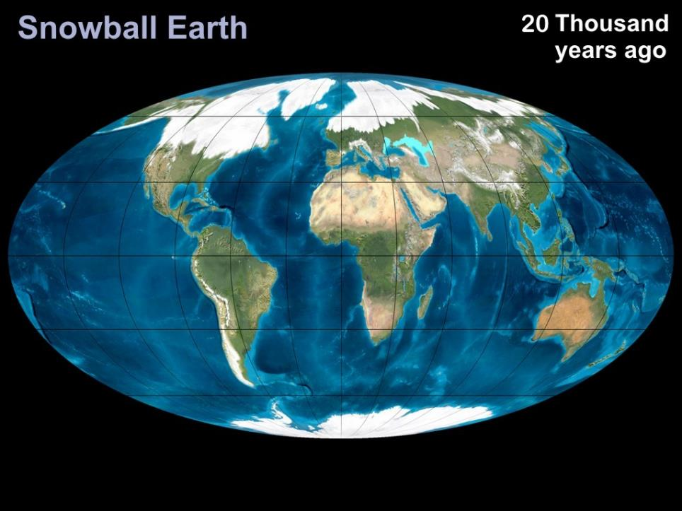
Last Ice Age
About 5ºC cooler Sea levels 100M LOWER
Notes:
JUST 20,000 years ago. Most of northern hemisphere countries under ice. You could walk to Tasmania or PNG - people did.

Slide 18
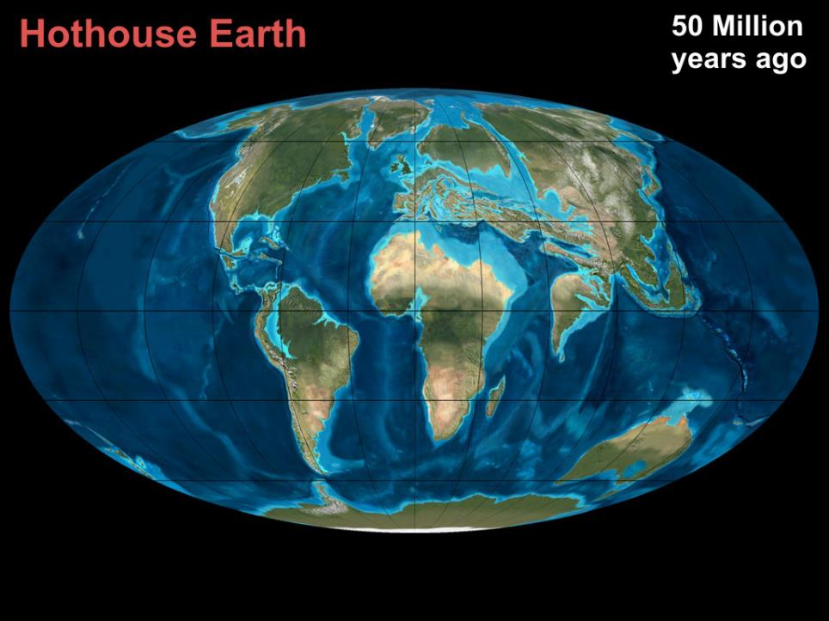
Eocene
About 5ºC warmer Sea levels 100M HIGHER
Notes:
For most of its life Earth has been hotter than now. Eocene was a full hothouse, but it has been warmer than now quite a lot. Most of Melbourne would be well under water. Shoreline around the foothills of the Dandenongs. Large inland Australian sea. Large areas of Europe, Middle east, Asia underwater.
Would take centuries or millennia to reach that stage, but do we want to condemn future generations to ever changing sea levels and climate? And we would have BIG problems with SLR of one metre – much less 100 metres.

Slide 19
Notes:
We have added a thousand billion tonnes of CO2 to the atmosphere (trillion tonnes) and it only started off with a bit over two thousand billion tonnes.
CO2 from land is increasing because we are clearing land and planting less
CO2 going into the ocean from the atmosphere is decreasing because more is going in from our emissions (decreasing the pH) and the ocean is warming.
(Ocean is warming but concentration of CO2 in the atmosphere is increasing at a faster rate.)
Note that every year around 770 gtn CO2 go in and out of the biosphere, our 40 gtn is “only” about 5% of that – hence the deniers that we only produce 5% of the greenhouse gas going into the biosphere. BUT…

Slide 20
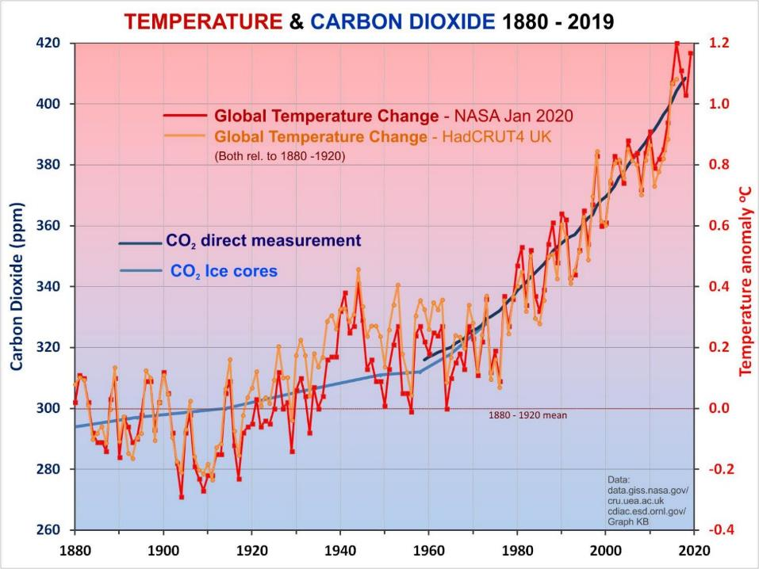
Notes:
So what is actually happening?
Temperatures (red, orange) have gone up pretty much in line with the CO2 (blue) as expected
To suggest that the short term flattening in the last couple of decades says anything about the long term trend is clearly nonsense!
What about the longer term? Is there a connection between CO2 and temperature? …

Slide 21
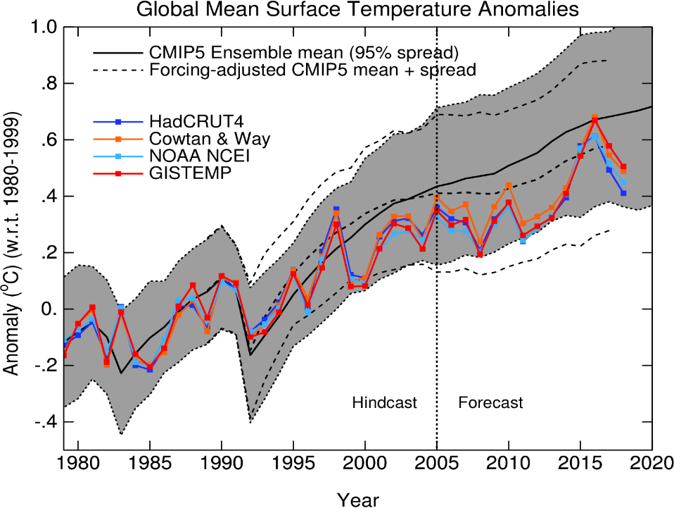
Notes:
Deniers often just look at the bit from 1998 on to2015 (not 2016!) and say the models are wrong but don’t realise there is a lot of natural variation and any one model run can be very variable – shaded area! Black line is only the average.

Slide 22
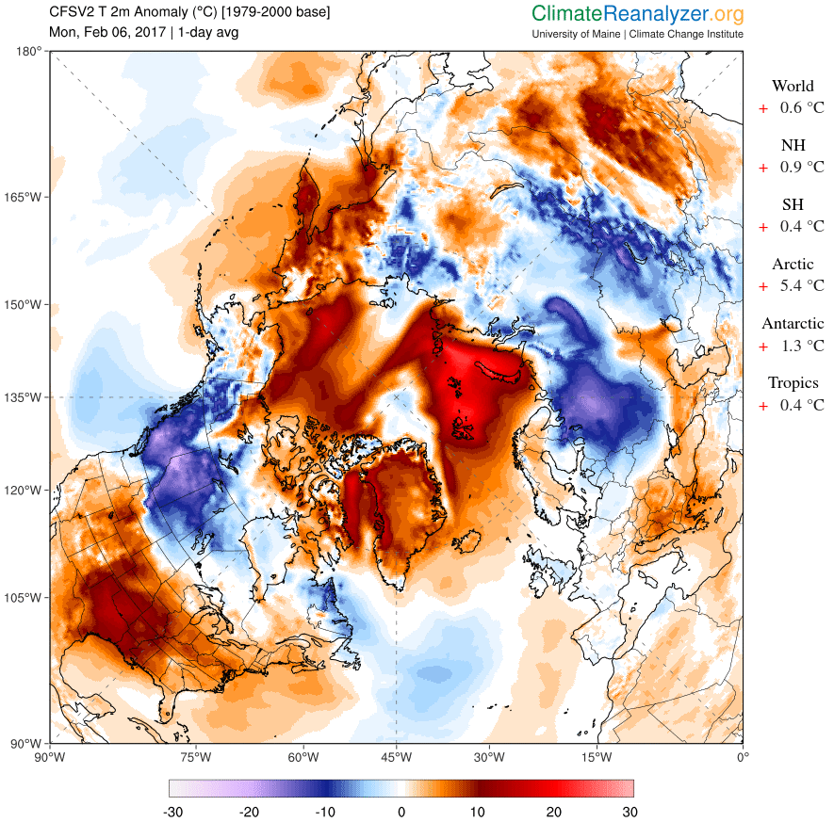
Alaska
Arctic
Greenland
New York
Temperature Anomaly
Notes:
Arctic is warming faster than elsewhere! This is why parts of the US have experienced very cold spells! Arctic weather is being pushed further south.

Slide 23
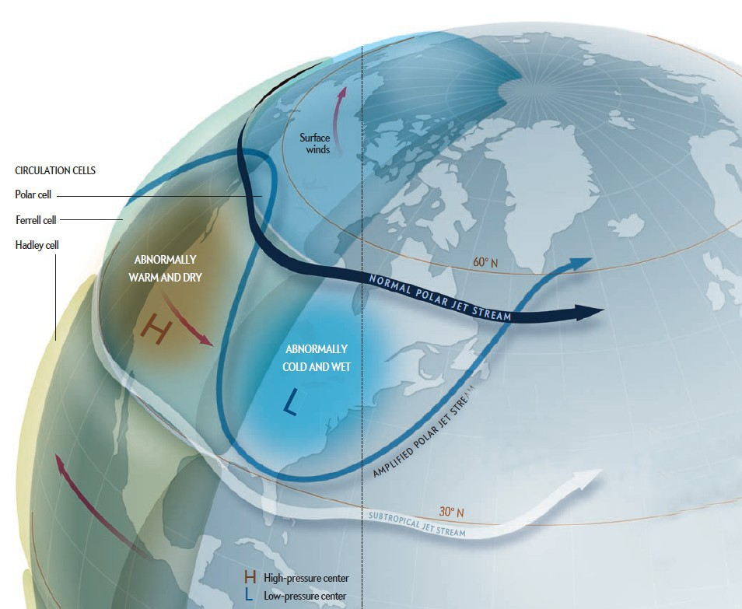
More solar heat absorbed by dark water
STRONGER WINDS
WARMER
Normal jet stream
COLDER
Stronger jet stream
Notes:
Arctic is warming faster than elsewhere! This is why parts of the US have experienced very cold spells! Arctic weather is being pushed further south.

Slide 24
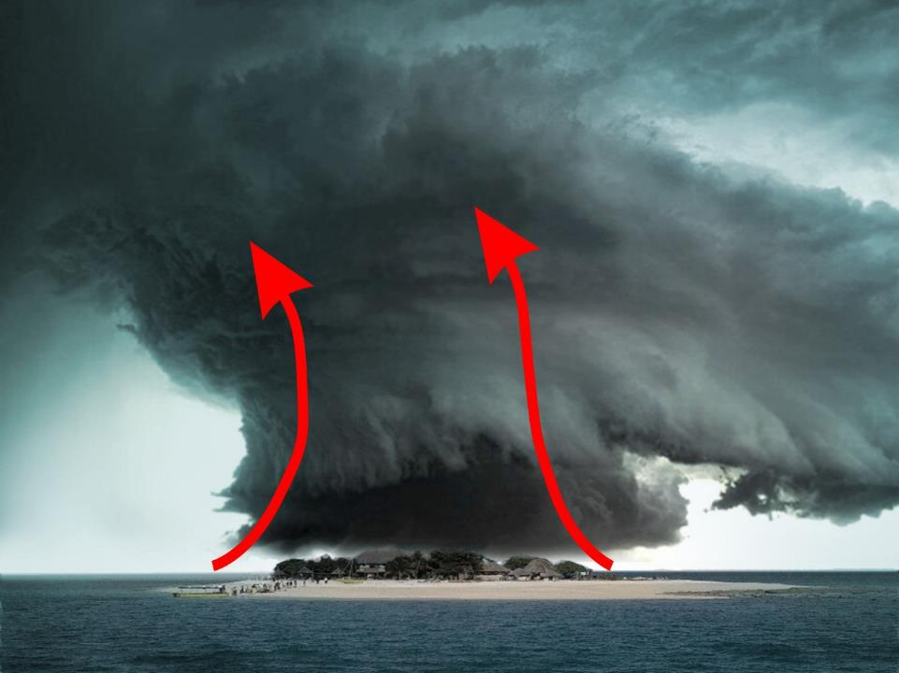
Whole system spins as a result of Earth’s rotation
Heat drives moist air upwards
Moist air condenses releasing heat
Warm water evaporates
Notes:
The heat in the warmer ocean drives hurricanes and cyclones harder.

Slide 25
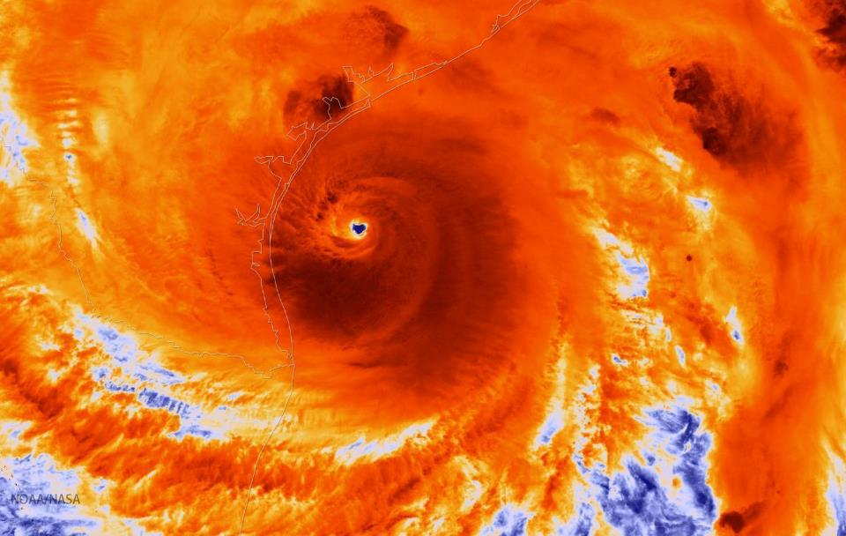
Hurricane Harvey in infrared
Hurricanes are powered by heat from the ocean
Warmer centre drives stronger winds and rain
Notes:
We don’t really know how much global warming has increased the severity of hurricanes and cyclones. But we do know that they get their energy from warmer water, and we know that the oceans are warmer than they have ever been (in human times). Although the frequency of cyclones and hurricanes has not changed much the severity has.

Slide 26
Notes:
Why ice sheets will keep melting for centuries to come The Conversation September 26, 2014 Eelco Rohling, Professor of Ocean and Climate Change, University of Southampton. Ice sheets respond slowly to changes in climate, because they are so massive that they themselves dominate the climate conditions over and around them. But once they start flowing faster towards the shore and melting into the ocean the process takes centuries to reverse. Ice sheets are nature’s freight trains: tough to start moving, even harder to stop. Also a number of more recent articles in Science and Nature.

Slide 27
Ice sheets ARE melting!
Eqi Glacier in Greenland
Notes:
Face of this glacier is 200 m high. Slabs constantly fall off. (KB photos)

Slide 28
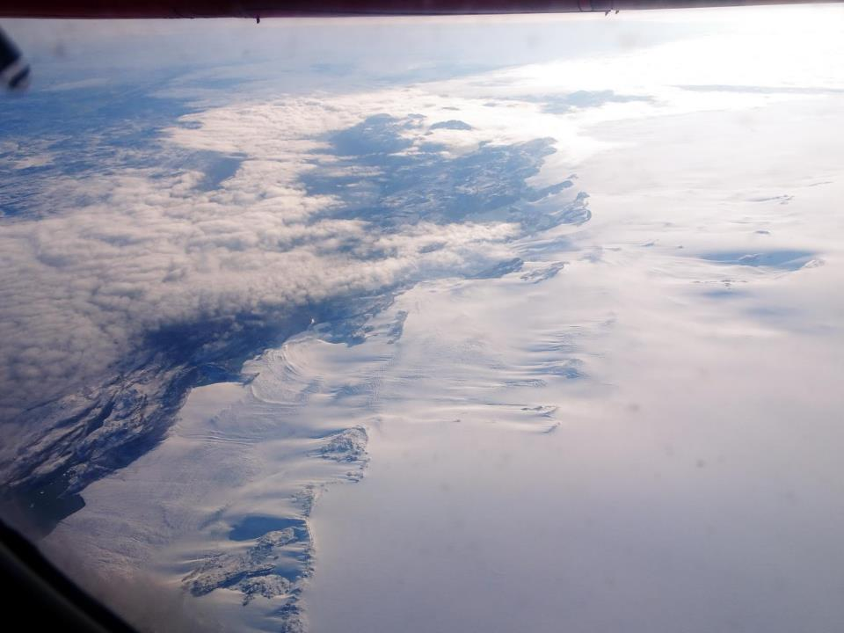
Notes:
Edge of the Greenland ice sheet (KB)

Slide 29
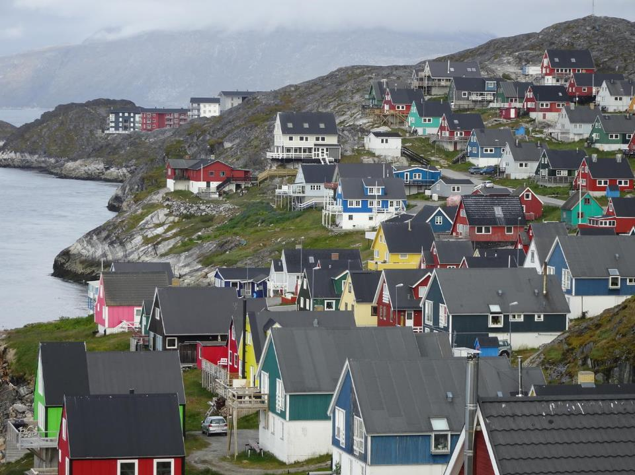
Notes:
Nuuk, capital of Greenland

Slide 30
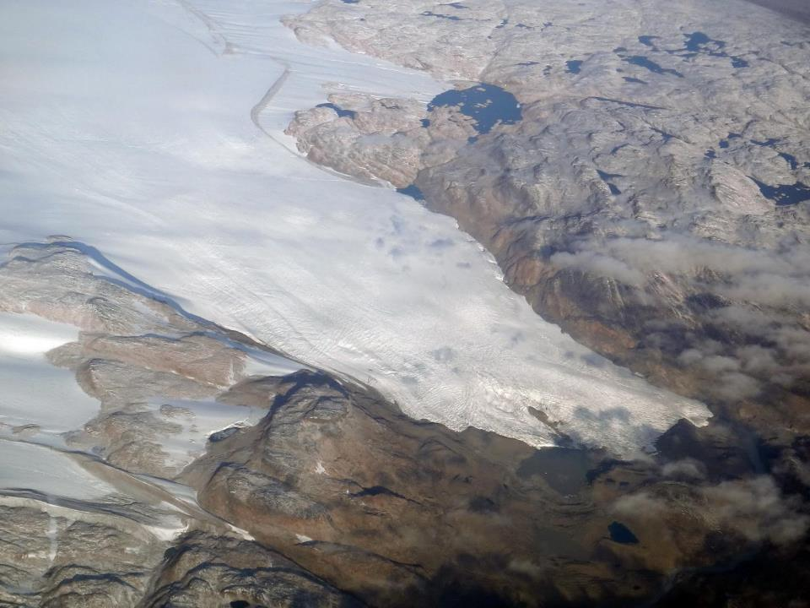
Notes:
One of the many glaciers leading off the Greenland ice sheet. Some end inland and flow to the sea as rivers, others like Eqi (previous) calve straight to the sea.

Slide 31
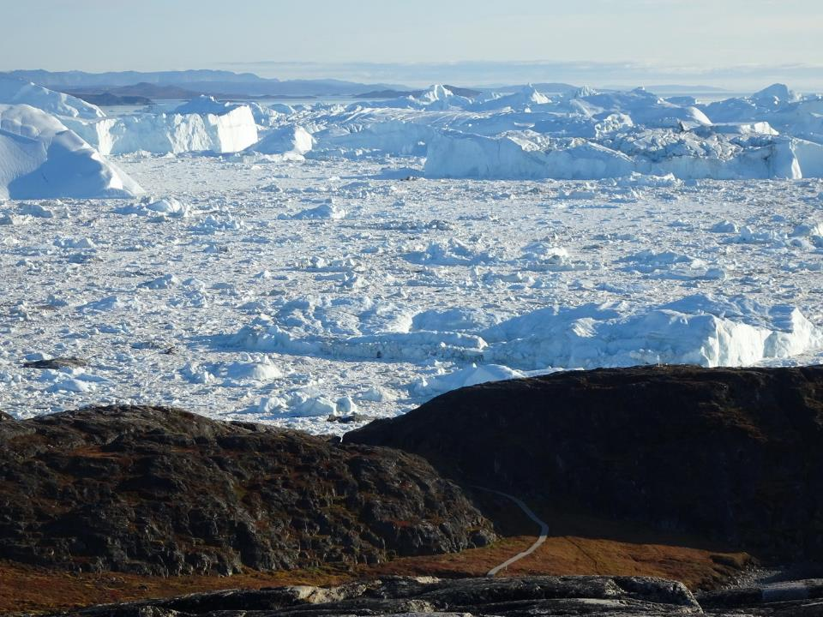
Jakobshavn, the largest, fastest glacier in Greenland
Notes:
Near Ilulissat

Slide 32
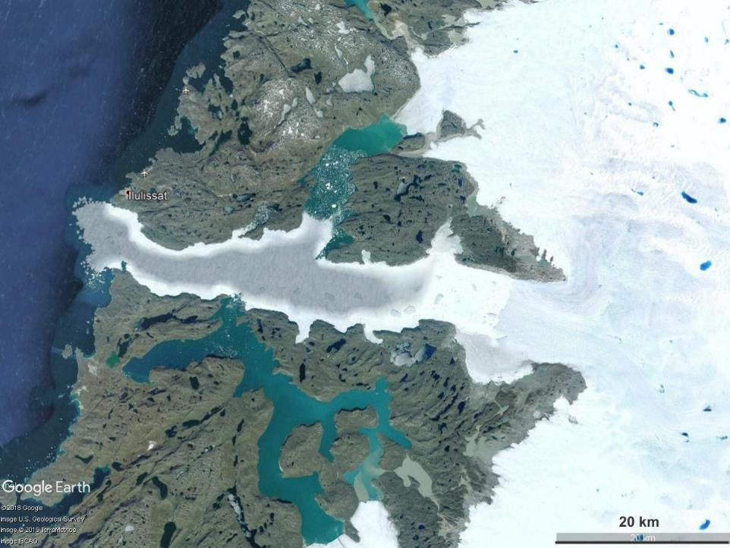
Jakobshavn
Notes:
Google Earth It releases 100 million tonnes of ice every day.

Slide 33
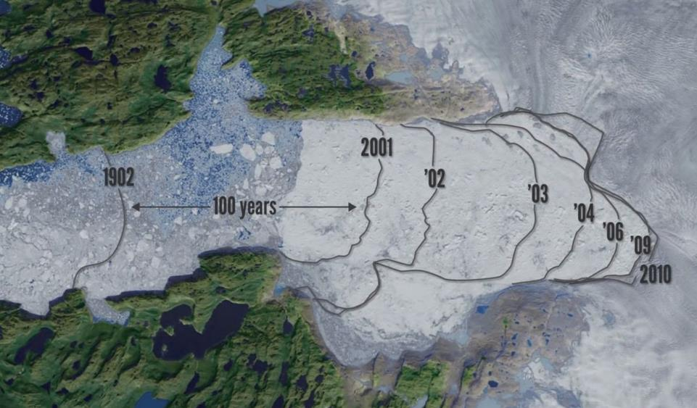
Jakobshavn, the largest, fastest glacier in Greenland
Carving face recession 1902 - 2010
20 km
Notes:
It took all last century to recede 20 km. It receded more than that in the first ten years of this century.

Slide 34
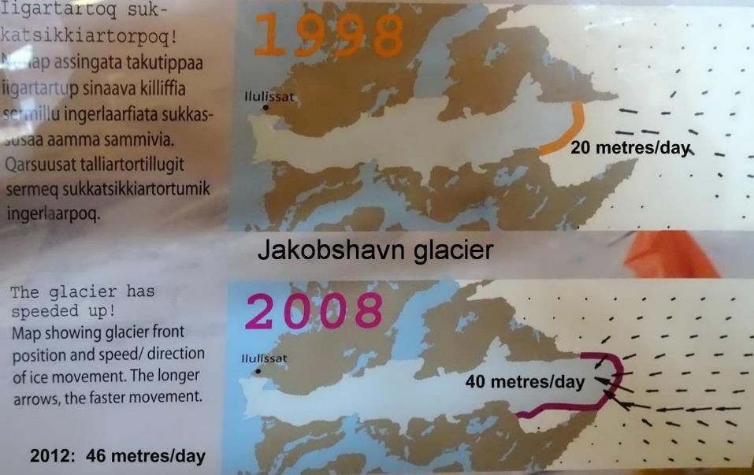
Jakobshavn, the largest, fastest glacier in Greenland
Notes:
(KB photos – in airport lounge, Ilulissat) In recent years it has slowed a little because of a cooler ocean current entering the region, but that will flip and the speed will get even greater.
SEE https://climate.nasa.gov/news/2882/jakobshavn-glacier-grows-for-third-straight-year/ for more on that.

Slide 35
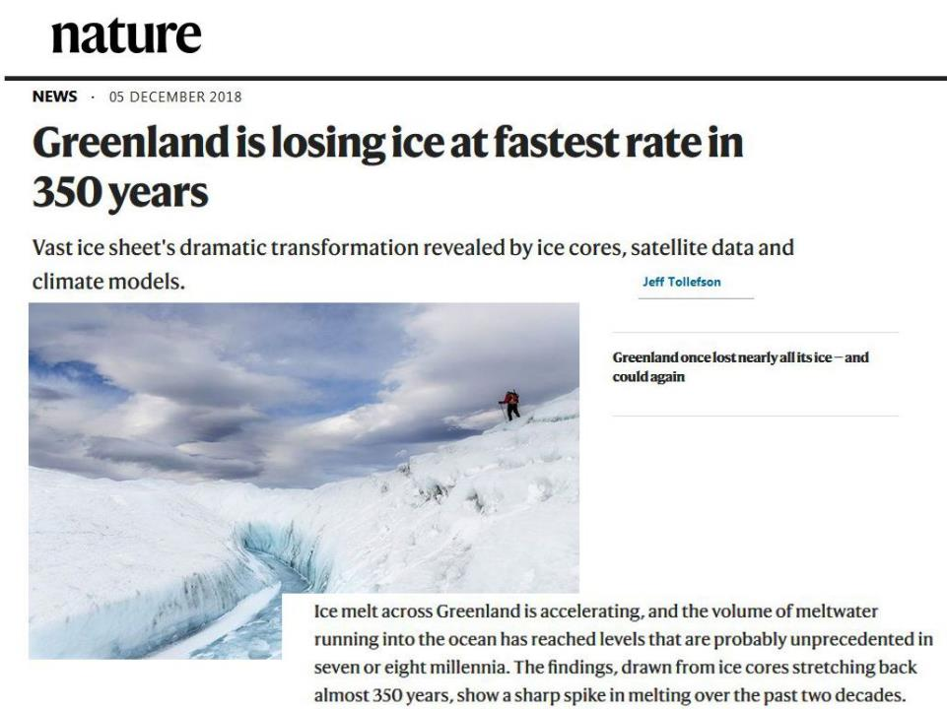

Slide 36
We detect widespread ice-covered valleys that extend significantly deeper below sea level and farther inland than previously thought. Our findings imply that the outlet glaciers of Greenland, and the ice sheet as a whole, are probably more vulnerable to ocean thermal forcing and peripheral thinning than inferred previously from existing numerical ice-sheet models.
Notes:
Deeply incised submarine glacial valleys beneath the Greenland ice sheet M. Morlighem, E. Rignot, etal
Nature Geoscience volume 7, pages 418–422 (2014): The bed topography beneath the Greenland ice sheet controls the flow of ice and its discharge into the ocean. Outlet glaciers move through a set of narrow valleys whose detailed geometry is poorly known, especially along the southern coasts. As a result, the contribution of the Greenland ice sheet and its glaciers to sea-level change in the coming century is uncertain. Here, we combine sparse ice-thickness data derived from airborne radar soundings with satellite-derived high-resolution ice motion data through a mass conservation optimization scheme. We infer ice thickness and bed topography along the entire periphery of the Greenland ice sheet at an unprecedented level of spatial detail and precision. We detect widespread ice-covered valleys that extend significantly deeper below sea level and farther inland than previously thought. Our findings imply that the outlet glaciers of Greenland, and the ice sheet as a whole, are probably more vulnerable to ocean thermal forcing and peripheral thinning than inferred previously from existing numerical ice-sheet models.

Slide 37
Notes:
Not just Greenland! Science 365 (6451), Underwater melting: How fast does warm ocean water melt glaciers that terminate in the sea? That question is central to understanding how fast ice sheets may lose mass, and thus how fast sea level will rise, in response to global warming, but there are few data about the process. Sutherland et al. used repeat multibeam sonar surveys to observe an Alaskan subsurface tidewater glacier face to create a time series of its melting and calving patterns. They observed melt rates up to a hundred times larger than those predicted by theory, observations that compel us to reevaluate predictions of such ice loss.
Abstract:
Ice loss from the world’s glaciers and ice sheets contributes to sea level rise, influences
ocean circulation, and affects ecosystem productivity. Ongoing changes in glaciers and
ice sheets are driven by submarine melting and iceberg calving from tidewater glacier
margins. However, predictions of glacier change largely rest on unconstrained theory for
submarine melting. Here, we use repeat multibeam sonar surveys to image a subsurface
tidewater glacier face and document a time-variable, three-dimensional geometry linked
to melting and calving patterns. Submarine melt rates are high across the entire ice face over
both seasons surveyed and increase from spring to summer. The observed melt rates are up
to two orders of magnitude greater than predicted by theory, challenging current simulations of
ice loss from tidewater glaciers.

Slide 38
100 times
as fast!
Notes:
Science 365 (6451), Underwater melting: How fast does warm ocean water melt glaciers that terminate in the sea? That question is central to understanding how fast ice sheets may lose mass, and thus how fast sea level will rise, in response to global warming, but there are few data about the process. Sutherland et al. used repeat multibeam sonar surveys to observe an Alaskan subsurface tidewater glacier face to create a time series of its melting and calving patterns. They observed melt rates up to a hundred times larger than those predicted by theory, observations that compel us to reevaluate predictions of such ice loss.
Abstract:
Ice loss from the world’s glaciers and ice sheets contributes to sea level rise, influences
ocean circulation, and affects ecosystem productivity. Ongoing changes in glaciers and
ice sheets are driven by submarine melting and iceberg calving from tidewater glacier
margins. However, predictions of glacier change largely rest on unconstrained theory for
submarine melting. Here, we use repeat multibeam sonar surveys to image a subsurface
tidewater glacier face and document a time-variable, three-dimensional geometry linked
to melting and calving patterns. Submarine melt rates are high across the entire ice face over
both seasons surveyed and increase from spring to summer. The observed melt rates are up
to two orders of magnitude greater than predicted by theory, challenging current simulations of
ice loss from tidewater glaciers.

Slide 39
Why ice sheets are melting fast
NASA/Goddard Space Flight Center Conceptual Image Lab
Notes:
Accelerating Ice Sheet
Animations by Susan Twardy Released on August 29, 2007 NASA_a10153_H264_30fps.mp4
During the summer melt season, melt water accumulates in undulations on the surface of the Greenland ice sheet. Eventually, these melt lakes drain through crevasses or moulins (tunnels under the ice sheet surface), delivering water to the bottom of the ice sheet. This melt water lubricates the interface between the ice and the bedrock, causing the ice to flow faster toward the sea during summer. As summer melt increases and more melt water is available, the greater its effect on summer ice sheet flow rates.

Slide 40
At the other end of the Earth...
East
Larsen
West
Thwaites
Totten
Ross
Notes:
the Thwaites Glacier, a keystone holding the massive West Antarctic Ice Sheet together, is starting to collapse. In the long run, they say, the entire ice sheet is doomed, which would release enough meltwater to raise sea levels by more than 3 meters

Slide 41
Notes:
This article suggests this would take centuries, but this is only the WAIS. When the rest of Antarctica and Greenland are added, some scientists are saying it could be 2 or 3 metres by end of century!
SEE: https://www.sciencemag.org/news/2015/11/just-nudge-could-collapse-west-antarctic-ice-sheet-raise-sea-levels-3-meters

Slide 42
Notes:
This article suggests this would take centuries, but this is only the WAIS. When the rest of Antarctica and Greenland are added, some scientists are saying it could be 2 or 3 metres by end of century!
SEE: https://www.sciencemag.org/news/2015/11/just-nudge-could-collapse-west-antarctic-ice-sheet-raise-sea-levels-3-meters

Slide 43
Notes:
ie. Losing one or two hundred billion tonnes of ice each year. Big problem is we don’t know how quickly warmer water is getting underneath the land ice (some of which is below sea level) and speeding up the glaciers.

Slide 44
Notes:
Earlier models simply had ice melting largely from the top and from warmer water. But it has been realised that it is more complex. Warmer water is melting from underneath and furthermore is pushing the ‘grounding line’ further back. This means that the overhanging ice shelf is more likely to break of – thus releasing more ice from the glaciers behind it.
Big problem is we don’t know how quickly warmer water is getting underneath the land ice (some of which is below sea level) and speeding up the glaciers.

Slide 45
Notes:
Earlier models simply had ice melting largely from the top and from warmer water. But it has been realised that it is more complex. Warmer water is melting from underneath and furthermore is pushing the ‘grounding line’ further back. This means that the overhanging ice shelf is more likely to break of – thus releasing more ice from the glaciers behind it.
Big problem is we don’t know how quickly warmer water is getting underneath the land ice (some of which is below sea level) and speeding up the glaciers.

Slide 46
Notes:
Figure 4d: Deglaciation episodes in the last 500 kyr. Maximum sea-level rise rates are plotted against: (c,d) lag between the onset of deglaciation pulses (d) and peak sea-level rise rates. The cumulative distribution of the number of deglaciation events/pulses as a function of lag is shown in c,d (solid red line), where the 68, 85 and 95% levels (red dashed lines) and corresponding lag intervals (orange shadings) are indicated.

Slide 47
Earth’s climate – looking at the past
The last ‘interglacial’ – similar to current climate.
Maybe ~ 1 - 2°C warmer than last century
… ie. about where we are now

Slide 48
July
2009
“Paul Blanchon's team at the National University of Mexico has been studying 121,000 year old coral reefs in the Yucatan Peninsula, formed during the
last interglacial period when sea level peaked at around 10 metres higher than today. His findings suggest that at one point the sea rose 3 metres within 50 to 100 years.”
Temperatures in that interglacial were only a couple of degrees warmer than the 20th C.
Notes:
Abrupt climate changes have occurred in the past. We should not think that it can’t happen again. 3 m this century would be absolutely catastrophic. And that’s just the sea rise – add to that the changes in land fertility and ecosystem collapse. SEE New Scientist: Sea level rise: It's worse than we thought * 01 July 2009 by Anil Ananthaswamy New Scientist issue 2715.

Slide 49
Problem is, every new discovery INCREASES the expected sea level rise!
Notes:
Some scientists are saying it could be 2 or 3 metres by end of century! SEE:
https://www.sciencemag.org/news/2015/11/just-nudge-could-collapse-west-antarctic-ice-sheet-raise-sea-levels-3-meters

Slide 50
In the LIG (last inter-glacial) sea levels were up to 10 metres higher than now ...
and temperatures about the same as now
... but much LESS CO₂ !
Notes:
Temperatures around 1 – 2 deg hotter than 1900’s ie about the same as now or a degree more.
We don’t know how long it would take for this sort of rise – probably 2 or 3 centuries, but could be next century!
We don’t know how fast the ice on Greenland and Antarctica will take to melt – but doesn’t have to melt, simply slide off the land into the ocean.

Slide 51
As if that’s not enough!
Decreasing weight of ice releases the pressure on the volcanoes
Notes:
Unknown – but another example of possible unexpected consequences

Slide 52
Bangladesh - Ganges delta
Croplands only 1 or 2 metres above SL
In the LIG sea levels were around 6 to 9 metres higher than now
Notes:
Huge low lying croplands of Asia would be inundated leading to mass starvation – and thus terrorism!

Slide 53
Areas which are only 1 or 2 metres above SL
Notes:
Huge low lying croplands of Asia would be inundated leading to mass starvation – and thus terrorism!

Slide 54
Nature 28 Nov 2019
Notes:
Tipping points SEE Nature 28 Nov 2019 – or email me for a copy if you can’t access it!
keithbphysics@gmail.com or through cs4s.net

Slide 55
What can we do about it?
Become aware!
Talk with others
Email politicians
Vote for the right politicians!
Notes:
The following slides are not well sorted, but show some of the things Australia should be doing.

Slide 56
Australian Solutions - solar!
Notes:
Australia has one of the best solar resources in the world. Note that our average irradiance is over 200 W/m². Germany, the world’s leader in solar PV, only has about half our solar radiation! We have lost the lead that we once had and it will be difficult to regain, but we could become one of the biggest producers of solar energy. If some sort of fuel can be produced from solar energy (hydrogen or ....) we could become a huge exporter of energy.

Slide 57
Australian Solutions - solar!
The yellow square is about 100 km per side
Receives ~200 PJ (av) of solar energy per day
Ample for ALL of Australia’s energy (at only 5% collection efficiency).
[A large city uses around 1 PJ of electricity
per day]
TOTAL Australian energy use:
~ 11 PJ per day = 120 GW
That is about 80 ‘Hazelwoods’ (1.6 GW)
Notes:
Australia’s total end use energy is of the order of 4000 PJ per year (after conversion losses etc) [1 PJ = 10¹⁵ joules]
This is 11 PJ/day or an average power of 120 GW [1 PJ/day = 1000000 GJ per (24x3600) sec = 11.6 GW]
120 GW is equivalent to about 80 Hazelwood power stations (1.6 GW)
Sunlight falls on Australia at an average rate of 250 W/m² (day/night/year average) which is 250 MW per sq km
And so area of 100 km x 100 km receives around 250 x 10,000 MW = 2500 GW or about 20 times the total needed.
This is over 200 PJ/day
So even at only 5% collection efficiency that area is ample for ALL of Australia’s energy needs.
[It is not suggested that we have one big station where that square is! It would be dispersed around the country nearer to major cities. Remember that a large city needs around 1 PJ per day.]
ABARE says Aus total electricity generation is 260 TWh/yr (2007) = 2.6 PJ/day (presumably after conversions losses) [1 TWh = 3.6 PJ]
Figure of 11 PJ/day is probably after conversion losses.

Slide 58
120 GW

Slide 59
Notes:
Graph by KB based on various different estimates including the Worley-Parsons report. There are wide differences in these sorts of estimates depending on the source of gas. Some suggest that gas could be as bad or even worse than coal – depending on the fugitive emissions.

Slide 61
Notes:
SuperPower – Australia’s low-carbon opportunity. Black Inc. $30

Slide 62
Utility = “Human welfare”
“Normal expectation”
Economic “progress”
GDP ??
As climate change kicks in, welfare will drop
Notes:
We are talking here about the way economists define “human welfare” – it is not necessarily the same way as many of us would. It is more than just ‘GDP’, and hopefully includes some cultural, environment aspects. But many aspects of our ‘welfare’ will be damaged by climate change.

Slide 63
? ?
Notes:
Many of us think that we should be taking stronger action sooner! Yes, it would result in more ‘costs’ now, but it would both bring forward the ‘crossover’ and result in greater utility beyond the crossover.
The probable dates for the crossover points depend on many things – notably how soon climate impacts start to occur, and of course the cost of taking mitigation action.
We will come back to that question! The ‘Four types’ [next slide] take into account the factors that are harder to account for.

Slide 64
Reasonably predictable consequences of CC.
Costs of CC difficult to include in economics.
Outcomes might be less or more severe than climate models predict.
‘Non-market’ values – environmental amenity, avoidance of trauma in other countries. Values of future generations of Australians
Notes:
Median expectations of the science of CC (The only ones the likes of Lomborg and co take any notice of!)
Difficult to measure consequences (‘unprecedented’)
Unpredictable but possibly catastrophic changes.
Values hard to place an economic value on – environment etc
Type 1 covers costs of climate change that are amenable to reasonably precise measurement using market prices. They are built around average (median) expectations of the science of climate change. [Costs of storms, fires, flooding, etc.]
Type 2 covers costs of climate change that are of a conventional economic kind but for which there is insufficient data to allow precise measurement through an economic model [‘unprecedented’ storms, droughts, fires, etc.]
Type 3 effects occur because outcomes may be much more benign or much more severe than the average suggested by scientific analysis. I noted that humans place greater weight on possible catastrophic outcomes than on a similar chance of an exceptionally favourable outcome. [If permafrost thaws faster or if ice melts faster]
Type 4 effects recognise that Australians value many things other than their own material standard of living. Examples of such non-market values include environmental amenity, including conservation of species; physical and cultural human heritage; and avoidance of trauma and poverty in other countries. I noted that what matters most is how future generations of Australians, experiencing the full force of climate change, will value these things. [Maybe we will become more caring about what happens to others!]

Slide 65
The view from 2011
2030 – 2050 ?
? ?
Notes:
When Garnaut did his 2011 report he thought the crossover would be in two or three decades, or even more. But…

Slide 66
But by 2020 …
Notes:
Since that time there has been an unexpected jump in the amount of wind and solar installed.

Slide 67
Notes:
Since that time there has been an unexpected jump in the amount of wind and solar installed. Most of the solar was rooftop, but bigger systems are belatedly catching up.
Although they are running into problems with the grid – which has not been updated sufficiently.

Slide 68
AEMO
Notes:
Price of solar PV has fallen dramatically. In 2011, AEMO guessed around $400 by 2020 – but it is now less than $50 and still heading down!

Slide 69
$2

Slide 70
Notes:
Although they are running into problems with the grid – which has not been updated sufficiently.
VRE = Variable Renewable Energy

Slide 71
As still larger PV farms come on line the price will continue to fall ...
... so what will this do to the “fish”?
Notes:
Since that time there has been an unexpected jump in the amount of wind and solar installed. Most of the solar was rooftop, but bigger systems are belatedly catching up.
Bigger systems are more efficient as they can be placed in sunnier regions, oriented the right way, regularly cleaned and monitored. Something like 20 – 30% more energy from large farms than rooftops. But… they are running into problems with the grid – which has not been updated sufficiently.

Slide 72
(2019)
Notes:
So with not much of an added cost for the next decade or so we gain a huge benefit in the following decades – or more particularly we avoid huge costs and disruptions!

Slide 74
... but – will the grid cope with more VRE?
Notes:
Although they are running into problems with the grid – which has not been updated sufficiently.
VRE = Variable Renewable Energy
This is something that should have been thought about a while ago! And should be being dealt with urgently NOW!

Slide 75
Notes:
IEA’s SDS – Sustainable Development Scenario

Slide 78
Notes:
BZE have a number of reports available. Go to bze.org.au to see more and download the reports.

Slide 85
Thyssen-Krupp
Hydrogen steel production

