Slide 1
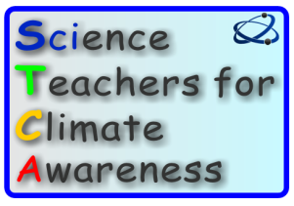

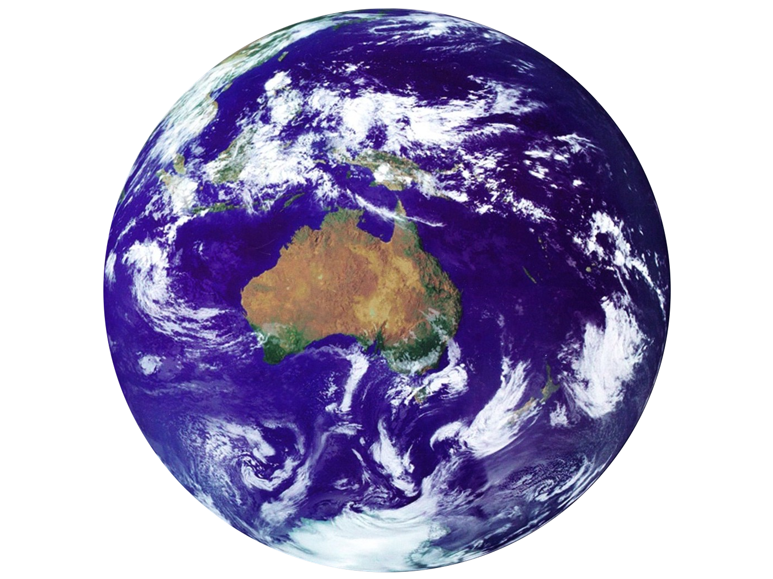


Climate Change
Our kids, their future?
Notes:
For PHYSCON Feb 2020. This is a version with just the climate science slides. Please feel free to use and adapt for your own purposes

Slide 2
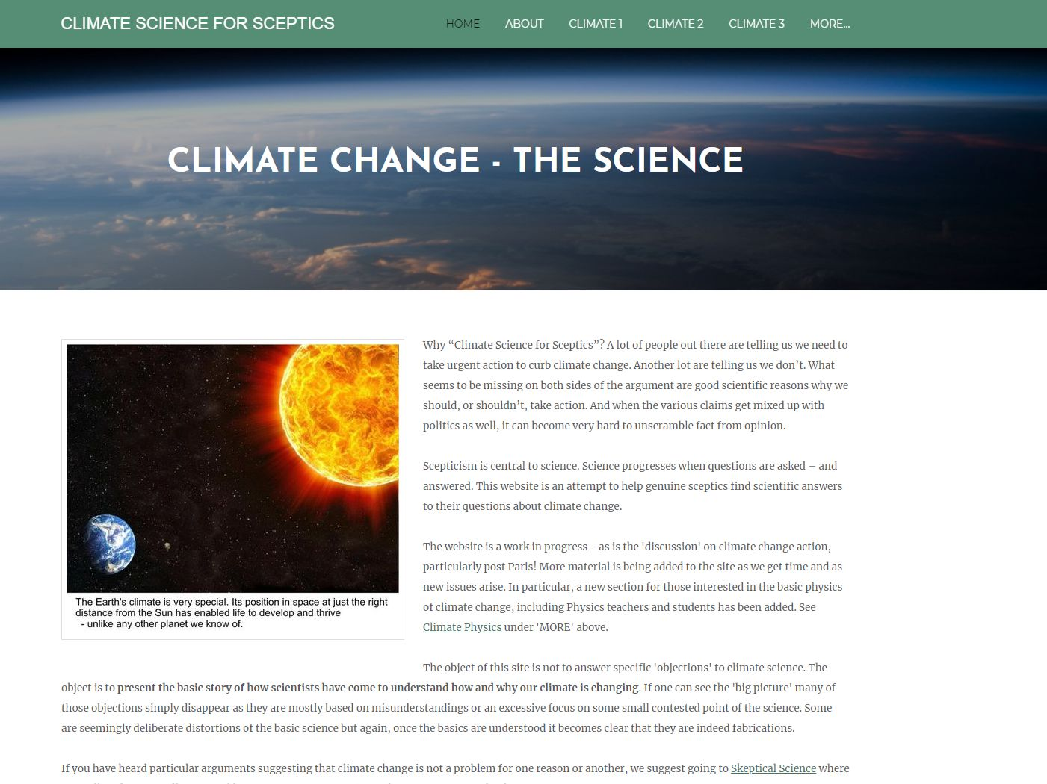
cs4s.net
Notes:
See my website for more of the background science. Scepticism is important in science! It is always good to question generally accepted ideas. BUT – it is important to look at ALL the evidence, not just the bit that suits one’s point of view.

Slide 3
Does Earth’s climate change?
If so, how much and why?
Could we be affecting it?
What will happen, does it matter?
What can we do about it?

Slide 4
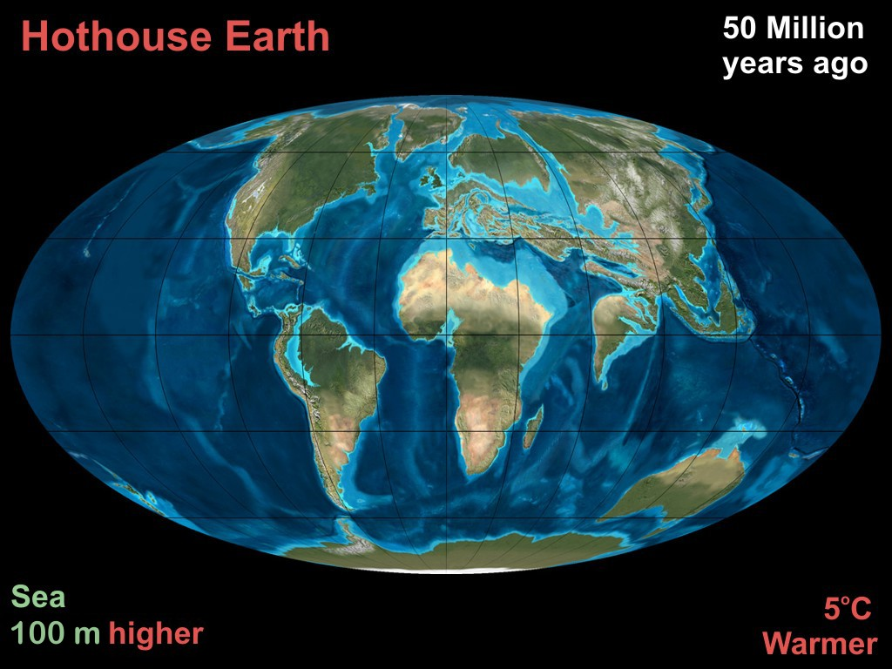
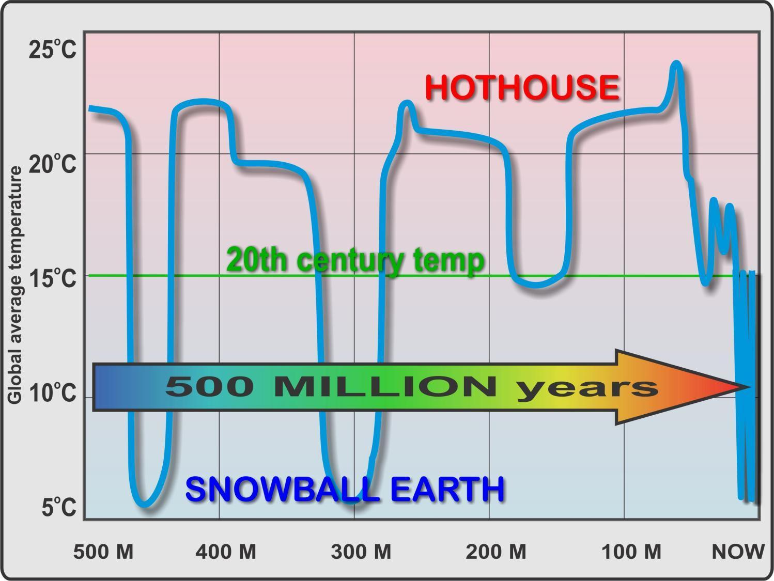
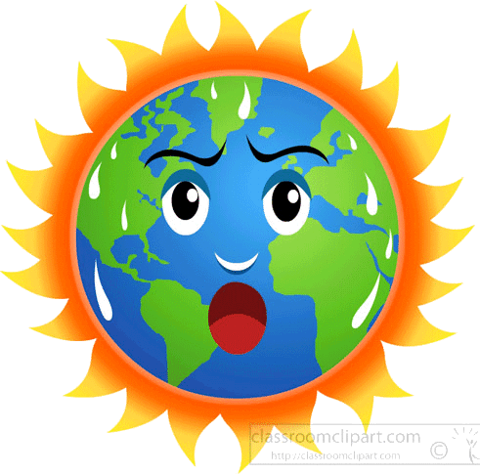
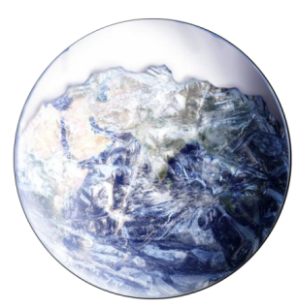
Notes:
The big picture – It changes a LOT over long time periods. Hothouse and Snowball were VERY different to now! See next two slides

Slide 5
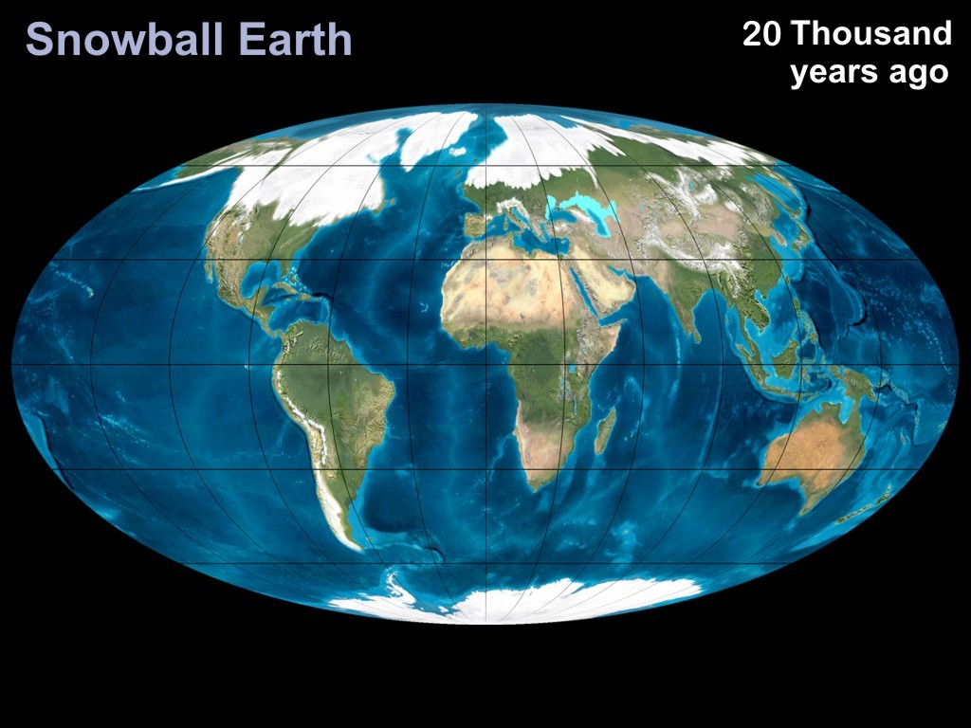
Last Ice Age
About 5ºC cooler Sea levels 100M LOWER
Notes:
JUST 20,000 years ago. Most of northern hemisphere countries under ice. You could walk to Tasmania or PNG - people did.

Slide 6
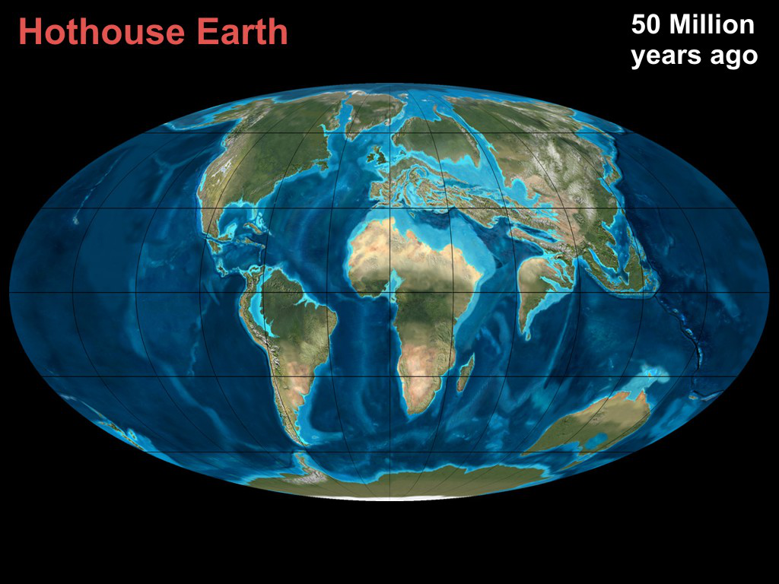
Eocene
About 5ºC warmer Sea levels 100M HIGHER
Notes:
For most of its life Earth has been hotter than now. Eocene was a full hothouse, but it has been warmer than now quite a lot. Most of Melbourne would be well under water. Shoreline around the foothills of the Dandenongs. Large inland Australian sea. Large areas of Europe, Middle east, Asia underwater.
Would take centuries or millennia to reach that stage, but do we want to condemn future generations to ever changing sea levels and climate? And we would have BIG problems with SLR of one metre – much less 100 metres.

Slide 7
Why?
Notes:
So what is the basic science that we know well?

Slide 8
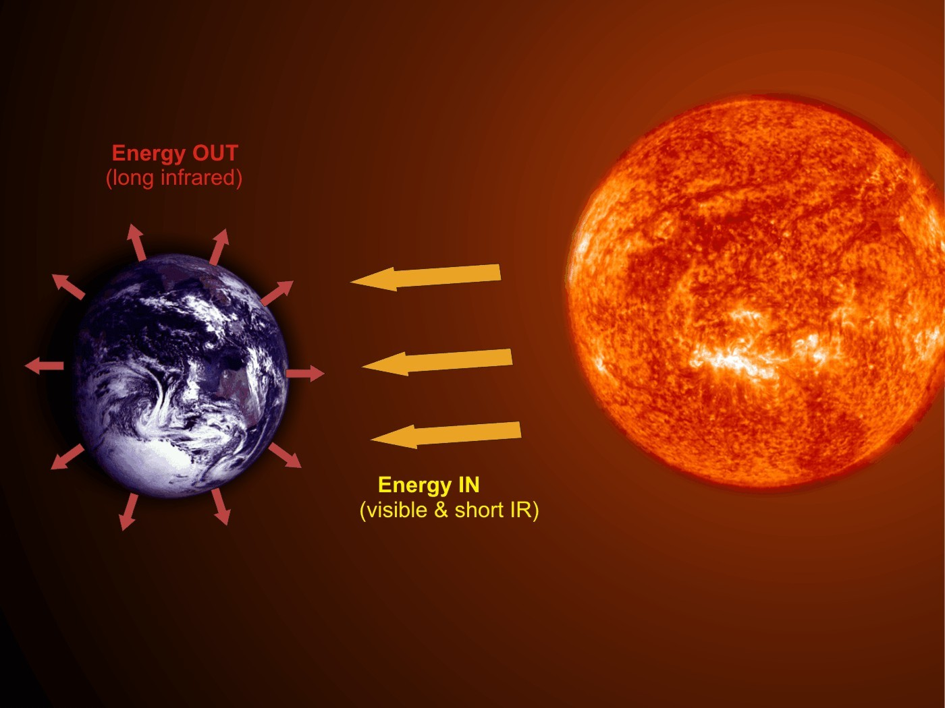
Climate Science 101
When Energy IN equals Energy OUT
the temperature is stable
Notes:
Earth’s temperature is controlled by the amount of energy we receive from the Sun and that absorbed and re-emitted by the Earth, but that changes for various reasons.
Describe Infrared, IR, light as below the red in the rainbow spectrum.
Its pretty simple really – if more heat is coming in than going out the Earth’s temperature must increase. As it gets hotter, the amount of IR radiation radiated will increase. Once the incoming and outgoing are equal the temperature will remain relatively stable.

Slide 9
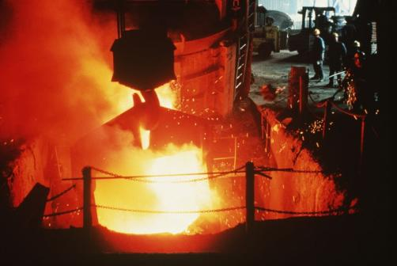
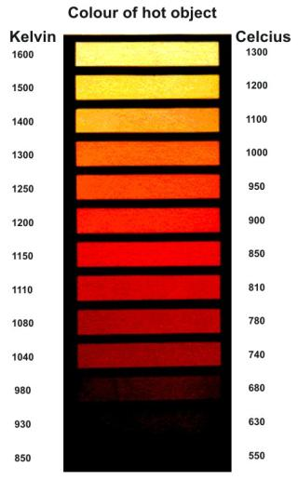
A little ^{(19th century)} physics
Don’t panic!
Earth’s energy balance
  Two simple laws of physics enable us to figure out the energy balance:
    The Stefan-Boltzmann law... I = εσT⁴
    Wien’s law... λ_{max} = 0.0029/T
  S-B just tells us how much heat a hot object radiates.
  Wien tells us what sort of radiation it will be.
  (fortunately others have done the hard work for us!)
Notes:
NOTE: It is NOT intended that these laws should be understood – just that they exist and that scientists can use them to figure out how the climate works. Could just mention the points below the formulae to show that it is not that complicated. For your info: S-B: I is the power (watts) radiated from a 1 m² area of surface at a temperature of T (K). The σ is the Stefan-Boltzmann constant which has a value of 5.67 x 10⁻⁸ W/m².K. So σ is partly just a conversion of units, but it tells us how much energy is radiated away from a hot “ideal blackbody”. ε is the emissivity of the radiating body and is 1 for an ideal black body.
Wien: λ in m and T in K This tells us that as something gets hotter it gets ... not redder ... but bluer! Well initially it gets red (from invisible, or rather IR) but then gets ‘white hot’ and then blue hot. (Demo car headlight with increasing volts).

Slide 10
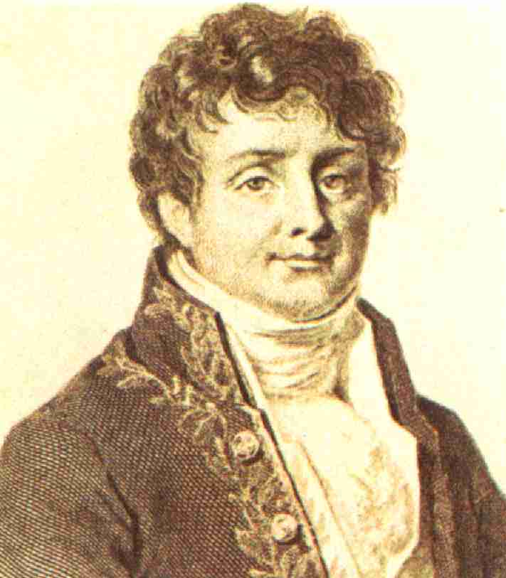
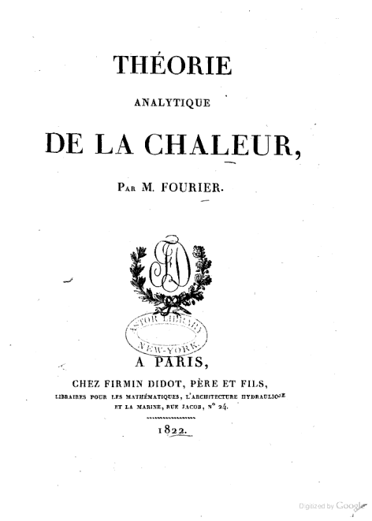
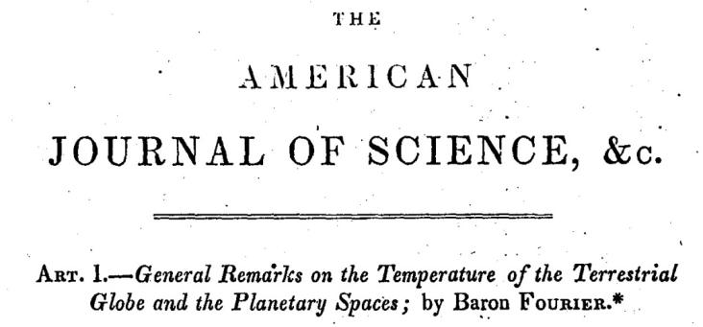
Climate Science 101
“The Earth should be a lot colder than it is”
Joseph Fourier ~1820
Notes:
Could use the term “Earth’s energy balance” here if appropriate to explain that energy in from the Sun can be calculated and energy out must balance this – but energy out is dependent on the average temperature. From AIP: Beginning with work by Joseph Fourier in the 1820s, scientists had understood that gases in the atmosphere might trap the heat received from the Sun. As Fourier put it, energy in the form of visible light from the Sun easily penetrates the atmosphere to reach the surface and heat it up, but heat cannot so easily escape back into space. For the air absorbs invisible heat rays (“infrared radiation”) rising from the surface. The warmed air radiates some of the energy back down to the surface, helping it stay warm. This was the effect that would later be called, by an inaccurate analogy, the "greenhouse effect." [The Discovery of Global Warming - Spencer Weart, AIP]

Slide 11
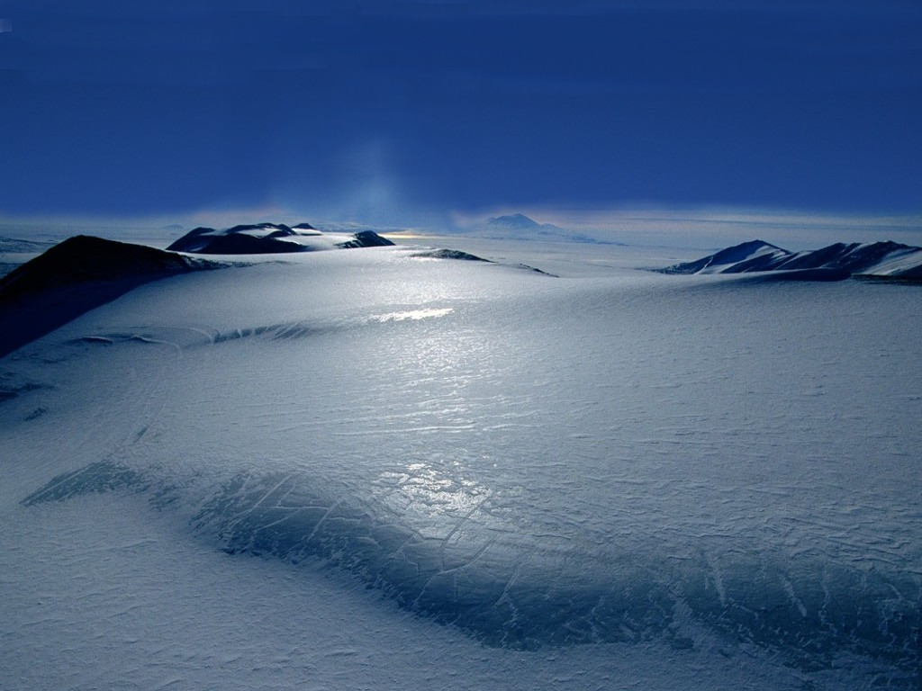
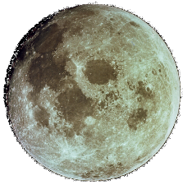
Climate Science 101
– 18ºC
Fourier used basic physics to calculate that the Earth ought to be a frozen snowball!
Notes:
Two simple laws of physics enable us to figure out the energy balance: The Stefan-Boltzmann law... I = εσT^4 and Wien’s law... λmax = 0.0029/T (see previous slide).
S-B just tells us how much heat a hot object radiates. Wien tells us what sort of radiation it will be. Together they can be used to work out the temperature of a body such as the Earth receiving radiation from the Sun at the distance it is and radiating it away according to these laws. While Fourier couldn’t work out an accurate value, we now know that it would be about –18 degC. Noticeably this is just what the average temperature of the Moon is – but because of it’s slow rotation it varies from very hot indeed to very cold during the long nights.

Slide 12
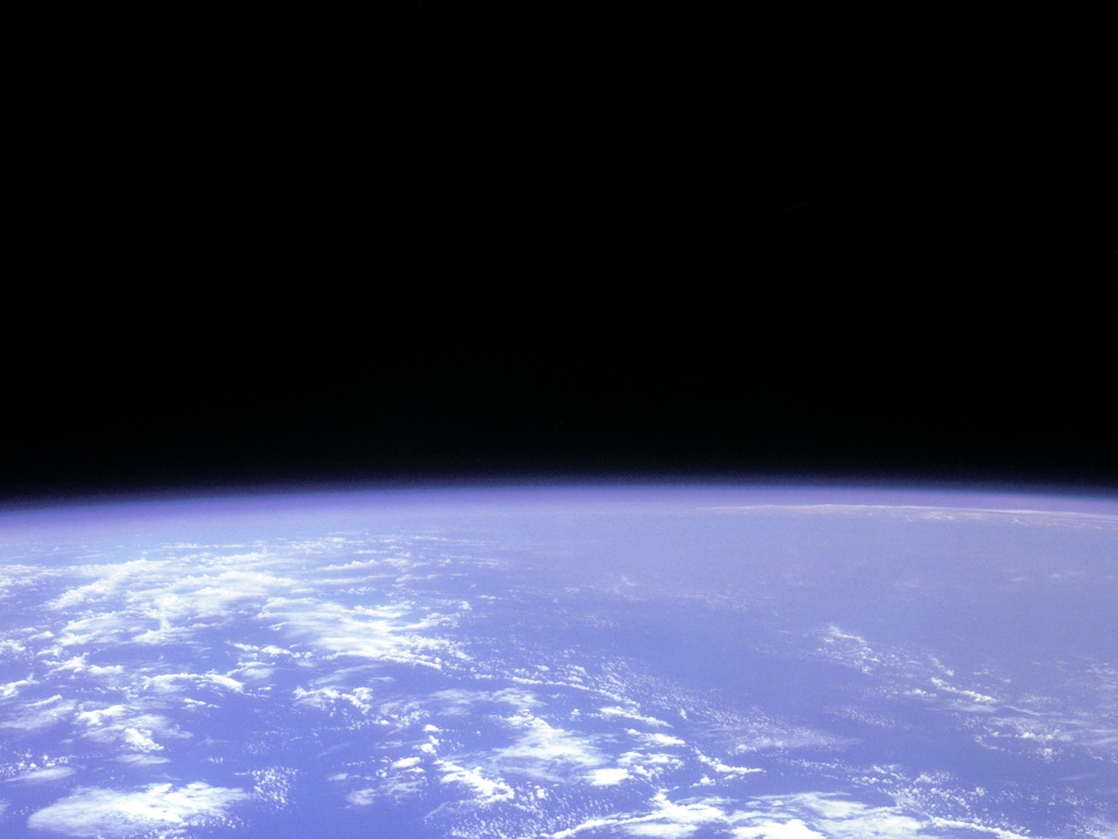
Climate Science 101
Fourier realised that (despite its apparent transparency) the atmosphere must be trapping heat
Notes:
This was a little surprising because air appears to be totally transparent to the light from the Sun – which is why we see it so clearly. It is also a very thin layer and doesn’t LOOK as though it would insulate the Earth. Explained later: However, the outgoing ‘heat radiation’ is not visible light like that from the Sun but infrared radiation. (The light from the Sun includes short wavelength IR, but the outgoing IR is longer wavelength radiation which turns out to be absorbed by H2O and CO2)

Slide 13
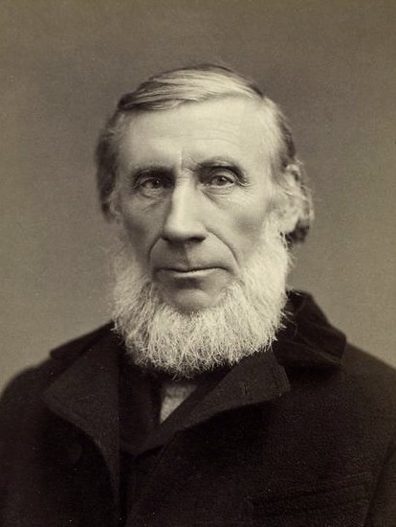
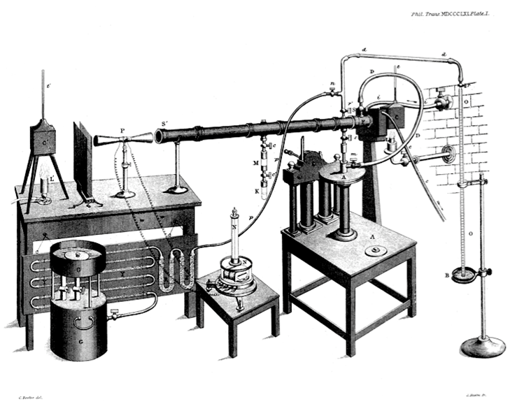
Climate Science 101
Tyndall found it was the water vapour and carbon dioxide gases in the air
John Tyndall ~ 1860
H₂O and CO₂ are not transparent to IR light
Notes:
Even though they compose only less than 1% (H2O) and 0.04% (CO2).
Tyndall set out to find whether there was in fact any gas in the atmosphere that could trap heat rays. In 1859, his careful laboratory work identified several gases that did just that. The most important was simple water vapor (H2O). Also effective was carbon dioxide (CO2), although in the atmosphere the gas is only a few parts in ten thousand. Just as a sheet of paper will block more light than an entire pool of clear water, so the trace of CO2 altered the balance of heat radiation through the entire atmosphere. [The Discovery of Global Warming - Spencer Weart, AIP]

Slide 14
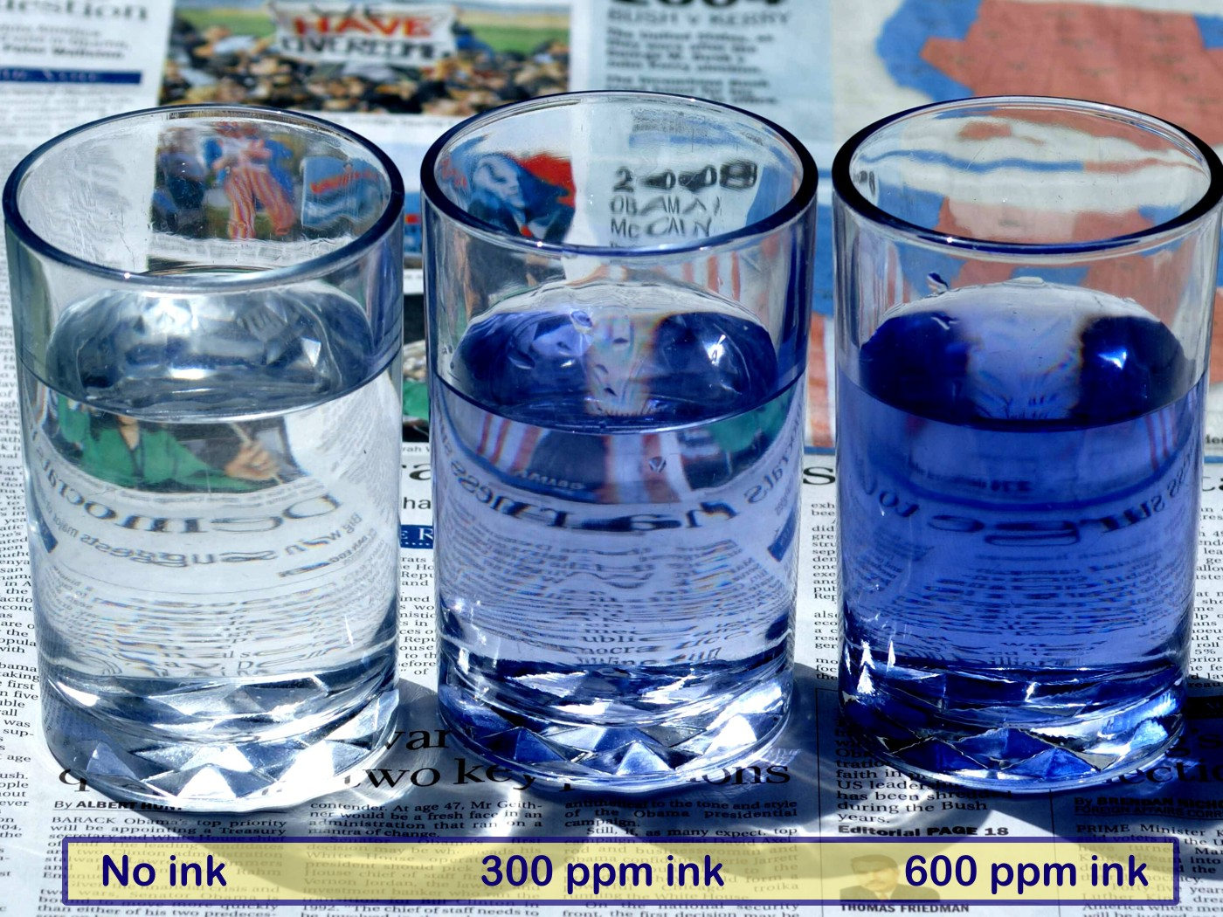
Climate science
300 ppm (or 0.03%) might not sound like much, but here is the effect of adding 300 ppm of ink to a glass of water:
“But there is only 0.04% (that’s 400 ppm) of CO₂ in the air!”
Notes:
400 ppm might seem a very small amount of CO2 to have such an effect. Only 0.04%. But consider this analogy. Think of the water as like the atmosphere – most light goes straight through it.
Think of ink rather like the CO2 in the atmosphere – it absorbs light, just as CO2 absorbs invisible infrared light (warmth)
The air, or water simply have little or no effect on the light/IR, but the CO2 does.
400 ppm might sound like a very small amount of CO2 in the atmosphere, but the problem is that over 99% of the atmosphere has NO EFFECT on the greenhouse effect. In this experiment, the water is like the nitrogen and oxygen – simply irrelevant as far as the absorption of light (or IR) is concerned. TRY THIS AT HOME! (Could use food colour etc.)

Slide 15
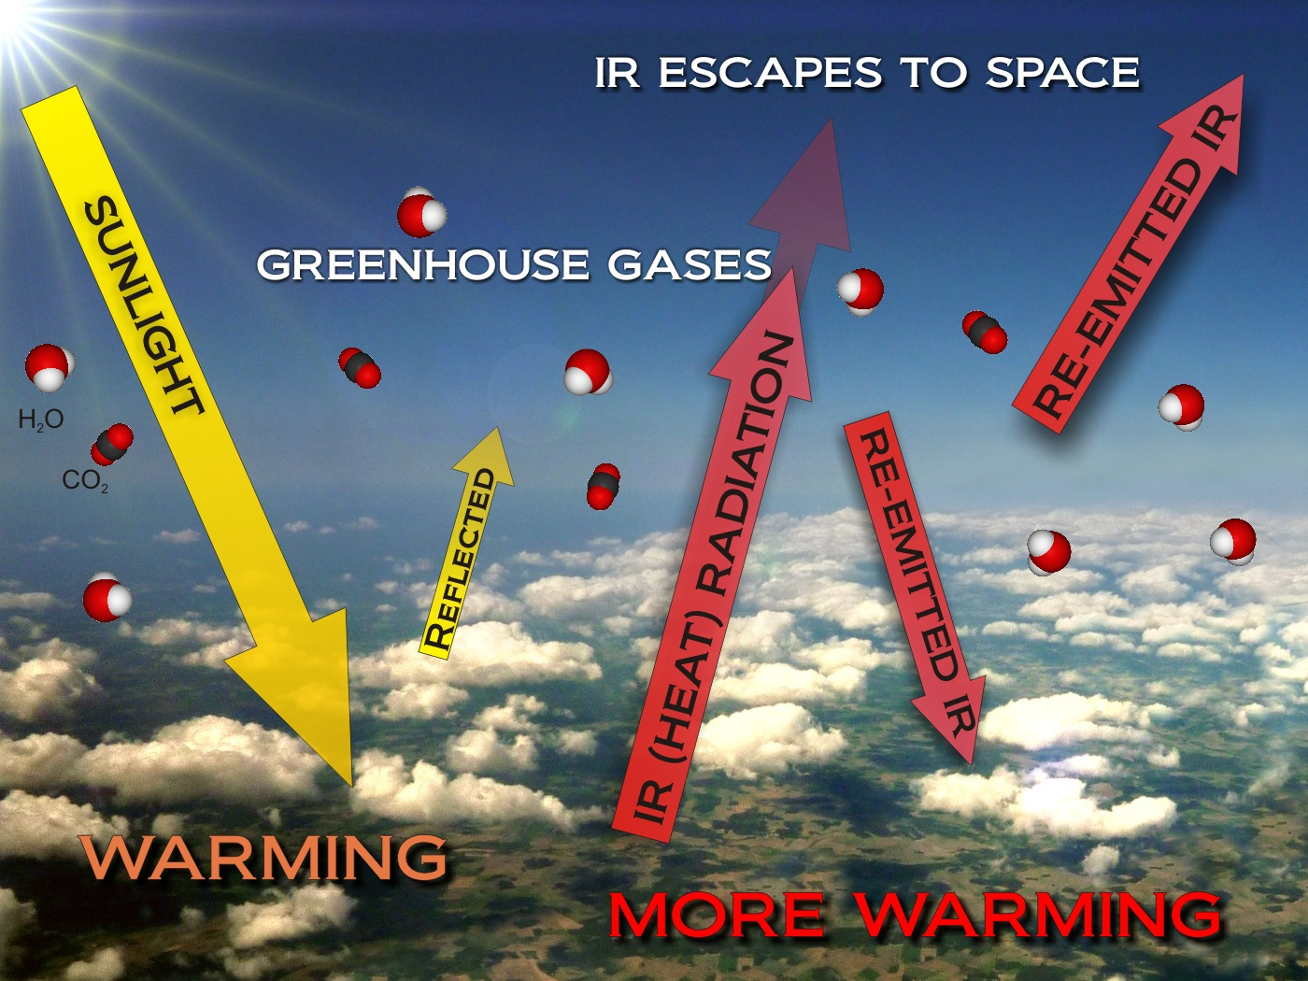
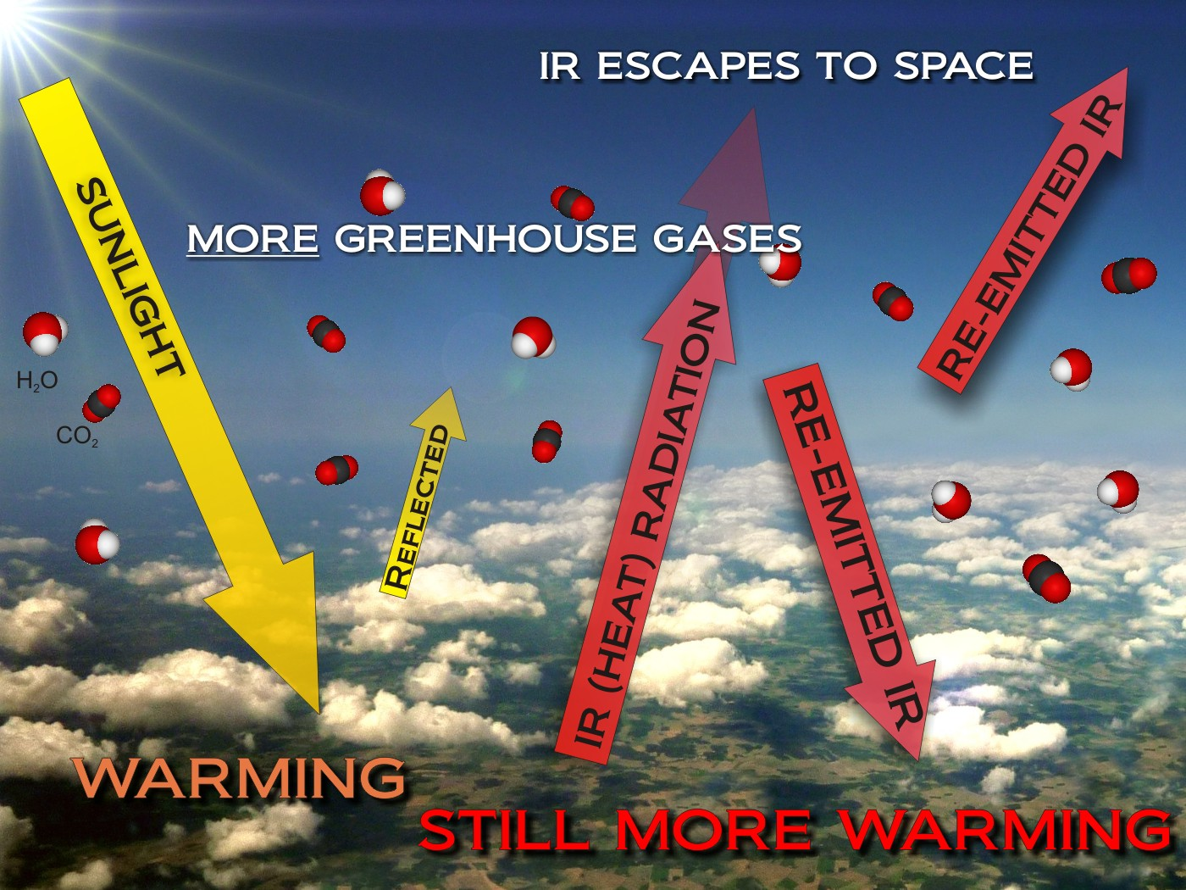
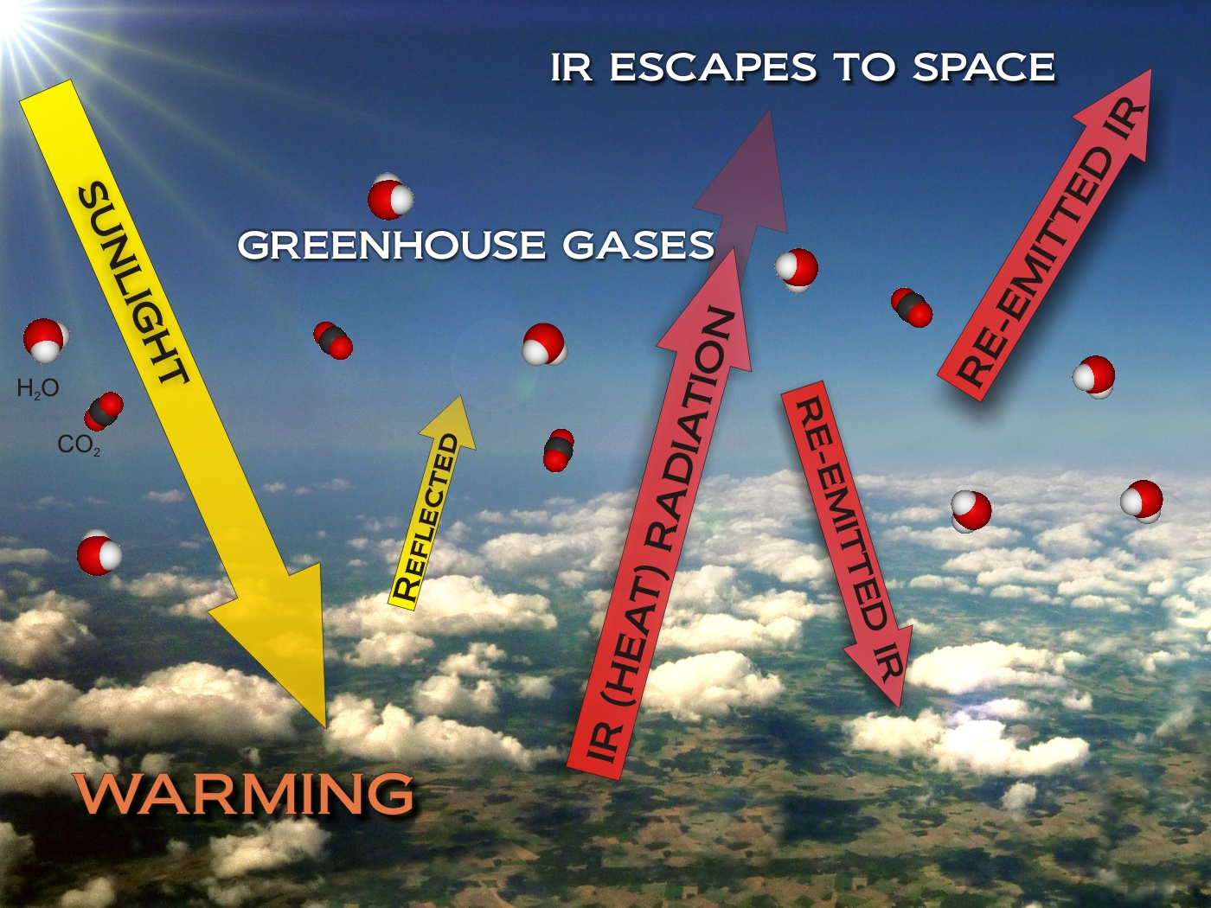
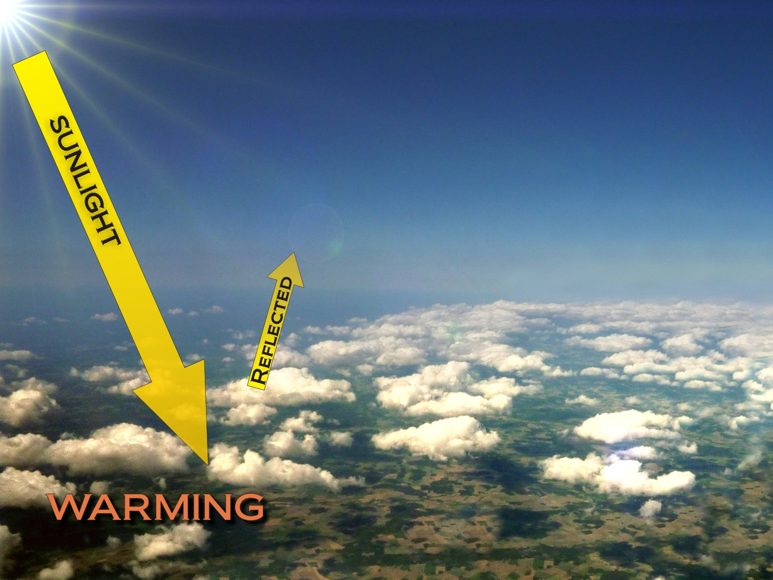
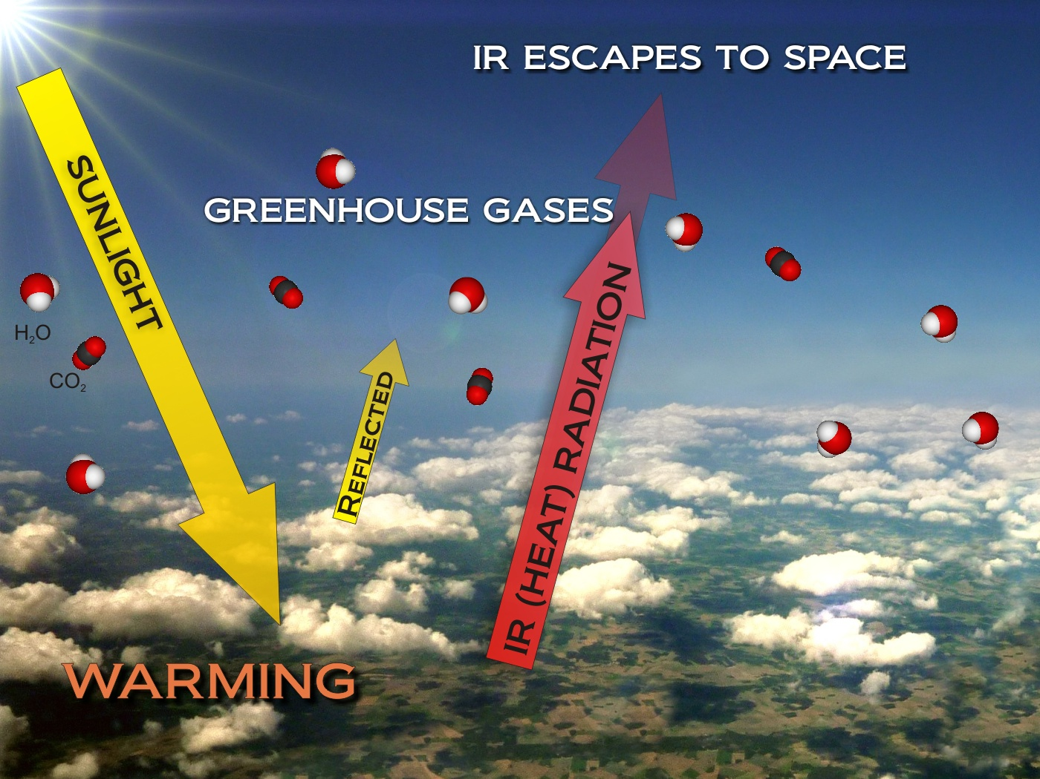
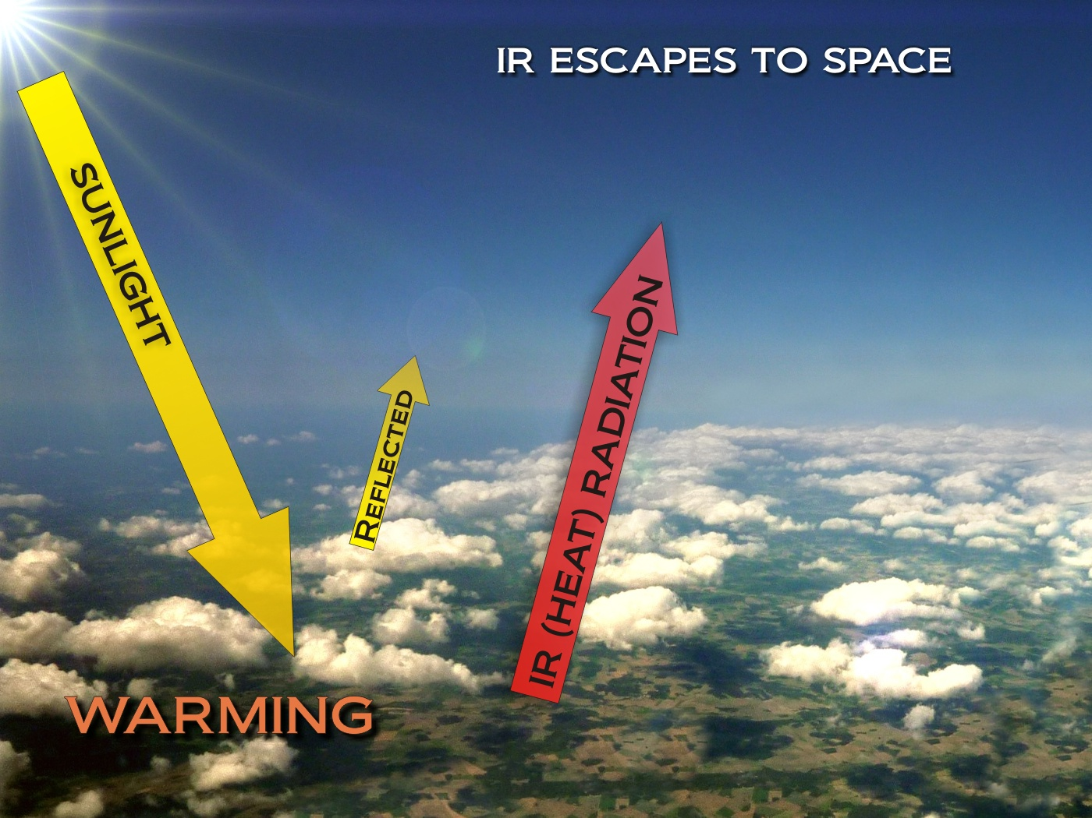
Climate Science 101
Notes:
Sunlight falls on Earth after going straight through the atmosphere.

Slide 16

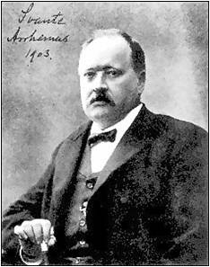
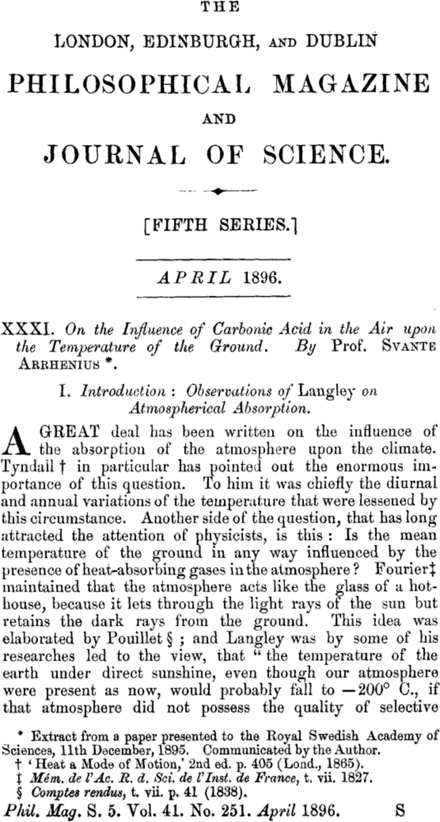
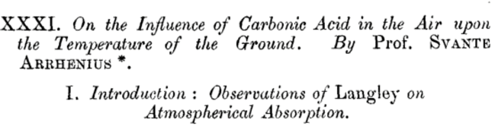
Climate Science 101
Svante August Arrhenius worked it out in 1896
It’s a matter of the Earth’s energy balance
Notes:
Refer to ‘Earth’s energy balance’ again. And his analysis was pretty much correct.

Slide 17
Climate Science 101
Svante August Arrhenius worked it out in 1896
“CO₂ and H₂O absorb heat and send enough back to Earth to raise the temperature by
+33 degrees!”
Notes:
From -18 to +15

Slide 18

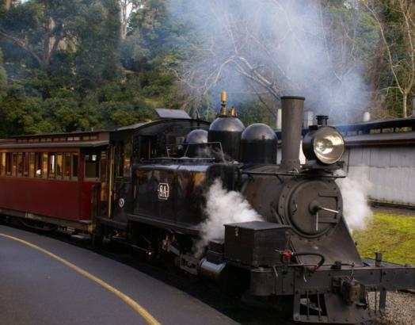
Climate Science 101
Svante August Arrhenius worked it out in 1896
?
“So what will all the CO₂ we are putting in the atmosphere do?”
Notes:
Photo Puffing Billy KB (not quite a Swedish train!)

Slide 19

Climate Science 101
Svante August Arrhenius worked it out in 1896
“If we double the CO₂ it could raise the temperature by about 5 degrees!”
That’s not all that far off modern IPCC estimates of 2°C – 5°C
“That will make Sweden warmer
– good !”
Notes:
And his analysis was pretty much correct. (Note his smile here!) Actually he did realise that this could create a problem, but didn’t realise that it would take so little time to increase the CO2 concentration.

Slide 20
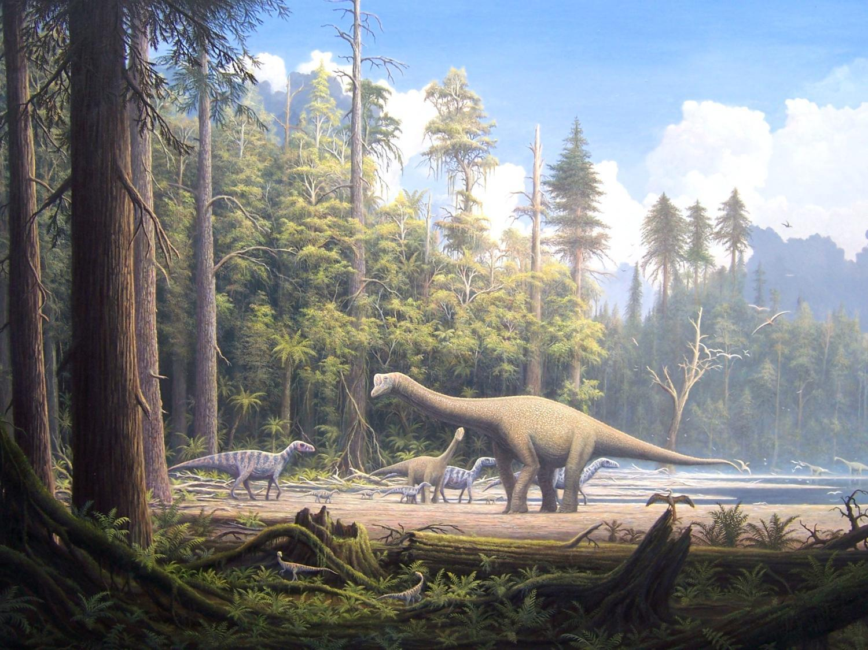
If there was no greenhouse effect Earth would be a frozen snowball at about – 18ºC
So Greenhouse effect
= +33ºC warmer
Notes:
The present greenhouse effect is responsible for a +33 deg temperature increase. If we increase the CO2 this MUST increase this 33 deg - big question is by how much?

Slide 21
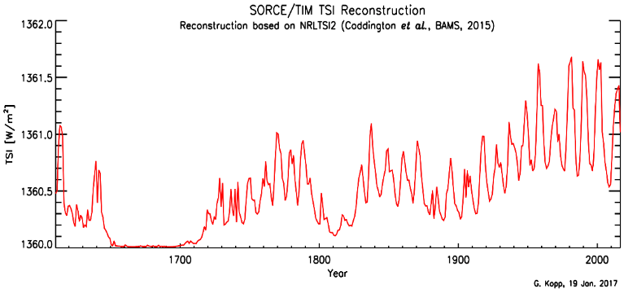
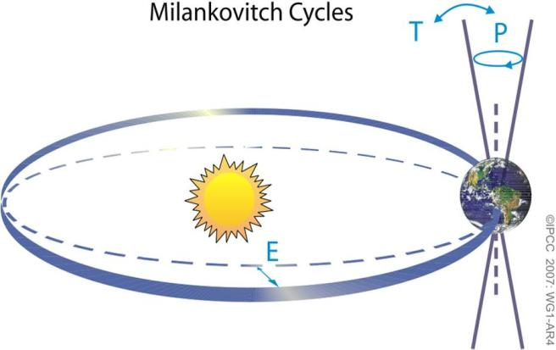
So the big question is ...
WHY the changes?
The Sun
Solar Irradiance
Wobbles in Earth’s orbit
1362
1360
1700 2015
Notes:
Why does the heat balance change?
Two main reasons: 1 Heat received depends on Sun and Earth’s position and angle
Greenhouse effect is not the only factor that influences the Earth’s temperature. Why does the heat balance change? The energy received from the Sun varies slightly over time, Note that it was low ~ 1700 which caused the Little Ice Age (LIA)
Also, since late 20th cent it has been dropping – but temperatures are going up!

Slide 22
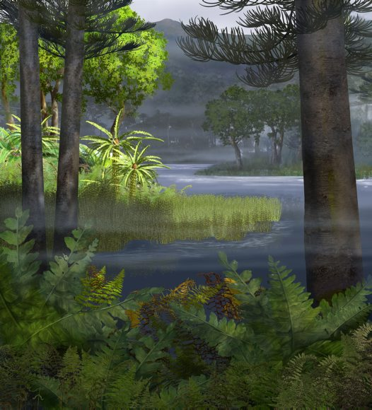
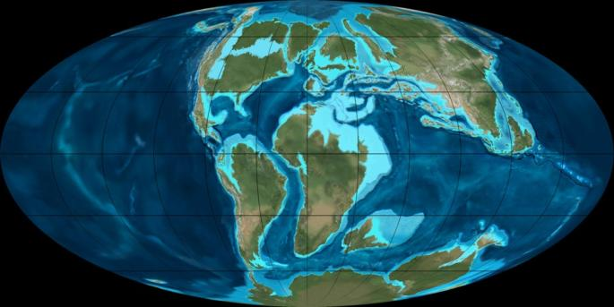
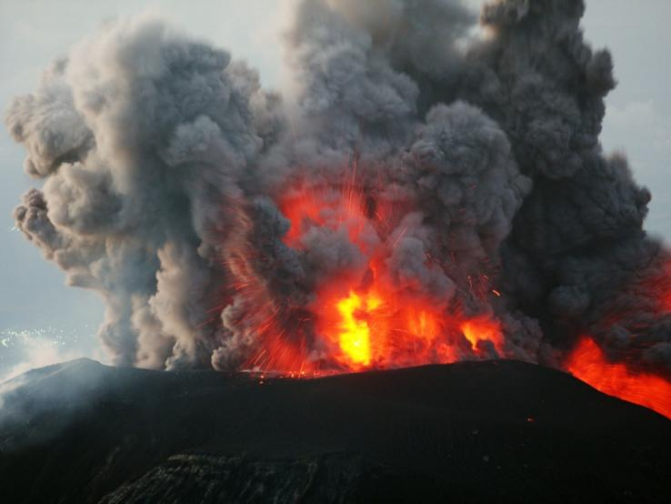

So the big question is ...
WHY the changes?
The Earth
Continental drift
Different life forms changed the atmosphere
Massive volcanoes
Other changes in Greenhouse gases (CO₂ and H₂O)
Notes:
Two main reasons: 2 Heat absorbed depends on the atmosphere and surface
We know very well that CO2 and H2O molecules absorb IR light and send (some of) it back to warm the Earth. Greenhouse effect is not the only factor that influences the Earth’s temperature. Why does the heat balance change? The energy received from the Sun varies slightly over time, Note that it was low ~ 1700 which partly caused the Little Ice Age (LIA)
Also, since late 20th cent it has been dropping – but temperatures are going up!

Slide 23
Does Earth’s climate change?
If so, how much and why? …Yes, a LOT!
Could we be affecting it?
What will happen, does it matter?
What can we do about it?

Slide 24
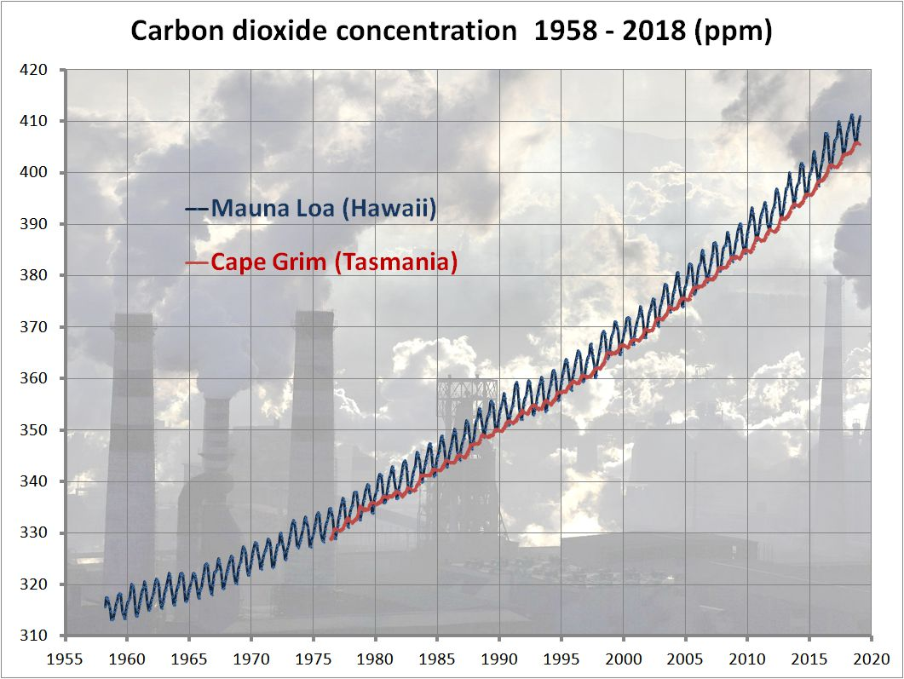
400 ppm = 0.04%
Notes:
Problem is that even if we can keep our emissions from rising (we were just – but now they are rising again – thanks Trump!) there is a large part of the world which is trying to catch up to us and their emissions are rising – causing the curve to bend upwards.

Slide 25
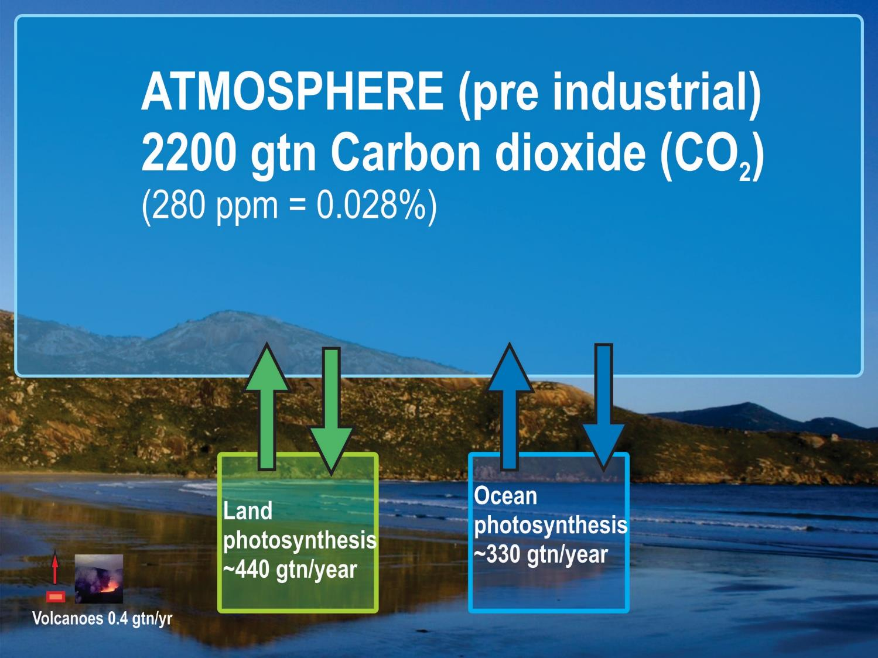

Slide 26
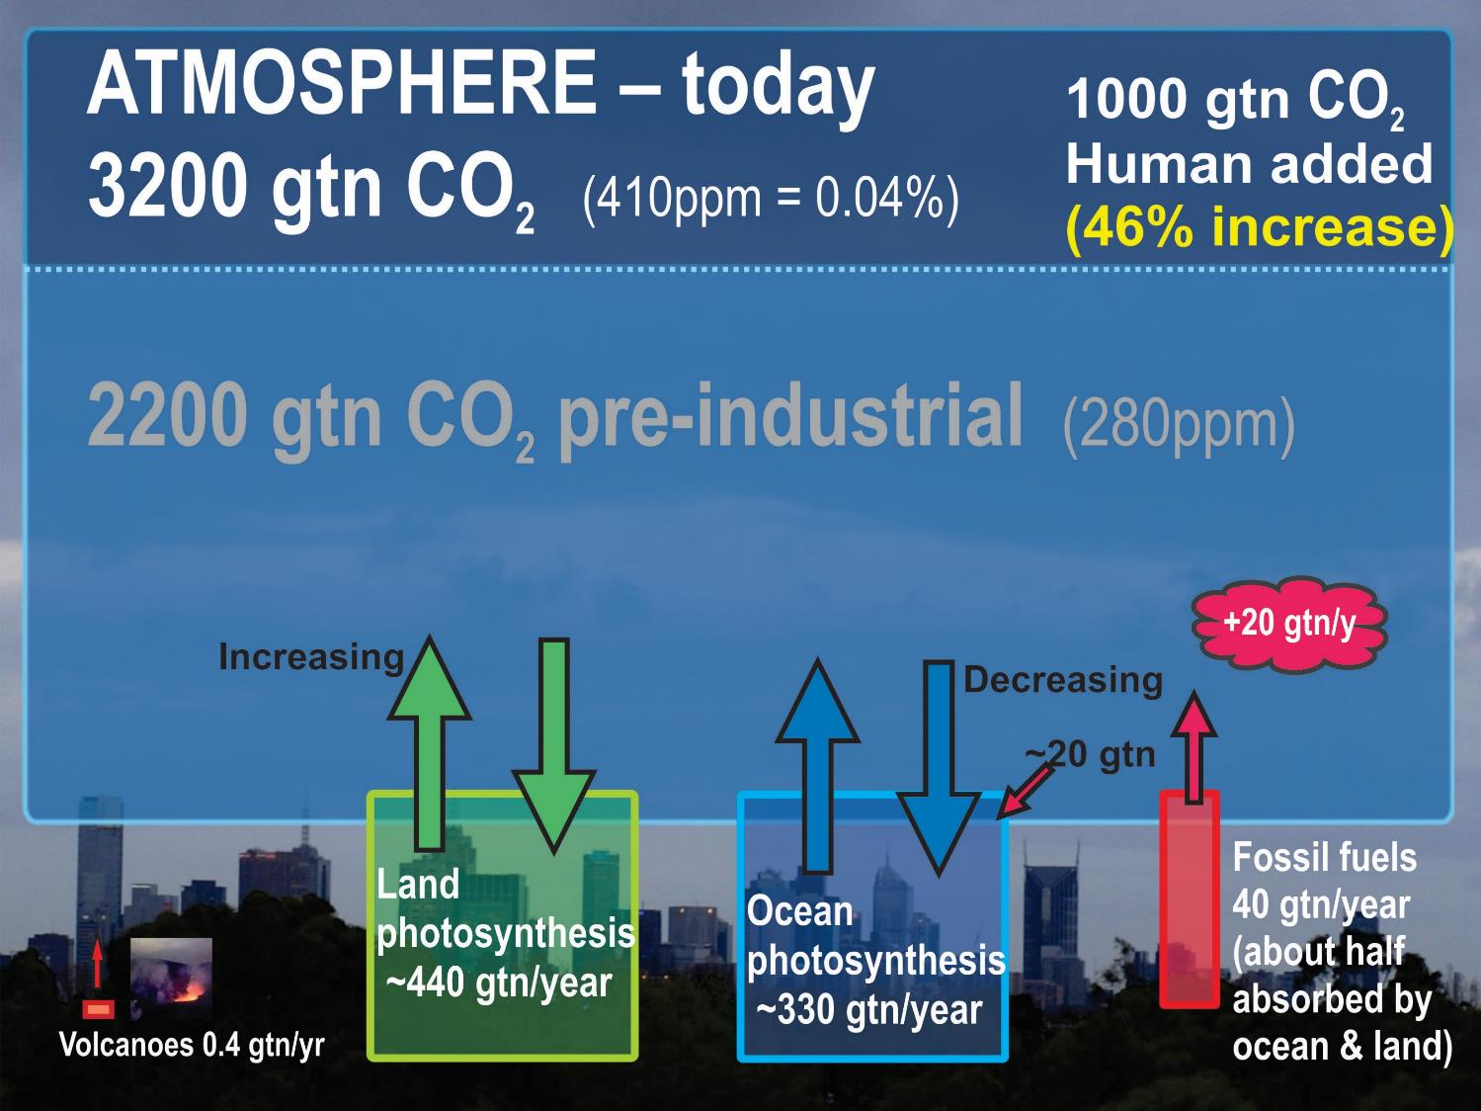
Notes:
We have added a thousand billion tonnes of CO2 to the atmosphere (trillion tonnes) and it only started off with a bit over two thousand billion tonnes.
CO2 from land is increasing because we are clearing land and planting less
CO2 going into the ocean from the atmosphere is decreasing because more is going in from our emissions (decreasing the pH) and the ocean is warming.
(Ocean is warming but concentration of CO2 in the atmosphere is increasing at a faster rate.)
Note that every year around 770 gtn CO2 go in and out of the biosphere, our 40 gtn is “only” about 5% of that – hence the deniers that we only produce 5% of the greenhouse gas going into the biosphere. BUT…

Slide 27
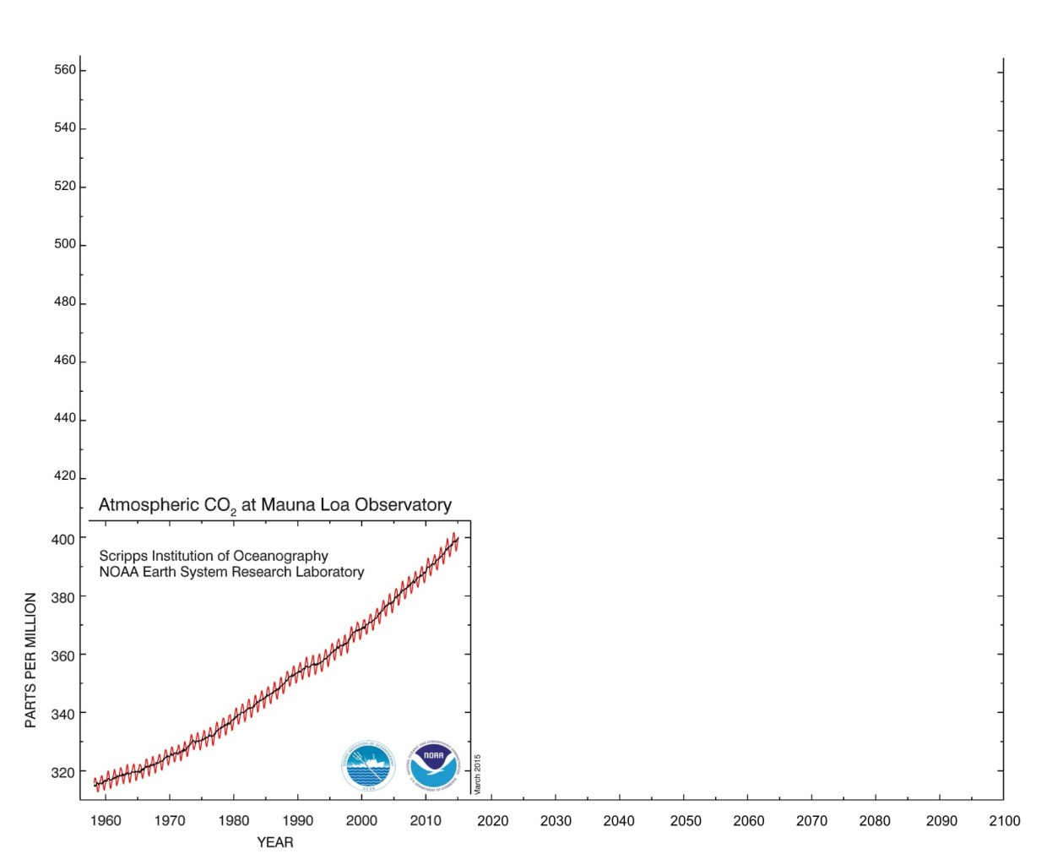
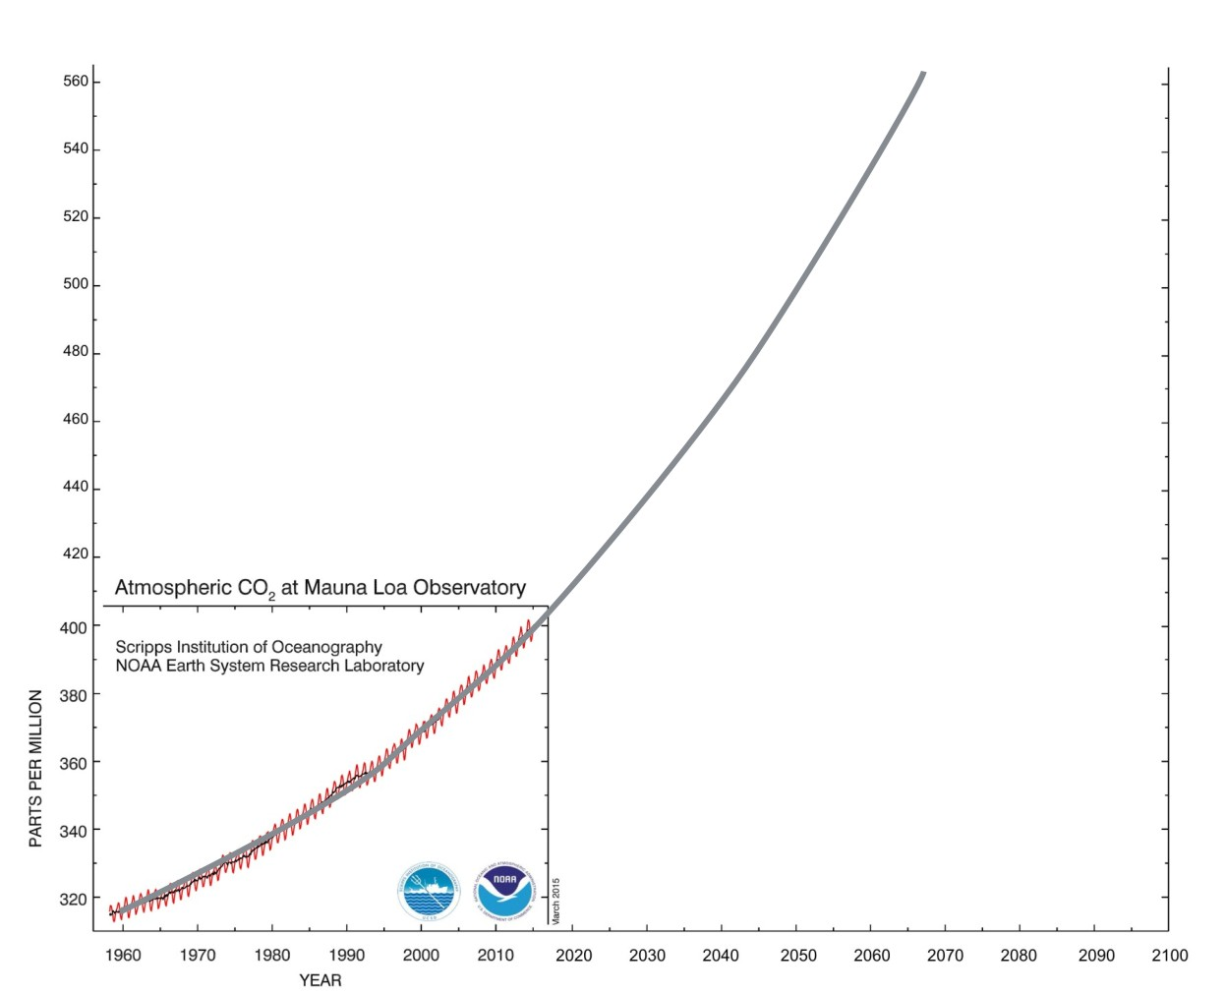
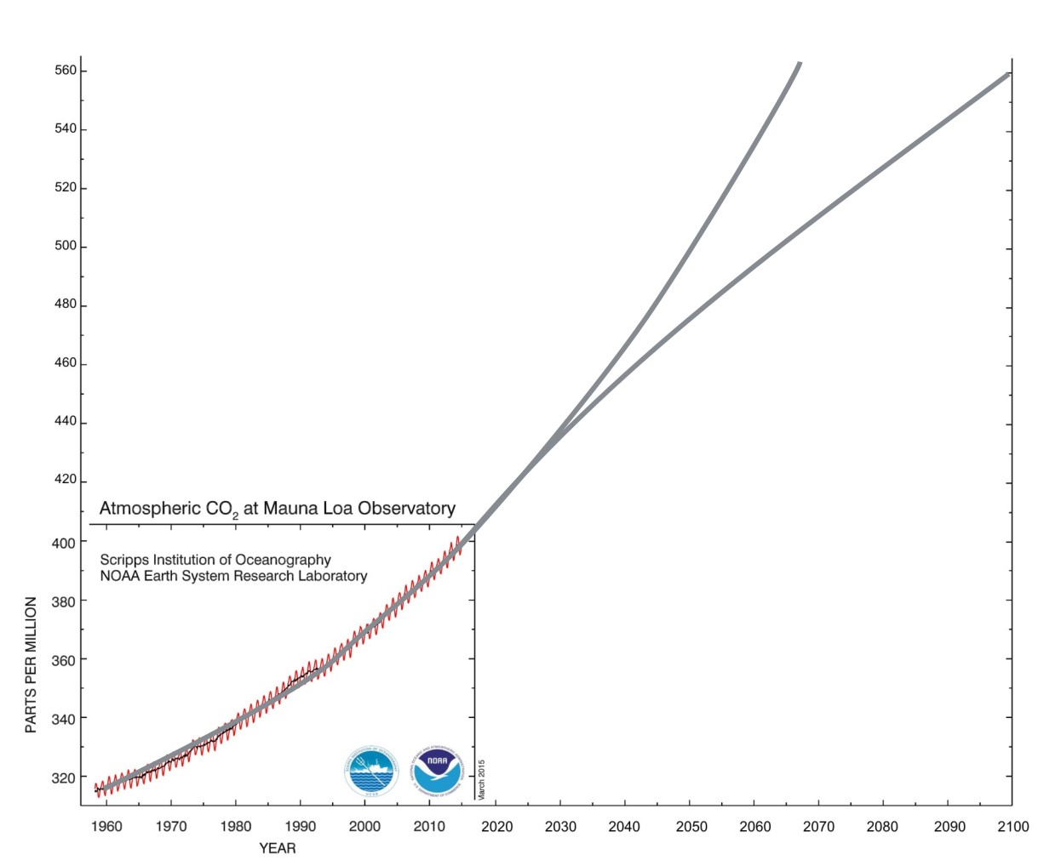
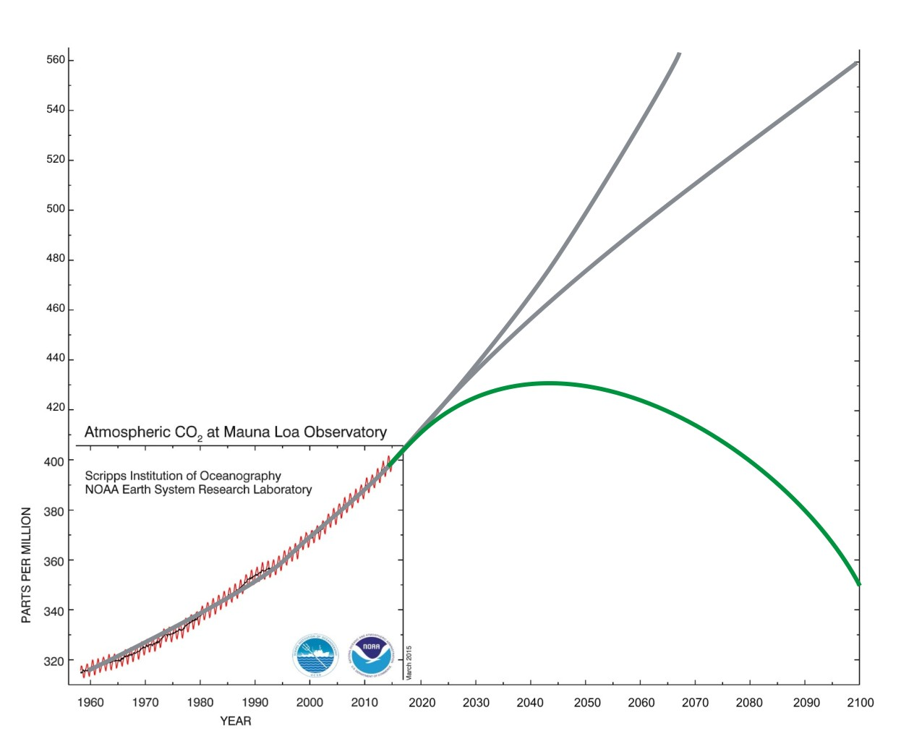
Double pre-industrial
+3ºC by 2060’s
+3ºC by 2100
To keep below +2ºC by 2100
Notes:
We will have to reduce the amount of CO2 already in the atmosphere to avoid +2 deg
That will be far more expensive than not putting it there in the first place!
Flue chimney about 20% CO2, Air 0.04% (ie flue is 500 times more concentrated)
Pre industrial was 280 ppm (around 100 yrs ago)

Slide 28
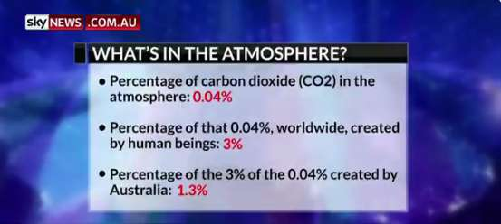



Nonsense from News Corp
Alan Jones thinks climate change is a hoax
BUT !
It’s 46% !
46%
46%
Sort of, BUT that’s from 0.3% of the population!
So we are contributing over 4 times
our fair share!!!
Notes:
Our % of the 46% is actually higher than 1.3% because of our historical emissions!
And if we included our exported coal and gas it would be more like 5% and rising rapidly!

Slide 29
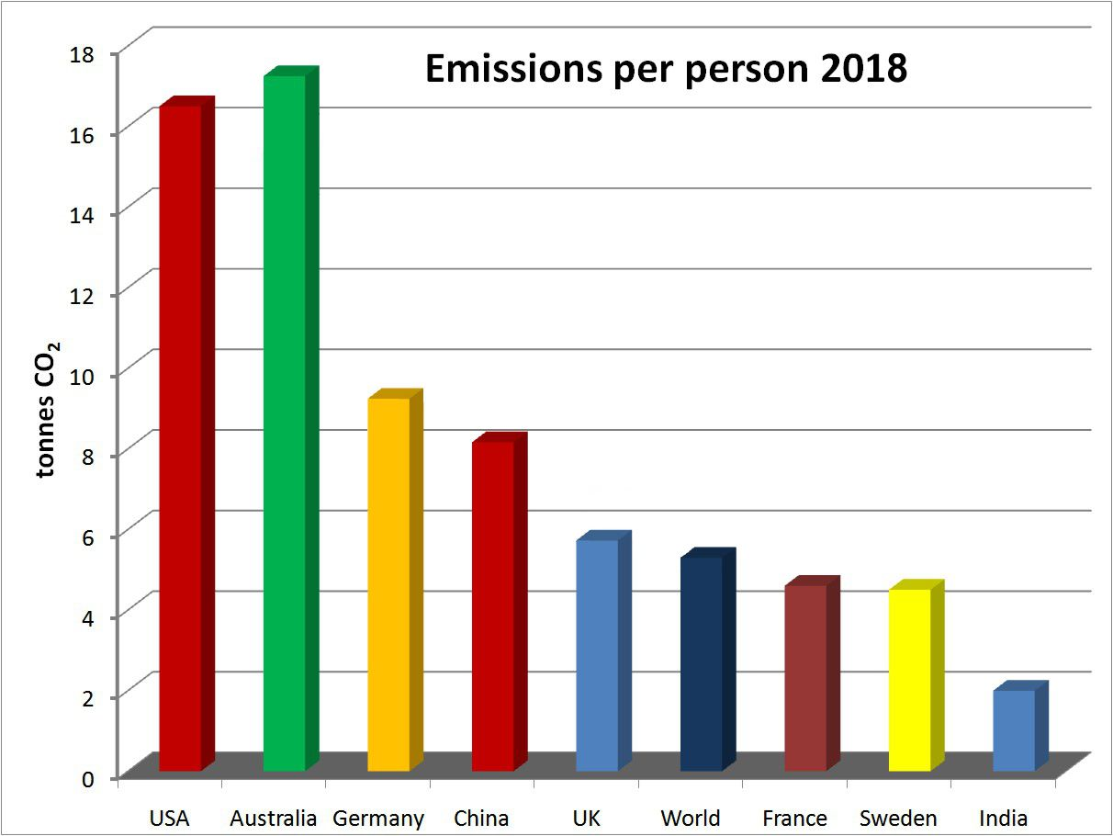
Let’s look at the reality!
Notes:
Only places like Qatar and UAE are higher than us! Even Saudi Arabia is less!
If exported fossil fuels were included the figure would be about three times that!
[Different calculations seem to give figures about 22 tonnes]

Slide 30
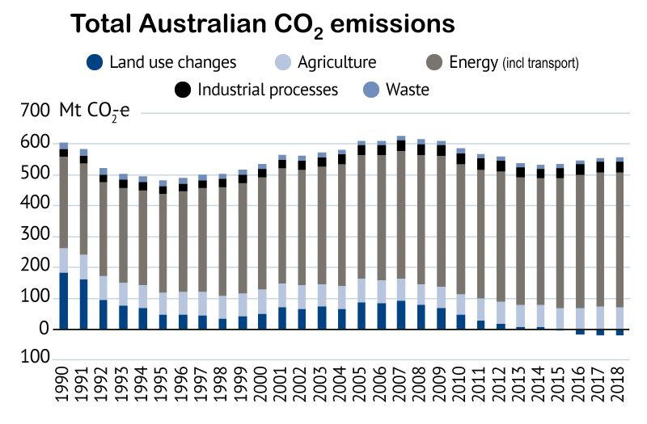
Let’s look at the reality!
But exported coal and gas are about DOUBLE that!
SMH 29 May 2019
Notes:
Emissions have been RISING not falling in the last few years – despite fall in land use emissions since 2007.
Note that the drop after 2007 has mostly been due to decreasing agricultural emissions due to less deforestation. Energy (includes transport and industry) has been increasing after dropping during C tax.
From SMH 29 May 2019 Source: United Nations Climate Change/Australia 2019 National Inventory Report

Slide 31
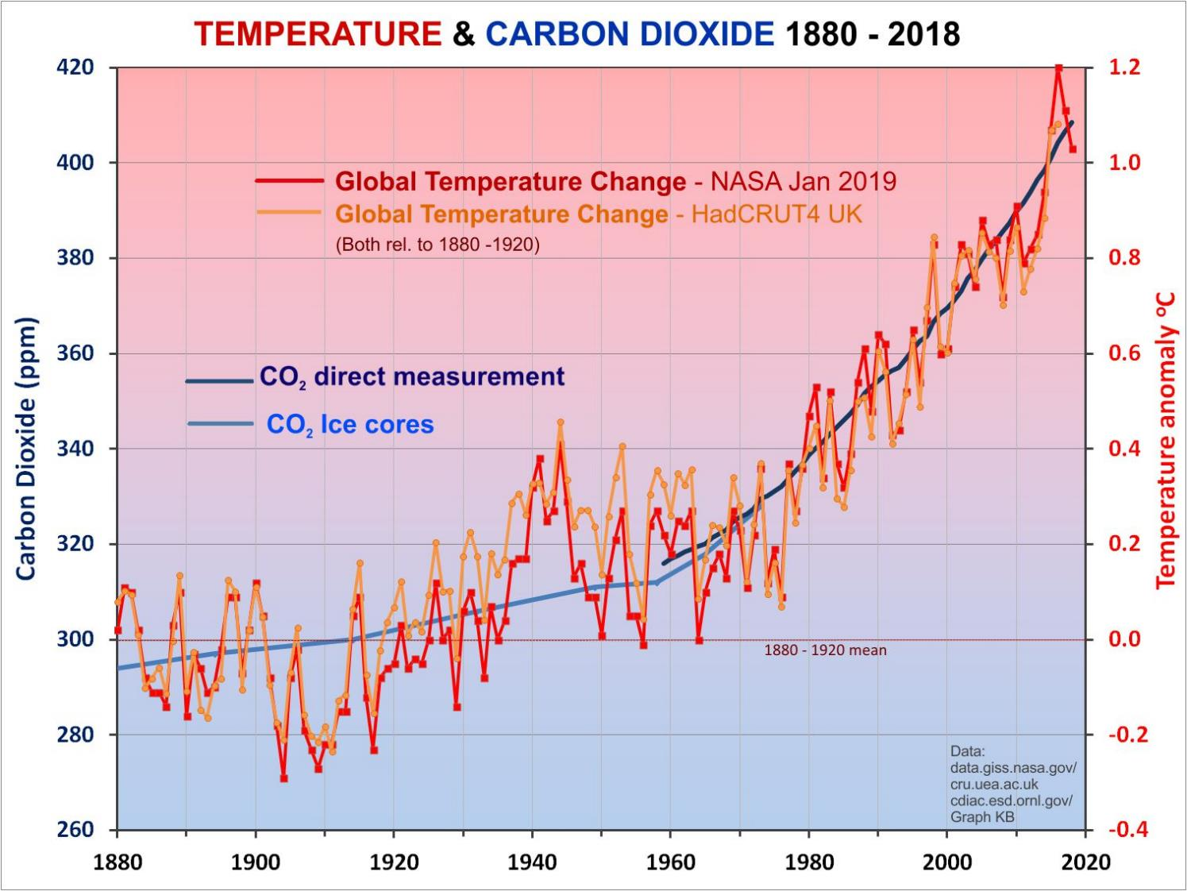
Notes:
So what is actually happening?
Temperatures (red, orange) have gone up pretty much in line with the CO2 (blue) as expected
To suggest that the short term flattening in the last couple of decades says anything about the long term trend is clearly nonsense!
What about the longer term? Is there a connection between CO2 and temperature? …

Slide 32
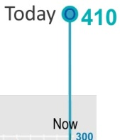
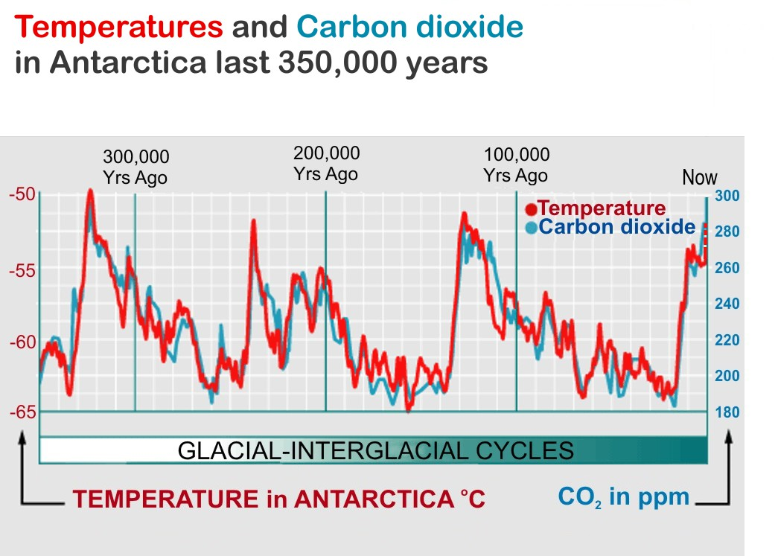
?
Notes:
If we look further back we see a strong relationship between CO2 and temperature.
The reason for these changes is well known, the Milankovitch (Milanković) cycles. But the CO2 actually follows the temperature as it is one of those positive feedback effects – warmer water releases CO2 which traps heat and warms the water further releasing more CO2 – giving more warming etc. But it reaches a limit because more moisture means more clouds and therefore more reflected sunlight. (That didn’t happen on Venus – which has a runaway greenhouse effect and temperature of about 450 degrees.)
CO2 has gone up from less than 300 ppm to over 400 ppm in the last century - almost entirely as the result of our burning of coal oil and gas.

Slide 33

Earth’s climate
The orbital wobbles triggered the changes
The carbon dioxide AMPLIFIED them …
Notes:
It was the Milankovitch cycles that caused the small changes in the amount of energy received by the Earth, the CO2 and H2O increase that followed the small warming amplified the change.

Slide 34

Earth’s Greenhouse climate
Solar warming
Higher temperatures
More greenhouse warming
More H₂O & CO₂ into atmosphere
Positive feedback!
Notes:
The solar warming because of changes in the orbit starts the process, but this means more CO2 goes into the air – which means more warming ….
Note that while H2O goes in and out of the atmosphere every day, once CO2 goes into the atmosphere it stays there for around a century. So while H2O is called a “feedback GHG”, CO2 is a “forcing GHG”

Slide 35
Does Earth’s climate change?
If so, how much and why? … YES!
Could we be affecting it? … YES!
What will happen, does it matter?
What can we do about it?
Notes:
There is no real doubt that the extra CO2 we are putting in the atmosphere is causing the warming we are seeing. To suggest otherwise goes against all the science we know about the greenhouse effect. The rapid increase in temperatures does not correlate with any other known natural phenomena.
But what will happen and does it matter?

Slide 36
So what will this extra CO₂ do to the +33ºC Greenhouse effect?
Two ways to answer:
Look at what has happened in the past
Use our understanding of the way the climate works (ie. ‘computer modelling’)

Slide 37

Earth’s climate – looking at the past
The last ‘interglacial’ – similar to current climate.
Maybe ~2°C warmer than last century average...

Slide 38

10 m SLR
Current SL
Notes:
Temperature was only about 1 deg above now.

Slide 39


July
2009
“Paul Blanchon's team at the National University of Mexico has been studying 121,000 year old coral reefs in the Yucatan Peninsula, formed during the
last interglacial period when sea level peaked at around 10 metres higher than today. His findings suggest that at one point the sea rose 3 metres within 50 to 100 years.”
Temperatures in that interglacial were only a couple of degrees warmer than the 20th C.
Notes:
Abrupt climate changes have occurred in the past. We should not think that it can’t happen again. 3 m this century would be absolutely catastrophic. And that’s just the sea rise – add to that the changes in land fertility and ecosystem collapse. SEE New Scientist: Sea level rise: It's worse than we thought * 01 July 2009 by Anil Ananthaswamy New Scientist issue 2715.

Slide 40

(Balsillie and Donoghue, 2004)
Notes:
Two or three metres SLR per century. And that was without the high greenhouse forcing we have now!
High resolution sea-level history for the Gulf of Mexico since the last glacial maximum: Florida Geological Survey
https://www.researchgate.net/publication/286028174_Northern_Gulf_of_Mexico_sea-level_history_for_the_past_20000_years/link/574a019708ae5bf2e63f1bd0/download

Slide 41


In the LIG (last inter-glacial) sea levels were up to 10 metres higher than now ...
and temperatures about the same as now
... but much LESS CO₂ !
Notes:
Temperatures around 1 – 2 deg hotter than 1900’s ie about the same as now or a degree more.
We don’t know how long it would take for this sort of rise – probably 2 or 3 centuries, but could be next century!
We don’t know how fast the ice on Greenland and Antarctica will take to melt – but doesn’t have to melt, simply slide off the land into the ocean.

Slide 42

85 mm in 23 yr
= +0.4 m by 2100
BUT!

Slide 43

60 – 70 cm rise
The rate of increase is accelerating
This is mainly due to thermal expansion, not melting ice
Notes:
This is basically just the sea level rise expected due to thermal expansion of the ocean water. The big problem is the SLR expected due to the melting of polar ice – or more particularly, the release of ice into the ocean from Greenland and Antarctica as the warmer water seeps in underneath the glaciers that are feeding the ice to the oceans. See the later slides about that.

Slide 44
Sea level rise has two components
As temperature rises water expands
As ice melts sea level rises slowly at first but then accelerates rapidly
Sea level →
Time →
Notes:
It accelerates because the more ice that melts the more easily it will slide into the sea. Also, the melt rate depends on temperature differences between ice and water, not just actual temperature. Initially that might be only a degree, eg 0 and 1 degrees, but as water warms to 2 degrees the temperature difference has DOUBLED. There is considerable uncertainty about the rate at which the ice will flow into the sea. It may be a little less than some models suggest, but it also may be a LOT MORE than the current models suggest. Remember that in the past sea levels have risen more rapidly than most of the models suggest.

Slide 45

Looking at the past – the big picture
Pliocene
CO₂ ~400ppm
Sea levels
~40 m higher
LIG CO₂~280ppm 130,000 yr ago About +1ºC
Sea ~8m higher
Holocene
10,000 yrs of stable climate
+3°C
+2°C
+1ºC
LIA & MWP
Human civilisation
Notes:
I feel that this is a very important slide! It is important to answer the “climate has always changed” argument from the deniers. Yes it has – but not over the period humans have been developing civilization! And the changes would be disastrous for our current society. Of course in the long run a stable ecosystem would develop, but the rapidly changing climate systems would wide out coastal cities and croplands. Particularly compare the LIG (Last Inter-Glacial) 150,000 – 100,000 yr ago – a few slides back, the CO2 was similar to pre-industrial (280 ppm) temperatures only about 1 deg higher (ie about same as now!) but sea levels around 6 – 9 m higher than now.
Pliocene, 2-3 million yr ago – CO2 similar to now, only a couple of degrees warmer, but sea level about 25 – 40 m higher, little polar ice, …. Etc!! ?? That has to be a warning!

Slide 46

CO₂ about 400 ppm
About 2ºC warmer Sea levels 20 - 40M HIGHER
Notes:
This isn’t going to happen in our lifetime, but it could in a few generations.
With 40m of sea rise we would be on the shoreline if not under water here!

Slide 47
So what will this extra CO₂ do to the +33ºC Greenhouse effect?
Two ways to answer:
Look at what has happened in the past
Use our understanding of the way the climate works (ie. ‘computer modelling’)

Slide 48

Doing the Physics
Notes:
Divide atmosphere up into cells. If one cell is warmer than the one next door heat will flow to the cooler one. Likewise with pressure. This is basically how weather forecasters do their work.
BoM diags
See also https://www.carbonbrief.org/qa-how-do-climate-models-work

Slide 49

Doing the Physics …
IPCC
Notes:
From IPCC FAQ Based on excellent article about climate modelling in Physics World Feb 07 www.physicsweb.org

Slide 50

IPCC
Notes:
NB 1 less out than in!

Slide 51

Doing the Physics
Scientists put all the laws of physics and chemistry into computer models which can do the vast numbers of calculations needed.
Some of the
basic equations:
Good description of climate models at
www.carbonbrief.org/
qa-how-do-climate-models-work

Slide 52

So what do they predict?

Slide 53

So what do they predict?

Slide 54

?

Slide 55

Models could be wrong!
Climate “sensitivity” (ECS) could be more like 5ºC
(Rise for doubling CO₂)
Notes:
Most of the new work coming out is finding that things are WORSE than we thought, not better!

Slide 56

Models could be wrong!
Sea level rise could displace many more people than we thought.
630 million by 2100
340 million by 2050
Notes:
Most of the new work coming out is finding that things are WORSE than we thought, not better!

Slide 57
So what’s happening now?

Slide 58

Some good things!
“CO₂ is a plant food”
Greening of the Earth and its drivers
Zaichun Zhu et.al.
Nature Climate Change 25/4/16
Notes:
Global environmental change is rapidly altering the dynamics of terrestrial vegetation, with consequences for the functioning of the Earth system and provision of ecosystem services.
Yet how global vegetation is responding to the changing environment is not well established. Here we use three long-term satellite leaf area index (LAI) records and ten global ecosystem models to investigate four key drivers of LAI trends during 1982–2009. We show a persistent and widespread increase of growing season integrated LAI (greening) over 25% to 50% of the global vegetated area, whereas less than 4% of the globe shows decreasing LAI (browning).
https://www.nature.com/articles/nclimate3004

Slide 59
Some good things!?
“CO₂ is a plant food”
However:
This ignores all the other negative factors
  Effect of heat
  Droughts & floods
  Rising sea levels
And
  Plants adapt to increased CO₂ (so effect drops)
  Nutrition value falls (encourages leaf growth)
Notes:
FROM https://phys.org/news/2016-04-co2-fertilization-greening-earth.html [CC_SCIENCE/CO2&Plants]
"The fallacy of the contrarian argument is two-fold. First, the many negative aspects of climate change, namely global warming, rising sea levels, melting glaciers and sea ice, more severe tropical storms, etc. are not acknowledged. Second, studies have shown that plants acclimatize, or adjust, to rising CO2 concentration and the fertilization effect diminishes over time," says co-author Dr. Philippe Ciais, Associate Director of the Laboratory of Climate and Environmental Sciences, Gif-suvYvette, France
AND FROM: SA-Ask the Experts Does Rising CO2 Benefit Plants.pdf
...research shows plants “get some benefits early on from higher CO , but that [benefit] starts to saturate” after the gas reaches a certain level, Moore says—adding, “The more CO you have, the less and less benefit you get.” And while rising carbon dioxide might seem like a boon for agriculture, Moore also emphasizes any potential positive effects cannot be considered in isolation, and will likely be outweighed by many drawbacks. “Even with the benefit of CO fertilization, when you start getting up to 1 to 2 degrees of warming, you see negative effects,” she says. “There are a lot of different pathways by which temperature can negatively affect crop yield: soil moisture deficit [or] heat directly damaging the plants and interfering with their reproductive process.” On top of all that, Moore points out increased CO also benefits weeds that compete with farm plants.
Rising CO ’s effect on crops could also harm human health. “We know unequivocally that when you grow food at elevated CO levels in fields, it becomes less nutritious,” notes Samuel Myers, principal research scientist in environmental health at Harvard University. “[Food crops] lose significant amounts of iron and zinc—and grains [also] lose protein.” Myers and other researchers have found atmospheric CO levels predicted for mid-century —around 550 parts per million—could make food crops lose enough of those key nutrients to cause a protein deficiency in an estimated 150 million people and a zinc deficit in an additional 150 million to 200 million. (Both of those figures are in addition to the number of people who already have such a shortfall.) A total of 1.4 billion women of child-bearing age and young children who live in countries with a high prevalence of anemia would lose more than 3.8 percent of their dietary iron at such CO levels, according to Meyers.
Researchers do not yet know why higher atmospheric CO alters crops’ nutritional content. But, Myers says, “the bottom line is, we know that rising CO reduces the concentration of critical nutrients around the world,” adding that these kinds of nutritional deficiencies are already significant public health threats, and will only worsen as CO levels go up. “The problem with [the skeptics’] argument is that it’s as if you can cherry-pick the CO fertilization effect from the overall effect of adding carbon dioxide to the atmosphere,” Myers says. But that is not how the world—or its climate—works.

Slide 60


Some good things??
But CO₂ is also warming the world!
Amazon forest die-back
“dry-season length over southern Amazonia has increased significantly since 1979”
Increased dry-season length over southern Amazonia in recent decades and its implication for future climate projection
Rong Fu et.al. PNAS 5 Nov 2013
Notes:
PNAS | November 5, 2013 | vol. 110 | no. 45 www.pnas.org/cgi/doi/10.1073/pnas.1302584110
Whether the dry-season length will increase is a central question in determining the fate of the rainforests over Amazonia and the future global atmospheric CO2 concentration. We show observationally that the dry-season length over southern Amazonia has increased significantly since 1979. We do not know what has caused this change, although it resembles the effects
of anthropogenic climate change. The global climate models that were presented in the Intergovernmental Panel on Climate Change’s fifth assessment report seem to substantially underestimate the variability of the dry-season length. Such a bias implies that the future change of the dry-season length, and hence the risk of rainforest die-back, may be underestimated
by the projections of these models.

Slide 61



Changing temperatures
GREATER SPREAD
MORE HOT DAYS
HIGHER AVERAGE
HOTTER EXTREME DAYS
+1ºC
Notes:
Note that the curve flattens out – a greater spread of temperatures, still with cold days, but the hot extremes are more than just 1 degree hotter.
This means that already hot part of the Earth become almost impossible to work in.

Slide 62


Notes:
Herald Sun 13 Nov 2019, Age 12 Nov 2019

Slide 63


Of the response from the government, he said "in a nutshell it has been difficult and the Prime Minister has seen fit not to meet with us"
Notes:
In the past I have heard some federal politicians dodge the question of the influence of climate change on extreme weather and fires by saying, "It's terrible that this matter is being raised while the fires are still burning." But if not now, then when?
"Unprecedented" is a word that we are hearing a lot: from fire chiefs, politicians, and the weather bureau. I have just returned from California where I spoke to fire chiefs still battling unseasonal fires. The same word, "unprecedented", came up.
NSW residents told to brace for 'unprecedented' conditions as fatal bushfires persist
Unprecedented dryness; reductions in long-term rainfall; low humidity; high temperatures; wind velocities; fire danger indices; fire spread and ferocity; instances of pyro-convective fires (fire storms – making their own weather); early starts and late finishes to bushfire seasons. An established long-term trend driven by a warming, drying climate. The numbers don’t lie, and the science is clear.
If anyone tells you, "This is part of a normal cycle" or "We’ve had fires like this before", smile politely and walk away, because they don’t know what they’re talking about.
Warmer, drier conditions with higher fire danger are preventing agencies from conducting as much hazard reduction burning – it is often either too wet, or too dry and windy to burn safely. Blaming "greenies" for stopping these important measures is a familiar, populist, but basically untrue claim.

Slide 64

Notes:
The 2018 and 2019 Californian fires have been FAR worse than anything seen before.

Slide 65

Unprecedented fires in Greenland and Sweden!
Notes:
A series of blazes is burning roughly in the vicinity of Kangerlussuaq, Greenland, a small town that serves as a basecamp for researchers in the summer to access Greenland’s ice sheet and western glaciers. The largest fire has burned roughly 3,000 acres and sent smoke spiraling a mile into the sky, prompting hunting and hiking closures in the area, according to local news reports. Aug 2017

Slide 66


"Unprecedented" is a word that we are hearing a lot: from fire chiefs, politicians, and the weather bureau. I have just returned from California where I spoke to fire chiefs still battling unseasonal fires. The same word, "unprecedented", came up.
Unprecedented dryness; reductions in long-term rainfall; low humidity; high temperatures; wind velocities; fire danger indices; fire spread and ferocity … early starts and late finishes to bushfire seasons… The numbers don’t lie, and the science is clear.
If anyone tells you, "This is part of a normal cycle" or "We’ve had fires like this before", smile politely and walk away, because they don’t know what they’re talking about.
Notes:
In the past I have heard some federal politicians dodge the question of the influence of climate change on extreme weather and fires by saying, "It's terrible that this matter is being raised while the fires are still burning." But if not now, then when?
"Unprecedented" is a word that we are hearing a lot: from fire chiefs, politicians, and the weather bureau. I have just returned from California where I spoke to fire chiefs still battling unseasonal fires. The same word, "unprecedented", came up.
Unprecedented dryness; reductions in long-term rainfall; low humidity; high temperatures; wind velocities; fire danger indices; fire spread and ferocity; instances of pyro-convective fires (fire storms – making their own weather); early starts and late finishes to bushfire seasons. An established long-term trend driven by a warming, drying climate. The numbers don’t lie, and the science is clear.
If anyone tells you, "This is part of a normal cycle" or "We’ve had fires like this before", smile politely and walk away, because they don’t know what they’re talking about.
Warmer, drier conditions with higher fire danger are preventing agencies from conducting as much hazard reduction burning – it is often either too wet, or too dry and windy to burn safely. Blaming "greenies" for stopping these important measures is a familiar, populist, but basically untrue claim.

Slide 67




Slide 68


?
CHANGE in FFDI (Forest Fire Danger Index)
2017
Notes:
Clearly there are very large variations in conditions causing dangerous fires – including ENSO and IOD etc. BUT there is also, clearly, a steady underlying upwards trend. See next slide for a more averaged out trend.
PLOS article text: Australian fire weather shows spatiotemporal variability on interannual and multi-decadal time scales. We investigate the climate factors that drive this variability using 39 station based historical time series of the seasonal 90th-percentile of the McArthur Forest Fire Danger Index (FFDI) extending from 1973 through 2017. Using correlation analyses, we examine the relationship of these time series to the El Niño Southern Oscillation (ENSO), the Southern Annular Mode (SAM) and the Indian Ocean Dipole (IOD), considering both concurrent and time-lagged relationships. Additionally, longer term behaviour of the time series using linear trend analysis is discussed in the context of the climate drivers, Interdecadal Pacific Oscillation (IPO) and anthropogenic climate change.

Slide 69

CHANGE in FFDI (Forest Fire Danger Index)
2017
Notes:
Yearly average (accumulated) FFDI for spring. 2019 spring stands out as a particularly bad spring. This hides the very large variability in the index even over quite short times.

Slide 70


Unprecedented drought in northern Australia

Slide 71

Unprecedented drought in northern Australia
& unprecedented floods (Feb 2019)

Slide 72

Notes:
Source: E. M. Fischer & R. Knutti Nature Clim. Change 5, 560–564 (2015)

Slide 73

Notes:
In the beautiful Midwest, windchill temperatures are reaching minus 60 degrees, the coldest ever recorded. In coming days, expected to get even colder. People can’t last outside even for minutes. What the hell is going on with Global Warming? Please come back fast, we need you!
— Donald J. Trump (@realDonaldTrump) January 29, 2019

Slide 74

Jim Inhofe: “We are having freezing weather” No global warming here!

Slide 75



Alaska
Arctic
Greenland
New York
Temperature Anomaly

Slide 76

More solar heat absorbed by dark water
STRONGER WINDS
WARMER
Normal jet stream
COLDER
Stronger jet stream

Slide 77

Whole system spins as a result of Earth’s rotation
Heat drives moist air upwards
Moist air condenses releasing heat
Warm water evaporates
Notes:
The heat in the warmer ocean drives hurricanes and cyclones harder.

Slide 78

Hurricane Harvey in infrared
Hurricanes are powered by heat from the ocean
Warmer centre drives stronger winds and rain
Notes:
We don’t really know how much global warming has increased the severity of hurricanes and cyclones. But we do know that they get their energy from warmer water, and we know that the oceans are warmer than they have ever been (in human times)

Slide 79

Hurricane Harvey - Texas

Slide 80

Each +1ºC means:
7% more moisture goes into the atmosphere
30 kph increase in wind speeds
Notes:
“Sea surface temperatures 2 or 3 deg higher”
“sea level rise has contributed to the coastal flooding associated with major hurricanes”
“strongest storms are getting stronger, with roughly 30 kph increase in wind speed per degree C of warming”
“a warmer ocean surface means 7% more moisture in the atmosphere for each degree C”. More condensing moisture → more heat
More moisture more rain.

Slide 81

But the Oz knows better!!
But nobody said they were “caused” by climate change!
They are intensified by warmer sea temperatures
Notes:
Typical Oz misleading headlines
This increase in intense storm occurrence was projected despite a likely decrease (or little change) in the global numbers of all tropical cyclones, it said. [Note the wording here, disguising the real meaning - more intense!]

Slide 82


Arctic summer sea ice
Notes:
Particularly note that now most ice is less than 4 years old – ie. It is very vulnerable to short term changes.

Slide 83


Arctic summer sea ice
HALF
LOST!
Notes:
Note that there is considerable variation – a number of factors affect the melting ice

Slide 84

More dark water
Less ice
Warmer water
Another “positive feedback loop”
Notes:
This is a feedback loop! Another potential feedback is the melting of permafrost and release of methane.

Slide 85

Alaskan tundra (permafrost) is melting
This is increasing CO₂ & CH₄ emissions
Notes:
Slow-freezing Alaska soil driving surge in carbon dioxide emissions
Northern tundra’s autumn carbon dioxide emissions increased 70% between 1975 and 2015, researchers find, blaming warming temperatures
Guardian, Tue 9 May 2017
The soils of Alaska’s tundra are taking longer to freeze over than in past decades. Photograph: Andrew Burton/Getty Images
Alaska’s soils are taking far longer to freeze over as winter approaches than in previous decades, resulting in a surge in carbon dioxide emissions that could portend a much faster rate of global warming than scientists had previously estimated, according to new research.
In the Arctic summer, the upper level of soil, which sits above a vast sheet of permafrost that covers much of Alaska, thaws out and decomposing organic matter starts to produce CO2. From October, colder temperatures help freeze the soil again, locking up the CO2.
It is estimated that Arctic permafrost contains roughly twice as much carbon as the Earth’s entire atmosphere. This means its disappearance would probably contribute to a severe change in the climate that would be dangerous to many species, including humans.

Slide 86

Greenland ice sheets are melting
Notes:
This is the edge of the Greenland ice sheet.

Slide 87



Notes:
One of the many glaciers running from the ice sheet
Town of Nuuk, capital of Greenland
Edge of the ice sheet – note the bare Earth. Nothing has had time to grow in the newly exposed rock under the ice.
4. This is us on the ice sheet

Slide 88


Notes:
Eqip glacier near Ilulissat. The wall is 200 metres high and over 1 km long. It is constantly carving ice.

Slide 89

We detect widespread ice-covered valleys that extend significantly deeper below sea level and farther inland than previously thought. Our findings imply that the outlet glaciers of Greenland, and the ice sheet as a whole, are probably more vulnerable to ocean thermal forcing and peripheral thinning than inferred previously from existing numerical ice-sheet models.
Notes:
Deeply incised submarine glacial valleys beneath the Greenland ice sheet M. Morlighem, E. Rignot, etal
Nature Geoscience volume 7, pages 418–422 (2014): The bed topography beneath the Greenland ice sheet controls the flow of ice and its discharge into the ocean. Outlet glaciers move through a set of narrow valleys whose detailed geometry is poorly known, especially along the southern coasts. As a result, the contribution of the Greenland ice sheet and its glaciers to sea-level change in the coming century is uncertain. Here, we combine sparse ice-thickness data derived from airborne radar soundings with satellite-derived high-resolution ice motion data through a mass conservation optimization scheme. We infer ice thickness and bed topography along the entire periphery of the Greenland ice sheet at an unprecedented level of spatial detail and precision. We detect widespread ice-covered valleys that extend significantly deeper below sea level and farther inland than previously thought. Our findings imply that the outlet glaciers of Greenland, and the ice sheet as a whole, are probably more vulnerable to ocean thermal forcing and peripheral thinning than inferred previously from existing numerical ice-sheet models.

Slide 90

At the other end of the Earth...
East
Larsen
West
Thwaites
Totten
Ross
Notes:
the Thwaites Glacier, a keystone holding the massive West Antarctic Ice Sheet together, is starting to collapse. In the long run, they say, the entire ice sheet is doomed, which would release enough meltwater to raise sea levels by more than 3 meters

Slide 91

Notes:
Big problem is we don’t know how quickly warmer water is getting underneath the land ice (some of which is below sea level) and speeding up the glaciers.

Slide 92


Notes:
the Thwaites Glacier, a keystone holding the massive West Antarctic Ice Sheet together, is starting to collapse. In the long run, they say, the entire ice sheet is doomed, which would release enough meltwater to raise sea levels by more than 3 meters

Slide 93

“the Thwaites Glacier, a keystone holding the massive West Antarctic Ice Sheet together, is starting to collapse. In the long run, they say, the entire ice sheet is doomed, which would release enough meltwater to raise sea levels by more than 3 meters”
Notes:
the Thwaites Glacier, a keystone holding the massive West Antarctic Ice Sheet together, is starting to collapse. In the long run, they say, the entire ice sheet is doomed, which would release enough meltwater to raise sea levels by more than 3 meters

Slide 94

Notes:
Earlier models simply had ice melting largely from the top and from warmer water. But it has been realised that it is more complex. Warmer water is melting from underneath and furthermore is pushing the ‘grounding line’ further back. This means that the overhanging ice shelf is more likely to break of – thus releasing more ice from the glaciers behind it.
Big problem is we don’t know how quickly warmer water is getting underneath the land ice (some of which is below sea level) and speeding up the glaciers.

Slide 95

Notes:
Earlier models simply had ice melting largely from the top and from warmer water. But it has been realised that it is more complex. Warmer water is melting from underneath and furthermore is pushing the ‘grounding line’ further back. This means that the overhanging ice shelf is more likely to break of – thus releasing more ice from the glaciers behind it.
Big problem is we don’t know how quickly warmer water is getting underneath the land ice (some of which is below sea level) and speeding up the glaciers.

Slide 96


As if that’s not enough!
Decreasing weight of ice releases the pressure on the volcanoes
Notes:
There are inactive volcanoes underneath the Antarctic. There is a theory that as the ice load reduces the deep pressure could be reduced and allow the hot molten rock to rise – heating the underside of the ice and allowing it to flow off the land much more easily. Perhaps this is one of the mechanisms that has given rise to the higher than expected rates of SLR rise in the geological past?
Unknown – but another example of possible unexpected consequences!

Slide 97

Problem is, every new discovery INCREASES the expected sea level rise!
Notes:
Some scientists are saying it could be 2 or 3 metres by end of century!

Slide 98

Bangladesh - Ganges delta
Croplands only 1 or 2 metres above SL
In the LIG sea levels were around 6 to 9 metres higher than now
Notes:
Huge low lying croplands of Asia would be inundated leading to mass starvation – and thus terrorism!

Slide 99


Some recent science from Nature and Science

Slide 101




Notes:
These are from the New York Times article about the Kulp and Strauss article.

Slide 102


Slide 103


Slide 104


Slide 105


Slide 106


Slide 107
Does Earth’s climate change?
If so, how much and why? … YES!
Could we be affecting it? … YES!
Does it matter? … YES!
What can we do about it?

Slide 108



What can we do about it?
Become aware!
Tell others
Vote for the right politicians!

Slide 109
Now for the good news!
Importance of something positive in the message to kids!
The problem is difficult, but solvable.
Requires worldwide cooperation.
Australia can and should be LEADING the way, not being a laggard.
In fact we could become an energy SuperPower

Slide 110


Australian Solutions!
The big picture:
Solar and Wind
supplemented by
  Hydro
  Biofuels
  Geothermal
  Ocean (tidal and wave)
and perhaps ?
  Gas (?)
  Nuclear (??)
  Coal with CCS (???)
Notes:
There is little doubt that solar and wind are our two biggest potential renewable sources. Australia is again the LUCKY COUNTRY as far as solar and wind are concerned! Gas, Nuc & CCS are mentioned more because they are advocated by certain lobby groups than because they are needed. Gas is a better short term ‘fill in’ than coal and coal with CCS is unlikely to ever be economic and is a long way off. Nuclear is feasible but not in the short term and is politically unlikely – and unnecessary in Australia. There is not much chance of phasing nuclear out of the rest of the world for quite a while however. Australia has to look carefully at its role in supplying and possibly reprocessing uranium fuel. There is a strong argument that it would be better for us to reprocess (and bury waste) here than in less politically stable parts of the world. This is a difficult problem for many in the ‘environment’ movement!
SEEPS – SAHE = Hydro energy from rising fresh water currents in the ocean – very questionable!!

Slide 111


Notes:
Graph by KB based on various different estimates including the Worley-Parsons report. There are wide differences in these sorts of estimates depending on the source of gas. Some suggest that gas could be as bad or even worse than coal – depending on the fugitive emissions.

Slide 112

Australian Solutions - solar!
Notes:
Australia has one of the best solar resources in the world. Note that our average irradiance is over 200 W/m². Germany, the world’s leader in solar PV, only has about half our solar radiation! We have lost the lead that we once had and it will be difficult to regain, but we could become one of the biggest producers of solar energy. If some sort of fuel can be produced from solar energy (hydrogen or ....) we could become a huge exporter of energy.

Slide 113

Australian Solutions - solar!
The yellow square is about 100 km per side
Receives ~200 PJ (av) of solar energy per day
Ample for ALL of Australia’s energy (at only 5% collection efficiency).
[A large city uses around 1 PJ of electricity
per day]
TOTAL Australian energy use:
~ 11 PJ per day = 120 GW
That is about 80 ‘Hazelwoods’ (1.6 GW)
Notes:
Australia’s total end use energy is of the order of 4000 PJ per year (after conversion losses etc) [1 PJ = 10¹⁵ joules]
This is 11 PJ/day or an average power of 120 GW [1 PJ/day = 1000000 GJ per (24x3600) sec = 11.6 GW]
120 GW is equivalent to about 80 Hazelwood power stations (1.6 GW)
Sunlight falls on Australia at an average rate of 250 W/m² (day/night/year average) which is 250 MW per sq km
And so area of 100 km x 100 km receives around 250 x 10,000 MW = 2500 GW or about 20 times the total needed.
This is over 200 PJ/day
So even at only 5% collection efficiency that area is ample for ALL of Australia’s energy needs.
[It is not suggested that we have one big station where that square is! It would be dispersed around the country nearer to major cities. Remember that a large city needs around 1 PJ per day.]
ABARE says Aus total electricity generation is 260 TWh/yr (2007) = 2.6 PJ/day (presumably after conversions losses) [1 TWh = 3.6 PJ]
Figure of 11 PJ/day is probably after conversion losses.

Slide 114



